Slide 1
Action vs. Interaction
CS 4730 – Computer Game Design
Credit: Several slides from Walker White (Cornell)

Slide 2
Procedures and Rules
Procedures are the actions that players can take to achieve their objectives
Rules define the game objects and set limits on the player procedures

Slide 3
Procedures
At their most basic, procedures map to the input device you are using
You will fall into one of a few categories
  Gamepad: a controller input device with a specified set of directional and interactive command buttons
  Mouse: a pointer interface that can interact with click, hover, drag, and drop
  Keyboard: like a gamepad, but with far more discrete command button options
  Combination: such as Mouse/Keyboard

Slide 4
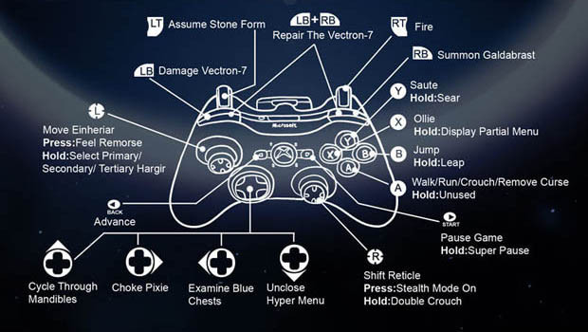
Is this real?

Slide 5
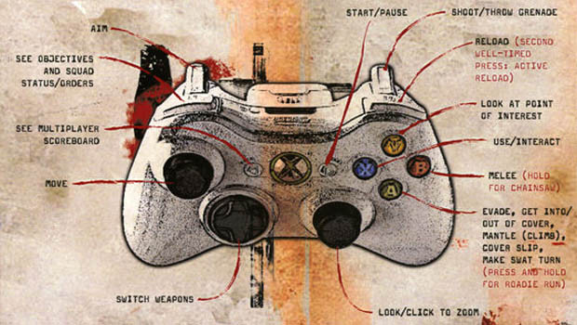
Is this real?

Slide 6
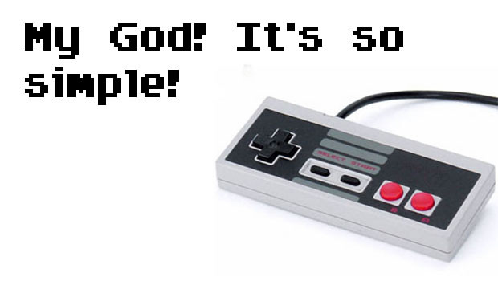
Is this real?

Slide 7
Actions vs. Interactions
In a game context, an action is a procedure that is mapped to a control input.
  Examples: Jump, Move, Run, Shoot, Slide, etc.
An interaction is an outcome of the game state and may not be the result of any direct action from the player and can happen without any input.
  Examples: Collisions, Line-of-sight, Resource change

Slide 8
Let’s Create Some Actions!
Verbs that describe what the player can do
Does not have to be attached to an avatar!
Let’s play!

Slide 9
Designing Actions
Start by brainstorming verbs that make sense in the world you are building
  Define the types of verbs
  Define the scope of the verbs
Do the verbs directly help the player achieve the goal?
How many verbs do I need?
  Well, enough to avoid being too simple
  And…

Slide 10
OMG So Many VERBS!

Slide 11
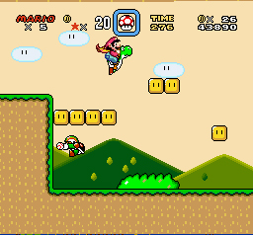
Primary vs. Secondary Verbs
Imagine you had no obstacles or challenges in a game… what verbs would you actually need?

Slide 12
Primary vs. Secondary Actions
Imagine you had no obstacles or challenges in a game… what verbs would you actually need?
Platformers:
Goal: Reach exit
Movement is only need verbs!
Killing enemies is secondary
Concentrate on primary verbs; too many secondary leads to bloat!

Slide 13
Verb Analysis
Pick a game; find the verbs

Slide 14
Finding Good Verbs
Keep number of verbs to minimum; utilize interesting interactions
Avoid verb proxies
  “use an item” -> What is the item doing?
  “shoot” -> What does the weapon do?
Outcome oriented verbs
Ask if the goal helps the player reach the goal?
Does it overcome a challenge or obstacle?

Slide 15
Combining Actions
Verbs can combine in interesting ways
  What verbs can you combine in Super Mario Bros?
  How can a verb change based on the environment (interactions)?
This is called emergent behavior
NOTE: Not all combos are emergent – not all have to do with interactions with environment

Slide 16
Interactions
Specifically NOT the direct action of a player
  Outcome of the game state
  Can happen without player input
Example: Collisions
  Can happen by player movement OR can happen by game state changing
What are some other interactions?

Slide 17
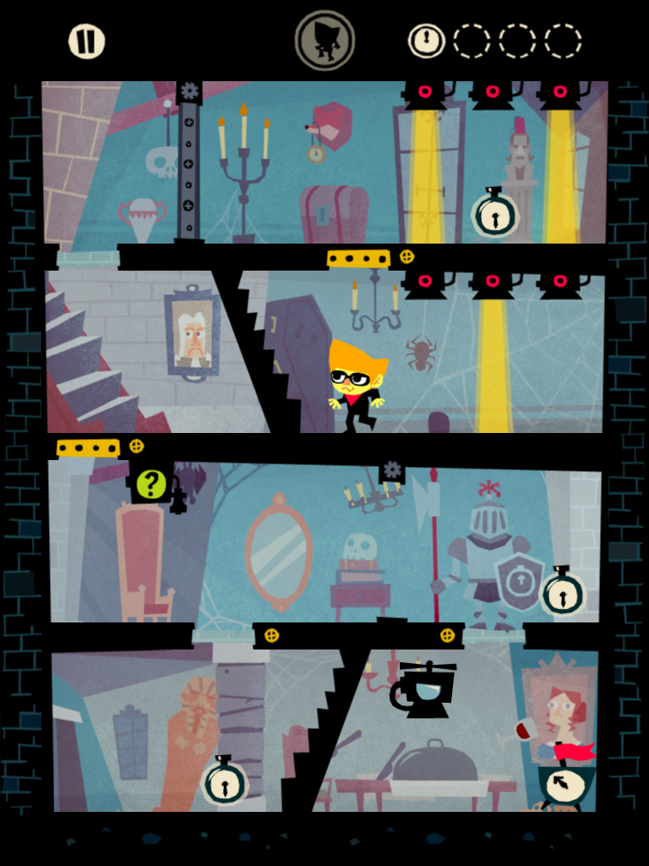
Interaction Example
Beat Sneak Bandit
  Verb: Move
  Rhythm game where you
  move to the beat
  All movement is on rails
  Turns at obstacles

Slide 18
Procedures vs. Rules
Rules are formal schemas
In general, we have three types of rules
  Operational - the “English” rules of a game as the player understands them
  Constitutive - the underlying math and logic behind the operational rules
  Implicit - extra rules understood by the players to make the game move forward

Slide 19
Operational Rules
The rules of the game as if you were explaining them to a friend
“In Mario, you can run and jump and land on top of goombas and they die!”
Consider this the instruction book approach to rules – highest level of abstraction

Slide 20
Constitutive Rules
The operational rules as understood by the game system itself
A goomba dies iff the bottom of Mario’s sprite collides with the top of the goomba’s sprite
This is how the game is actually programmed

Slide 21
Implicit Rules
Agreed upon rules of a game that are not part of the formal rule set, but are important to make the game work
For instance, a time limit on a move on a board game – not an actual time limit, but you know when someone is taking too long

Slide 22
Designing Good Rules
Should lead players to interesting choices
  Player MUST be able to make some decisions!
  System MUST respond and give feedback!
Bad rules
  Pure luck based
  Lack of interaction
  Doesn’t relate to goal

Slide 23
Mechanics vs. Rules
Mechanics are created by game designers in the framework of rules
Dynamics are created by players as interpretations of mechanics within the rules
Rules are the formal implementation of the game world

Slide 24
Formalizing Everything
The game state is the current positioning/value of all entities in the game world
Actions a player takes is input into the current game state
An interaction is a function between game states as determined by the actions (of both player and world) in generating a new game state
The Game Loop

