Slide 1
CS4730: Computer Game Design
Course Introduction

Slide 2

Overview
Lecture:
  TuTh 11:00-12:15 @ Zoooooooom
Mark Floryan, mfloryan@cs.virginia.edu
  Rice 203, but won’t be there much this semester
  OH on Zoom (time tbh)
Course website:
  https://markfloryan.github.io/gamedesign
Graduate Ta
  Ryan Kann rak3me@virginia.edu
Undergraduate Tas
  Sabrina Baldassarre sjb4sy@virginia.edu
  Helen Shi hs2fw@virginia.edu
  Saetbyull Park sp9he@virginia.edu

Slide 3
My Gaming CV
Why should Floryan teach us Game Design?
I play a lot of games, including Atari through modern games.
  I grew up seeing games evolve and that gives me a somewhat unique perspective
I research games
  My Ph.D. dissertation was about designing games that are used to collect data and teach A.I. algorithms new skills. A form of crowdsourcing data.
  I’ve built and studied biology learning games, history learning games, and a few others.
I have game industry experience. Not a lot…but some.
  I worked at Hitpoint Studios. We made mobile games, and some other cool things.
  Next slide has some games I worked on.

Slide 4
My Commercial Games

Slide 5
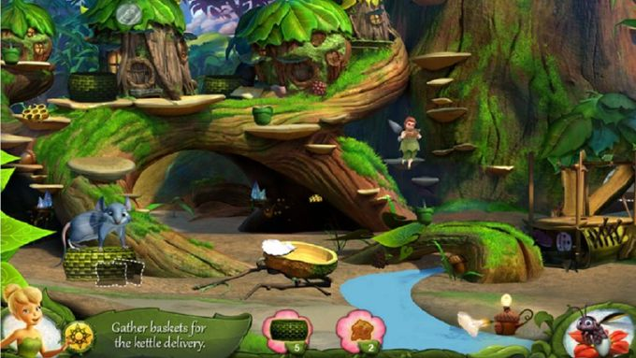
My Commercial Games

Slide 6
Course Outline
Lectures:
  Two per week (1 hour, 15 mins) on Zoom
  Lectures are (hopefully) pretty interactive and fun. We will talk about games, level design, character design, game engines, collision detection, sprites, game algorithms, etc.
  Lectures are recorded, but you are strongly encouraged to attend and interact.
    We will get the most out of the course if we work together to try to simulate the classroom experience as best we can!!
  We will play games on Zoom together as examples of good and bad game design.
  Please attend and try to have fun!

Slide 7
Course Schedule

Slide 8
Homework
Individual Homework Assignments:
  5 individual assignments, meant to teach basic concepts in Unity.
  Lectures and homework focus on 2D games, but we will teach you the theory to easily extend to 3D if you want.
    Go 3D at your own risk!!
  Unity scripts and such will be easily reusable for your project.
Optional Points / Assignments:
  Each assignment above has a pool of optional points available, so you can do extra work in areas that interest you most.
  These are a separate portion of your grade (more on this soon).

Slide 9
Homework (cont.)
Group Project
  Groups established early.
  Design document of your game due near end of part 1 of the course.
  Actually game development done during part 3 of the course.
  Four total submissions:
    Design document
    Alpha build
    Beta Build
    Final Build
  There will be some kind of game expo at the end of the year (likely on Twitch).
  Groups will be 2 or 3 students each.

Slide 10
Exams
No midterms in this course (let’s focus on making games)
There WILL BE a final exam though.
  Take home on Collab.
  Meant to make sure you’ve done the readings, attended class, etc.

Slide 11
Due Dates
The Due Dates in this course are as flexible as I can possible make them. But, it is a little bit confusing. See course calendar if you forget.
Individual Required Assignments:
  Have a recommended due date each (see course calendar).
  But, deadlines are flexible
  ALL individual assignments must be completed by Oct. 31 @ 11:59pm
Optional Individual Points:
  Can be submitted anytime throughout semester.
  Must all be submitted before end of classes: Nov. 24 @ 11:59pm
Group Project
  Has traditional hard deadlines (because group work requires accountability)
  See course calendar for the individual deadlines of these assignments.

Slide 12
How many times can I submit?
Individual Required Assignments have two guaranteed points at which we will grade and provide feedback.
  After the recommended due date: feedback / grades given back in a couple of days
  After hard required homework deadline: ALL required assignments will be graded again a final time.
  We will also have grading OH. You can show Grad TA working solution during this time in person to eliminate waiting. MUST be before hard deadline.
Optional Individual Assignment will have 3 guaranteed grading point:
  After the recommended deadline of the required portion of that assignment, we will also grade any optional components submitted in same repo.
  After the hard deadline of the required portion, we will do the same.
  After the hard deadline for all optional assignments (last day of class)
  Can be submitted in grading OH in person if you don’t want to wait for Tas to grade.
Group Project Assignments will have 1 guaranteed grading point:
  When the hard deadline passes
  Can be checked off / graded in grading OH like anything else ahead of time if you want.

Slide 13
Let’s Talk About Grading
All homework in this course is pass/fail:
Individual Required Homework: Pass/Fail. Each assignment will specify the exact requirements for a passing grade. Can be resubmitted with some restrictions.
  Submit by the recommended due date to guarantee at least one round of feedback.
Optional Individual Homework: Also Pass/Fail for each individual optional task. Can be submitted along with your required homework. Can be resubmitted as often as course staff can handle.
Group Project: Only one chance per submission. The project will either be up to standard or not (pass/fail). It is possible to fail one submission and still pass the next.
**Unsatisfactory homework can be resubmitted at grading OH. More on that in a moment.

Slide 14
Submitting Homework and Project
We are going to try to use Github Classroom (https://classroom.github.com)
This will allow us to:
  Provide starter code that you can get by simply cloning a Github repository.
  Submit by pushing changes to your repo.
  Quickly resubmit by fixing and recommitting.
  Track how much each team member contributes to group project
This is my first semester using this, so please be patient as we work out kinks.

Slide 15
Github Scary!!
If you are not familiar with using github, don’t worry too much. We will be posting a tutorial with the basics to go along with the first homework assignment.

Slide 16

Books
You need to purchase:
“Reality is Broken” by Jane McGonigal
There will be other readings through Collab
Please purchase this book asap!!
There will be questions on it on the final exam.

Slide 17
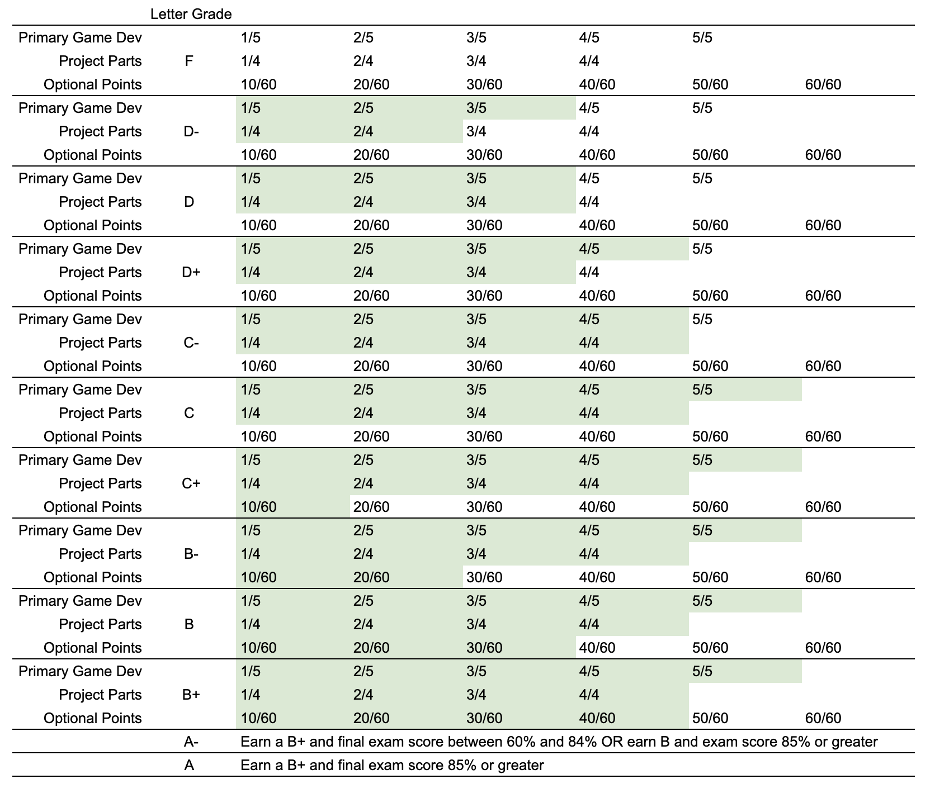
Grading Policy

Slide 18
More About the Project
Technologies:
  We will be using Unity (https://unity.com)
  We will be teaching you the basics of how game engines work, but Unity will implement a lot of this functionality for you.
  The assignments / tutorials will teach you the specifics of Unity. We won’t discuss Unity specifically in lecture.
Immediate Schedule:
  Week 2: Get into groups and start pitching game ideas
  Week 3: First individual hw (text based python adventure)
  Week 5: Design document of game project due

Slide 19
More About the Project
Size of the game:
  Unity does a lot of the hard work for you.
    Collision Detection, frame rate optimization, etc.
  So, I expect your games to be fairly large and focus on good level design.
  Your game is MUST have the following:
    10 minutes of fully playable game.
    Smooth, well designed game loop.
    Polished level design that teaches the player how to play, slowly introduces mechanics, etc.
    Music and sound effects
    …and much more

Slide 20
Quick Discussion:
What is, in your opinion, the best designed game you’ve ever played and why?

Slide 21
My Top 10 Games (no order)
Super Metroid (SNES) *A masterpiece
Final Fantasy 6 (SNES) *Though many FFs are great
Mega Man 3 (NES) *When it peaked
Zelda *(Breath of the Wild (Switch), ALTTP (SNES), and Ocarina of Time (N64))
Super Mario 64 (N64) *Odyssey, SMB3 are great too
Dark Souls (PS3) *If you want to cry
Starcraft (PC) *Despite the clunky controls
The Last of Us (PS3) *
Goldeneye (N64) *Hard to explain why this one is good
Metal Gear Solid 3 (PS2) *is the best one for sure

Slide 22
Some other games I love
Super Meat Boy (PC)
Hollow Knight (PC) *copied from super Metroid, but still great
Mario Kart (Many) *though getting old at this point
Super Smash Bros (N64) *not obsessed, prefer original version
Grand Theft Auto (PS2/3) *3 and 5
Celeste (PC) *Seriously, go play this one
Chrono Trigger (SNES) *Classic no one has heard of
Super Mario RPG (SNES) *Not sure why this is so great
…and many more

Slide 23
Ok, who cares?
As we study the design of games, we will do so using many examples of real games. An example:
Games teach players
their mechanics:

