Slide 1
Bi-Partite Matching and Reductions
Data Structures and Algorithms 2 Mark Floryan and Aaron Bloomfield

Slide 2
Roadmap: Where We’re Going and Why
In Computer Science, we can often solve a new problem by casting it as an instance of another problem we already know how to solve. This is called a reduction.
Let’s see some examples, and then we will formalize this concept a bit more

Slide 3
Edge Disjoint Paths

Slide 4

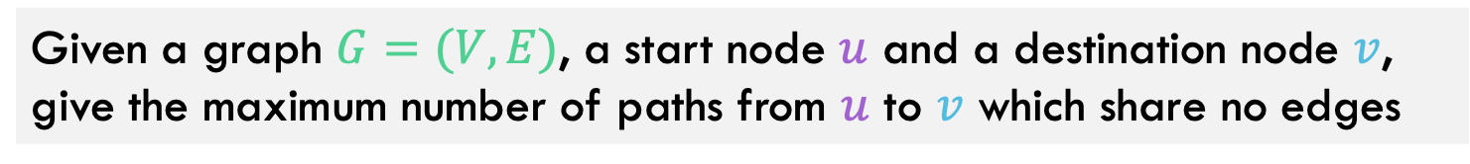

Edge-Disjoint Paths
Given a graph $G=(V,E)$, a start node $u$ and a destination node $v$, give the maximum number of paths from $u$ to $v$ which share no edges
$$u$$
g
Note this is an optimization problem.
h
f
$$v$$
e
b
c
a

Slide 5


Edge-Disjoint Paths
Given a graph $G=(V,E)$, a start node $u$ and a destination node $v$, give the maximum number of paths from $u$ to $v$ which share no edges
Set of edge-disjoint paths of size 3
(the red, blue, green paths)
$$u$$
g
h
f
$$v$$
e
b
c
a

Slide 6
Edge-Disjoint Paths
Given a graph $G=(V,E)$, a start node $u$ and a destination node $v$, give the maximum number of paths from $u$ to $v$ which share no edges
Set of edge-disjoint paths of size 4, is this max? Why or why not?
$$u$$
g
h
f
$$v$$
e
b
c
a

Slide 7



Edge-Disjoint Paths Algorithm
Use a problem we know how to solve, max network flow, to solve this!
Make $u$ and $v$ the source and sink, give each edge capacity $1$, find the max flow.
1/1
$$u$$
g
Set of edge-disjoint paths of size 4
1/1
0/1
Max flow = 4
1/1
1/1
h
1/1
1/1
f
1/1
0/1
Why does this work? We need to be able to make a valid argument that it always does.
1/1
$$v$$
e
b
0/1
1/1
c
1/1
0/1
a
0/1

Slide 8
What’s the situation?
Edge Disjoint Paths
Reduces to
Maximum Flow
Reduces to
Minimum Capacity Cut

Slide 9
Edge Disjoint Paths

Slide 10

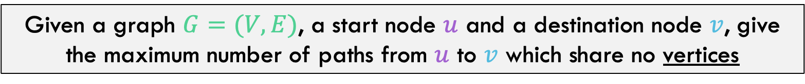

Vertex-Disjoint Paths
Given a graph $G=(V,E)$, a start node $u$ and a destination node $v$, give the maximum number of paths from $u$ to $v$ which share no vertices
$$u$$
g
h
f
$$v$$
e
b
c
a

Slide 11


Vertex-Disjoint Paths
Given a graph $G=(V,E)$, a start node $u$ and a destination node $v$, give the maximum number of paths from $u$ to $v$ which share no vertices
This shows 3 edge-disjoint paths. Note these aren’t vertex-disjoint paths!
$$u$$
g
h
f
$$v$$
e
b
c
a

Slide 12


Vertex-Disjoint Paths
Idea: Take each node and restrict how much many edge-disjoint paths can go through it. Split each node into two as shown.
$$u$$
g
e
h
f
Turns into
$$v$$
e
b
e
e’
c
a

Slide 13
Vertex-Disjoint Paths
Idea: Take each node and restrict how much many edge-disjoint paths can go through it. Split each node into two as shown.
e
Why does this make sense. When finding edge disjoint paths, we can only use one of the incoming edges, one of the outgoing edges, and the middle edge.
Turns into
e
e’

Slide 14
What’s the situation?
Vertex Disjoint Paths
Reduces to
Edge Disjoint Paths
Reduces to
Maximum Flow
Reduces to
Minimum Capacity Cut

Slide 15
The final vertex Disjoint Path Algorithm
Split each node into two as described
Add capacity of 1 to every edge
Vertex Disjoint Paths
Edge Disjoint Paths
Maximum Flow
Max flow IS the number of vertex disjoint paths

Slide 16
Reductions

Slide 17
Roadmap: Where We’re Going and Why
In Computer Science, we can often solve a new problem by casting it as an instance of another problem we already know how to solve. This is called a reduction.

Slide 18

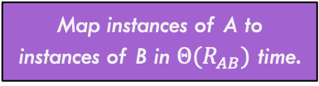
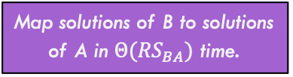
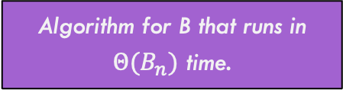
Mapping Reduction
A reduction uses a reduction function R() to map instances of one problem (A) to instances of another problem (B) such that for any input string $w$, $A\left(w\right)==B(R\left(w\right))$
Map instances of A to instances of B in $Θ(R_{AB})$ time.
Problem A
Problem B
Algorithm for B that runs in $Θ(B_{n})$ time.
Solution A
Solution B
Map solutions of B to solutions of A in $Θ({RS}_{BA})$ time.
To solve A we use the purple path. Takes:
$$Θ(R_{AB}+B_{n}+RS_{BA})$$

Slide 19
Bipartite Matching
Another example of a reduction

Slide 20
Reminder: Bipartite Graphs
A (undirected) graph is Bipartite provided every vertex can be assigned to one of two teams such that every edge “crosses” teams
Alternative: Every vertex can be given one of two colors such that no edges connect same-color nodes
Not Bipartite! No color can be assigned to several nodes!
2
5
2
5
Bipartite!
8
8
1
1
4
4
9
9
3
3
7
7
6
6

Slide 21

Maximum Bipartite Matching
Dog Lovers
Adoptable Dogs
Maximum Bipartite Matching: Given a bipartite graph as input where the edges represents candidate matches, what is the maximum number of ”matches” that can be made in total?
Example: Given a graph representing dog lovers and the dogs they are interested in adopting, what is the maximum number of adoptions that can be made (each dog lover can only adopt a dog they are interested in)

Slide 22
Maximum Bipartite Matching
Dog Lovers
Adoptable Dogs
With this matching, three dogs get adopted. Is this maximum? Can we do four?

Slide 23
Maximum Bipartite Matching
Dog Lovers
Adoptable Dogs
Better! In fact, the maximum possible! How can we tell?
A perfect bipartite match:
Equal-sized left and right subsets, and all nodes have a matching edge

Slide 24

Maximum Bipartite Matching
Given a graph $G=\left(L,R,E\right)$
a set of left nodes, right nodes, and edges between left and right
Find the largest set of edges $M⊆E$ such that each node $u∈L$ or $v∈R$ is incident to at most one edge.

Slide 25
Maximum Bipartite Matching Using Max Flow
We are going to show that maximum bipartite matching is reducible to max flow:
Need to describe this conversion!
Maximum Bipartite Matching
Maximum Flow
Run ford-Fulkerson or similar
Need to describe this conversion!
Which matches we should make
f = ??
flow values on edges

Slide 26

Reduction Details
Make $G=(L,R,E)$ a flow network $G^{′}=(V^{′},E^{′})$ by:

Slide 27
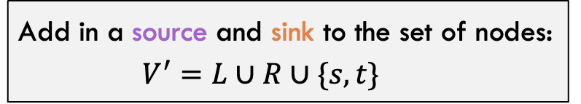
Reduction Details
Make $G=(L,R,E)$ a flow network $G^{′}=(V^{′},E^{′})$ by:
Add in a source and sink to the set of nodes:
$$V^{′}=L∪R∪\{s,t\}$$
s
t

Slide 28
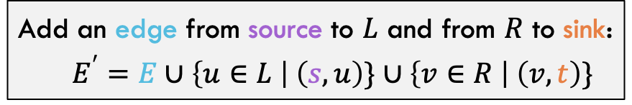
Reduction Details
Make $G=(L,R,E)$ a flow network $G^{′}=(V^{′},E^{′})$ by:
Add in a source and sink to the set of nodes:
$$V^{′}=L∪R∪\{s,t\}$$
Add an edge from source to $L$ and from $R$ to sink:
$$E^{′}=E∪\left\{u∈L \right| \left(s,u\right)\}∪\left\{v∈R \right| \left(v,t\right)\}$$
s
t

Slide 29
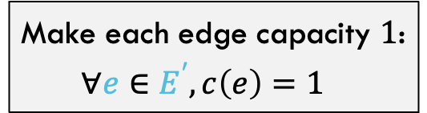
Reduction Details
Make $G=(L,R,E)$ a flow network $G^{′}=(V^{′},E^{′})$ by:
Add in a source and sink to the set of nodes:
$$V^{′}=L∪R∪\{s,t\}$$
Add an edge from source to $L$ and from $R$ to sink:
$$E^{′}=E∪\left\{u∈L \right| \left(s,u\right)\}∪\left\{v∈R \right| \left(v,t\right)\}$$
Make each edge capacity $1$:
$$∀e∈E^{′}, c\left(e\right)=1$$
1
1
1
1
1
1
1
1
1
s
t
1
1
1
1
1
1
1
1

Slide 30
Reduction Details
1
1
1
1
1
1
1
1
1
s
t
1
1
1
1
1
1
1
1

Slide 31
Reduction Details
Call Ford-Fulkerson to push as much flow through this network as possible
1/1
1/1
1/1
1/1
1/1
1/1
s
1/1
t
1/1
1/1
1/1
1/1
1/1
Red edges have flow running through, blue edges have 0 (number not shown to save space)

Slide 32
Reduction Details
Note that in this example, all edges going into t (and out from s) are saturated, so this is a perfect matching
If max flow equals number of (original) nodes divided by 2, then the matching is perfect!
1/1
1/1
1/1
1/1
1/1
1/1
s
1/1
t
1/1
1/1
1/1
1/1
1/1
The edges going across gap that are saturated with flow represent the matches that we found!

Slide 33



Maximum Bipartite Matching Using Max Flow
$$Θ(\left|V\right|)$$
Convert to flow network
Maximum Bipartite Matching
Maximum Flow
$$Θ\left(\left|E\right|⋅\left|V\right|\right), f≤|V|$$
Run ford-Fulkerson or similar
Find saturated edges across gap
Matches that can be made
f = ??
flow values on edges
$$Θ(\left|E\right|)$$

Slide 34
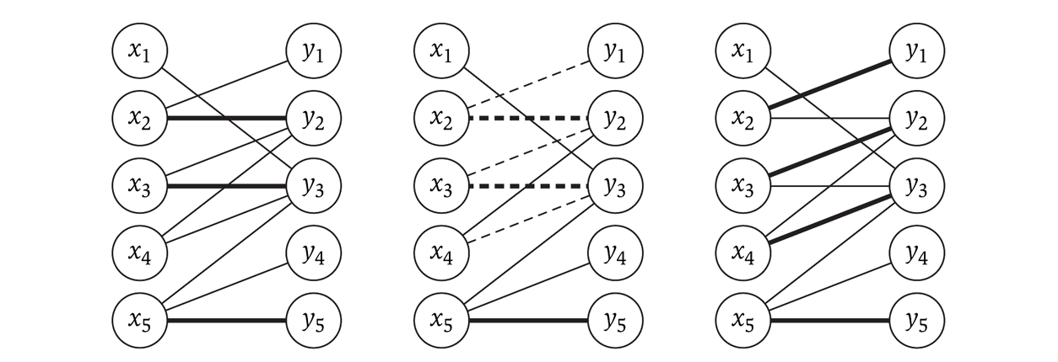
Imperfect bipartite matchings
These exist, and the algorithm may produce them, depending on the graph
The following shows an augmenting path (in the middle) used to achieve the maximal flow on the right

Slide 35
Reductions: Establishing Relative speed / Hardness

Slide 36
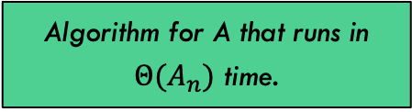
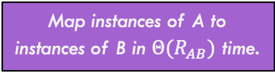
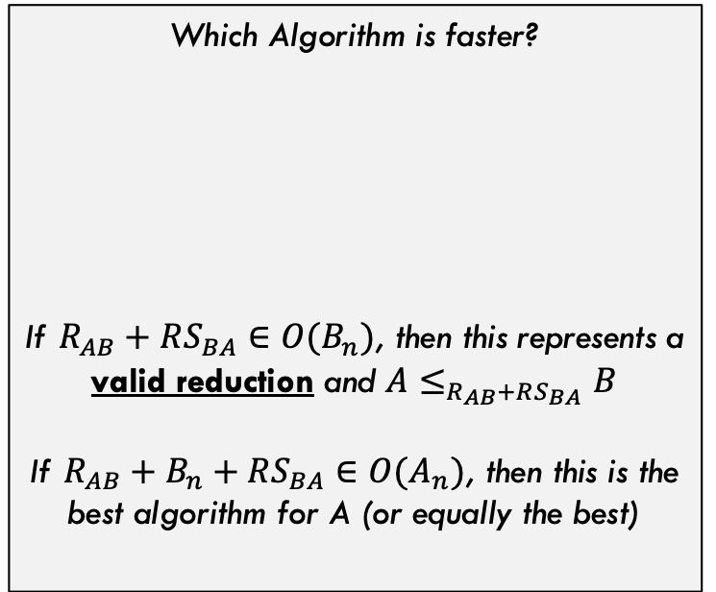
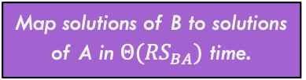
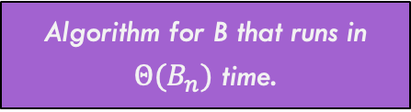
Runtime Comparison
Map instances of A to instances of B in $Θ(R_{AB})$ time.
Problem A
Problem B
Which Algorithm is faster?
If $R_{AB}+RS_{BA}∈O(B_{n})$, then this represents a valid reduction and $A≤_{R_{AB}+RS_{BA}}B$
If $R_{AB}+B_{n}+RS_{BA}∈O(A_{n})$, then this is the best algorithm for A (or equally the best)
$$A_{n}$$
Algorithm for A that runs in $Θ(A_{n})$ time.
Algorithm for B that runs in $Θ(B_{n})$ time.
$$R_{AB}+B_{n}+RS_{BA}$$
Solution A
Solution B
Map solutions of B to solutions of A in $Θ({RS}_{BA})$ time.

Slide 37



Runtime Comparison
Harder Problems (fastest algorithm has slower runtime)
$$B_{n}$$
$$A_{n}$$
Which Algorithm is faster?
$$A_{n}$$
$$R_{AB}+B_{n}+RS_{BA}∈Θ(B_{n})$$
Not surprisingly, if these two algorithms have same overall runtime, then either can be used (they are equivalent).
Easy Problems (fastest algorithm has very fast runtime)

Slide 38


Runtime Comparison
Harder Problems (fastest algorithm has slower runtime)
$$B_{n}$$
Which Algorithm is faster?
$$A_{n}$$
$$A_{n}$$
$$R_{AB}+B_{n}+RS_{BA}∈Θ(B_{n})$$
If solving A through reduction is SLOWER than directly solving A, this means problem B is simply harder than problem A (but the reduction is still valid)
Easy Problems (fastest algorithm has very fast runtime)

Slide 39


Runtime Comparison
Harder Problems (fastest algorithm has slower runtime)
$$A_{n}$$
Which Algorithm is faster?
$$A_{n}$$
$$B_{n}$$
$$R_{AB}+B_{n}+RS_{BA}∈Θ(B_{n})$$
If the reduction is FASTER than directly solving A, What does this mean? It means the reduction IS the best way to solve A (and this picture doesn’t make sense)
Easy Problems (fastest algorithm has very fast runtime)

Slide 40



Runtime Comparison
Harder Problems (fastest algorithm has slower runtime)
OLD $A_{n}$
Which Algorithm is faster?
$$A_{n}$$
$$A_{n}=B_{n}$$
$$R_{AB}+B_{n}+RS_{BA}∈Θ(B_{n})$$
…and the direct algorithm for A is obsolete. The reduction through problem B is the direct way to solve A
Easy Problems (fastest algorithm has very fast runtime)

Slide 41
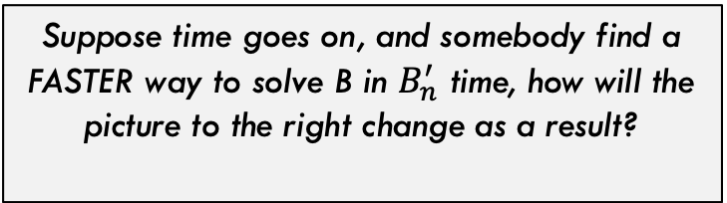


Runtime Comparison
Harder Problems (fastest algorithm has slower runtime)
Suppose time goes on, and somebody find a FASTER way to solve B in $B_{n}^{′}$ time, how will the picture to the right change as a result?
$$A_{n}=B_{n}$$
A now has a faster algorithm also! So improving B’s algorithm improves A’s. They are linked in this direction!
$${A′}_{n}=R_{AB}+{B′}_{n}+RS_{BA}$$
This is ONLY true if the reduction stays valid, meaning the conversion is still fast: $R_{AB}+RS_{BA}∈O(B_{n}^{′})$
Easy Problems (fastest algorithm has very fast runtime)

Slide 42


Runtime Comparison
Harder Problems (fastest algorithm has slower runtime)
Now suppose time goes on and someone finds a VERY fast algorithm for A. What could happen?
$${B′}_{n}$$
Now, the reduction may still be valid, but we are back to B being strictly harder than A
$${A′}_{n}$$
Easy Problems (fastest algorithm has very fast runtime)

Slide 43
Using reductions for Lower-Bounds Proof

Slide 44

Closest Pair of Points in 2D Space
Given:
2
A list of points in 2D space
1
5
4
Return:
6
Distance of the pair of points that are closest together (and the points themselves too)
7
3
8
We solved this in $Θ(n\log{n)}$ during our divide-and-conquer unit! Is that the best we can do?

Slide 45
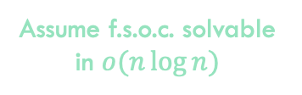
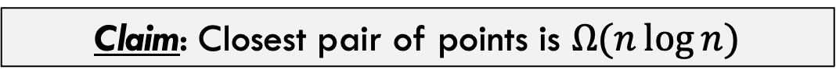
Using Reductions to Prove Lower-Bounds
Claim: Closest pair of points is $Ω(n\log{n)}$
Proof Approach:
Assume f.s.o.c. solvable in $o(n\log{n)}$

Slide 46
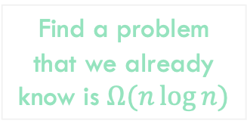
Using Reductions to Prove Lower-Bounds
Claim: Closest pair of points is $Ω(n\log{n)}$
Proof Approach:
Find a problem that we already know is $Ω(n\log{n)}$
Assume f.s.o.c. solvable in $o(n\log{n)}$

Slide 47
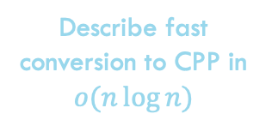
Using Reductions to Prove Lower-Bounds
Claim: Closest pair of points is $Ω(n\log{n)}$
Proof Approach:
Describe fast conversion to CPP in $o(n\log{n)}$
Find a problem that we already know is $Ω(n\log{n)}$
Assume f.s.o.c. solvable in $o(n\log{n)}$

Slide 48
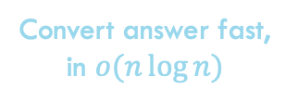
Using Reductions to Prove Lower-Bounds
Claim: Closest pair of points is $Ω(n\log{n)}$
Proof Approach:
Describe fast conversion to CPP in $o(n\log{n)}$
Find a problem that we already know is $Ω(n\log{n)}$
Assume f.s.o.c. solvable in $o(n\log{n)}$
Convert answer fast, in $o(n\log{n)}$

Slide 49

Using Reductions to Prove Lower-Bounds
Claim: Closest pair of points is $Ω(n\log{n)}$
Proof Approach:
Describe fast conversion to CPP in $o(n\log{n)}$
Find a problem that we already know is $Ω(n\log{n)}$
Assume f.s.o.c. solvable in $o(n\log{n)}$
Convert answer fast, in $o(n\log{n)}$
Solution found in $o(n\log{n)}$

Slide 50
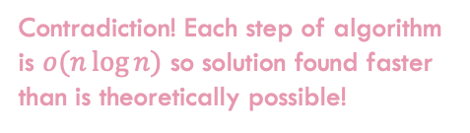
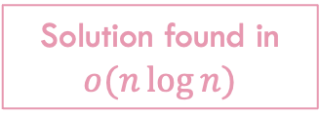
Using Reductions to Prove Lower-Bounds
Claim: Closest pair of points is $Ω(n\log{n)}$
Proof Approach:
Describe fast conversion to CPP in $o(n\log{n)}$
Find a problem that we already know is $Ω(n\log{n)}$
Assume f.s.o.c. solvable in $o(n\log{n)}$
Contradiction! Each step of algorithm is $o(n\log{n)}$ so solution found faster than is theoretically possible!
Convert answer fast, in $o(n\log{n)}$
Solution found in $o(n\log{n)}$

Slide 51

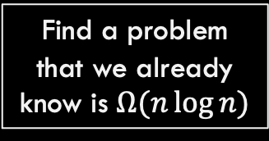
Using Reductions to Prove Lower-Bounds
Find a problem that we already know is $Ω(n\log{n)}$
Element Uniqueness Problem: Given a list of numbers, are all of the elements unique?
25
88
13
90
64
14
18
99
71
77
39
TRUE
25
88
13
90
64
14
88
99
71
77
39
FALSE
Theorem: The element distinctness problem is $Ω(n\log{n)}$ (just trust us for now…not enough time to get into it)

Slide 52
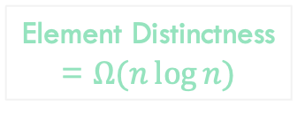
Using Reductions to Prove Lower-Bounds
Claim: Closest pair of points is $Ω(n\log{n)}$
Proof Approach:
Element Distinctness = $Ω(n\log{n)}$

Slide 53

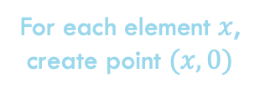
Using Reductions to Prove Lower-Bounds
Claim: Closest pair of points is $Ω(n\log{n)}$
Proof Approach:
For each element $x$, create point $(x,0)$
Element Distinctness = $Ω(n\log{n)}$
$$Θ(n)$$

Slide 54
Using Reductions to Prove Lower-Bounds
Claim: Closest pair of points is $Ω(n\log{n)}$
Proof Approach:
For each element $x$, create point $(x,0)$
Element Distinctness = $Ω(n\log{n)}$
$$Θ(n)$$
Assume f.s.o.c. solvable in $o(n\log{n)}$

Slide 55

Using Reductions to Prove Lower-Bounds
Claim: Closest pair of points is $Ω(n\log{n)}$
Proof Approach:
For each element $x$, create point $(x,0)$
Element Distinctness = $Ω(n\log{n)}$
$$Θ(n)$$
Assume f.s.o.c. solvable in $o(n\log{n)}$
If cpp distance == 0
return false;
else
return true
Solution found in $o(n\log{n)}$
$$Θ(1)$$

Slide 56
Using Reductions to Prove Lower-Bounds
Claim: Closest pair of points is $Ω(n\log{n)}$
Proof Approach:
For each element $x$, create point $(x,0)$
Element Distinctness = $Ω(n\log{n)}$
$$Θ(n)$$
Assume f.s.o.c. solvable in $o(n\log{n)}$
Contradiction! Each step of algorithm is $o(n\log{n)}$ so solution found faster than is theoretically possible!
If cpp distance == 0
return false;
else
return true
Solution found in $o(n\log{n)}$
$$Θ(1)$$

Slide 57
Another Example of Reduction: Ind. Set and VeRt. Cover.

Slide 58
Problem A: Independent Set

Slide 59


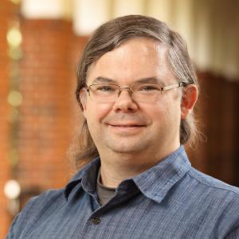


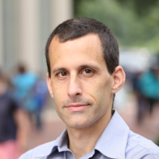





Problem A: Party Problem
A bunch of CS faculty members are going to a party! But…some faculty members DO NOT get along with one another.

Slide 60
Problem A: Party Problem
Draw connections between members that DO NOT get along

Slide 61
Problem A: Party Problem
Independent Set: What is the MAXIMUM number of people at this party who ALL get along with one another

Slide 62
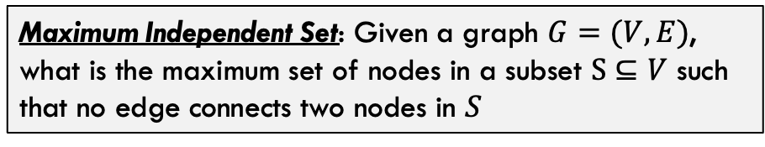
Problem A: Max Independent Set
Maximum Independent Set: Given a graph $G=(V,E)$, what is the maximum set of nodes in a subset $S⊆V$ such that no edge connects two nodes in $S$

Slide 63
Problem A: Max Independent Set

Slide 64
Problem A: Max Independent Set

Slide 65
Problem B: Vertex Cover

Slide 66
Problem B: Meeting Notes
A bunch of CS faculty don’t want to attend an important meeting…

Slide 67
Problem B: Meeting Notes
A bunch of CS faculty don’t want to attend an important meeting…but certain faculty members will see each other later 1-on-1 to discuss the faculty meeting. For EVERY 1-on-1 meeting later, at least one of the two must have gone to the faculty meeting.

Slide 68
Problem B: Vertex Cover
Vertex Cover: What is the minimum number of people that need to go if for every 1-on-1 meeting later in the day, at least one person must have been at the faculty meeting?

Slide 69
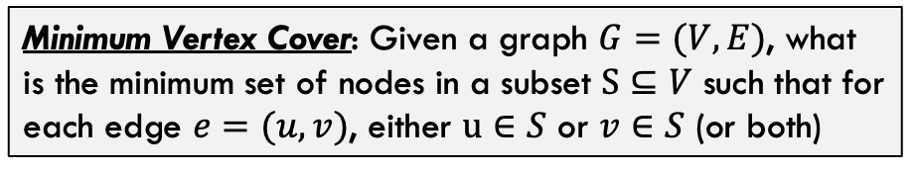
Problem B: Vertex Cover
Minimum Vertex Cover: Given a graph $G=(V,E)$, what is the minimum set of nodes in a subset $S⊆V$ such that for each edge $e=(u,v)$, either $u∈S$ or $v∈S$ (or both)

Slide 70
Problem B: Vertex Cover

Slide 71
Problem B: Vertex Cover

Slide 72
Connecting the Two Problems!

Slide 73
Observations
Vertex Cover: Every edge touches one of these nodes
Independent Set: None of these nodes are connected to each other!

Slide 74
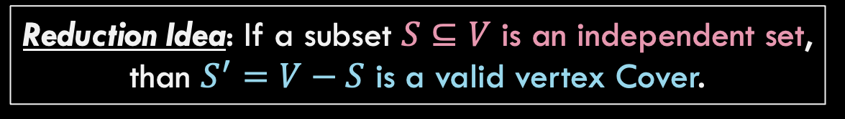
Reduction Idea: If a subset $S⊆V$ is an independent set, than $S^{′}=V−S$ is a valid vertex Cover.

Slide 75


Claim: If a subset $S⊆V$ is an independent set, then $S^{′}=V−S$ is a valid vertex Cover.
Proof:
Assume $S⊆V$ is an independent set

Slide 76
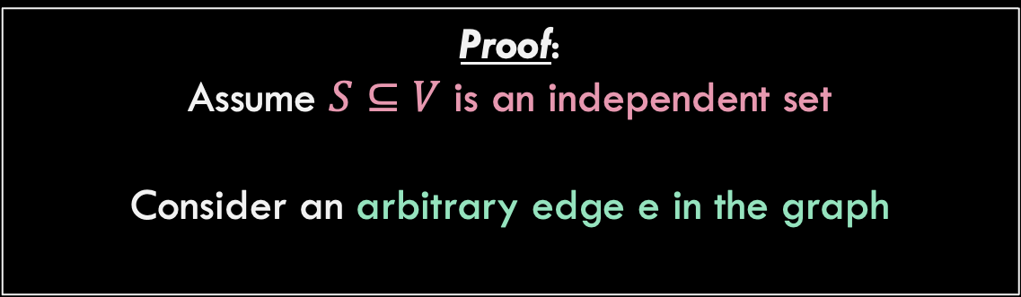
Claim: If a subset $S⊆V$ is an independent set, then $S^{′}=V−S$ is a valid vertex Cover.
Proof:
Assume $S⊆V$ is an independent set
Consider an arbitrary edge e in the graph
e

Slide 77
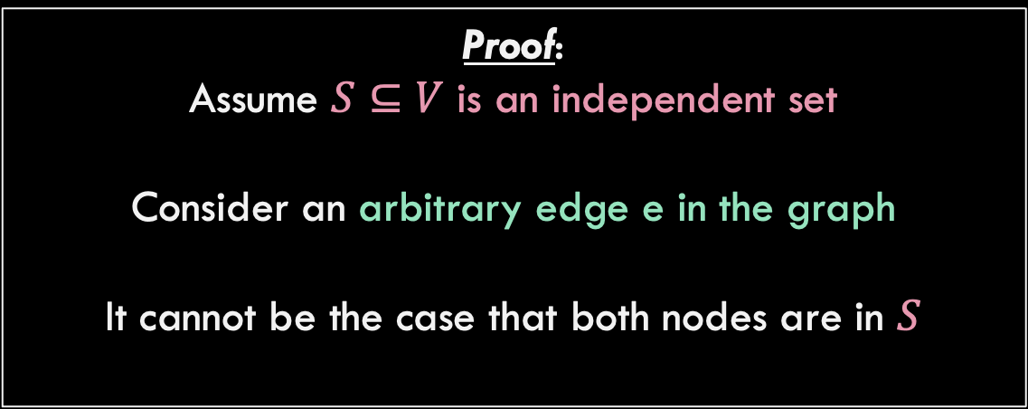
Claim: If a subset $S⊆V$ is an independent set, then $S^{′}=V−S$ is a valid vertex Cover.
Proof:
Assume $S⊆V$ is an independent set
Consider an arbitrary edge e in the graph
It cannot be the case that both nodes are in $S$
e
This is impossible because then S would not be independent set!

Slide 78
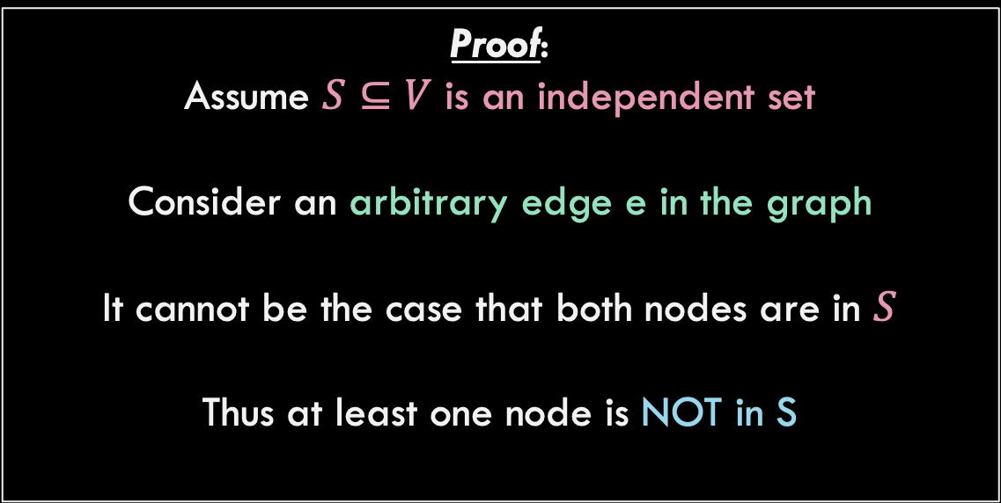
Claim: If a subset $S⊆V$ is an independent set, then $S^{′}=V−S$ is a valid vertex Cover.
Proof:
Assume $S⊆V$ is an independent set
Consider an arbitrary edge e in the graph
It cannot be the case that both nodes are in $S$
Thus at least one node is NOT in S
e

Slide 79
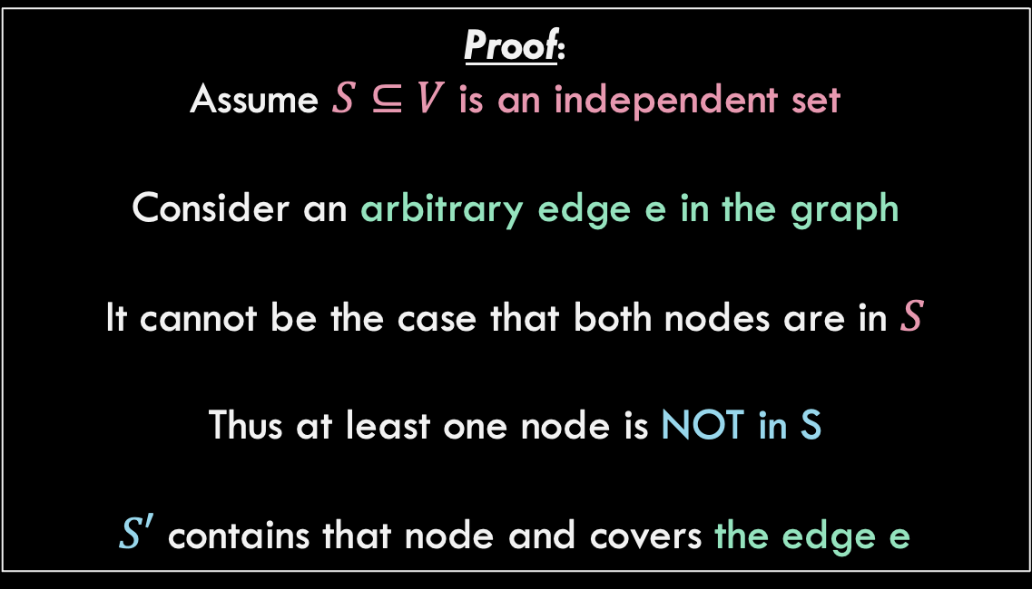
Claim: If a subset $S⊆V$ is an independent set, then $S^{′}=V−S$ is a valid vertex Cover.
Proof:
Assume $S⊆V$ is an independent set
Consider an arbitrary edge e in the graph
It cannot be the case that both nodes are in $S$
Thus at least one node is NOT in S
$S′$ contains that node and covers the edge e
e

Slide 80


Claim: If a subset $S^{′}=V−S$ is a valid vertex Cover, then $S⊆V$ is an independent set
Proof:
Assume $S′⊆V$ is vertex cover

Slide 81
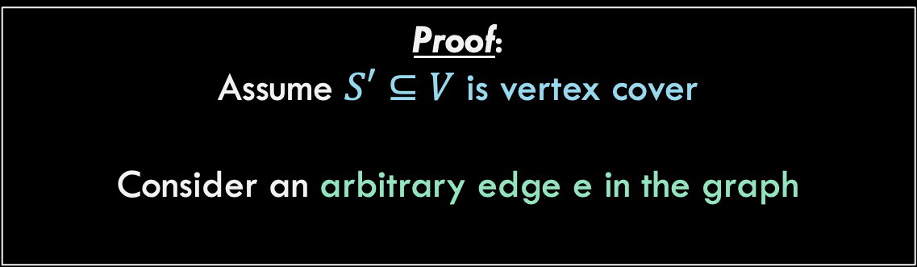
Claim: If a subset $S^{′}=V−S$ is a valid vertex Cover, then $S⊆V$ is an independent set
Proof:
Assume $S′⊆V$ is vertex cover
Consider an arbitrary edge e in the graph
e

Slide 82
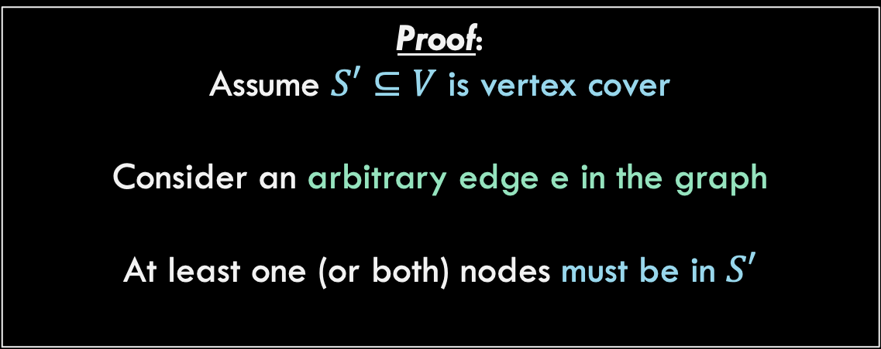
Claim: If a subset $S^{′}=V−S$ is a valid vertex Cover, then $S⊆V$ is an independent set
Proof:
Assume $S′⊆V$ is vertex cover
Consider an arbitrary edge e in the graph
At least one (or both) nodes must be in $S′$
e

Slide 83
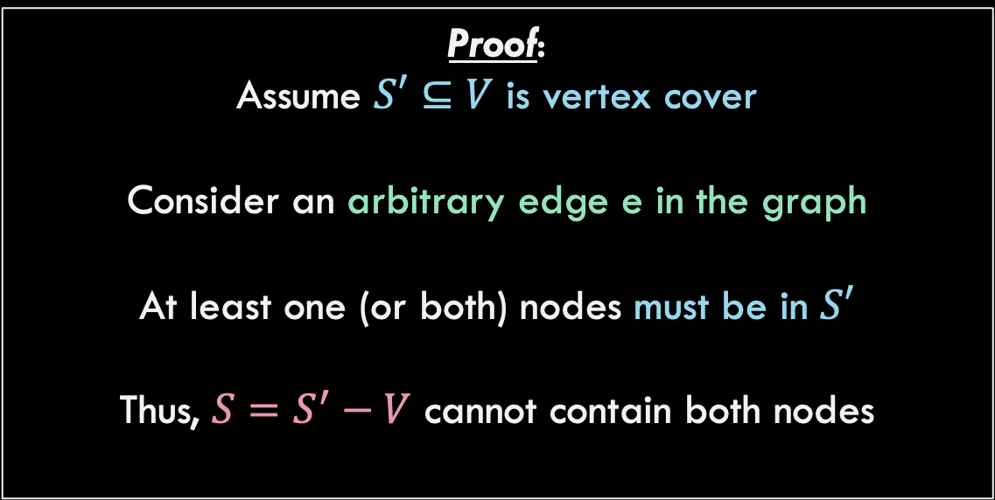

Claim: If a subset $S^{′}=V−S$ is a valid vertex Cover, then $S⊆V$ is an independent set
Proof:
Assume $S′⊆V$ is vertex cover
Consider an arbitrary edge e in the graph
At least one (or both) nodes must be in $S′$
Thus, $S=S^{′}−V$ cannot contain both nodes
e
$S$ will not contain both nodes, might contain one or zero

Slide 84
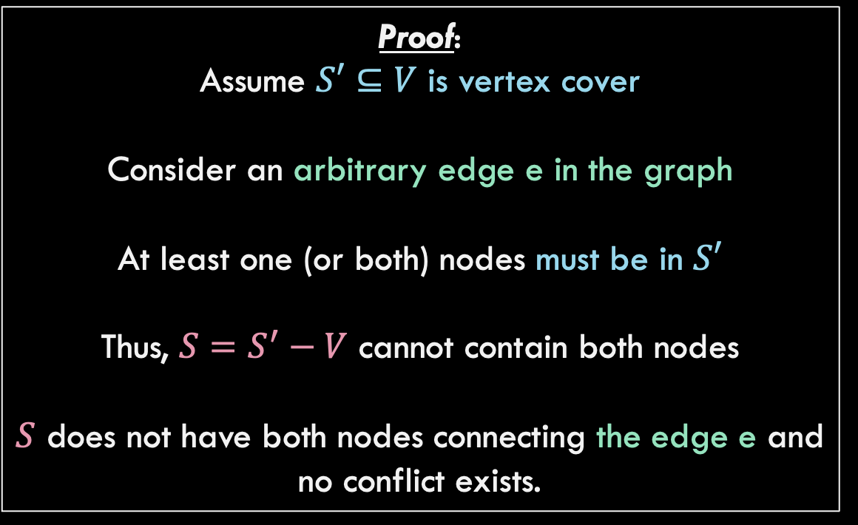
Claim: If a subset $S^{′}=V−S$ is a valid vertex Cover, then $S⊆V$ is an independent set
Proof:
Assume $S′⊆V$ is vertex cover
Consider an arbitrary edge e in the graph
At least one (or both) nodes must be in $S′$
Thus, $S=S^{′}−V$ cannot contain both nodes
$S$ does not have both nodes connecting the edge e and no conflict exists.
e

Slide 85




Final Reduction Picture
$$Θ(1)$$
Do nothing to convert
Maximum Independent Set
Minimum Vertex Cover
$$Θ\left(??\right)$$
Run MIS algorithm
Run MVC algorithm
$$Θ\left(??\right)$$
Take complement of nodes in solution
Max nodes with none connected by edge
Min nodes covering all edges
$$Θ(1)$$

Slide 86




Final Reduction Picture
What does this mean for the runtimes of these two algorithms?
$$Θ(1)$$
Maximum Independent Set
Minimum Vertex Cover
$$Θ\left(??\right)$$
Run MIS algorithm
Run MVC algorithm
$$Θ\left(??\right)$$
Max nodes with none connected by edge
Min nodes covering all edges
$$Θ(1)$$

Slide 87
What did we learn in this section
Reductions!
Converting problems into another via reduction.
Use an old algorithm that works and only have to “develop” the conversion parts.
Runtimes are linked!
Reductions establish a link between the runtimes of algorithms for the two problems. Sometimes the link goes in both directions!!

