Slide 1
CS3100 – Data Structures and Algorithms II
Mark Floryan
mfloryan@cs.virginia.edu
Course Mechanics
Course content
  Topics from earlier classes
  Course learning objectives
What’s the course all about? A quick tour

Slide 2
Course introduction

Slide 3
On the subject of multiple curriculums
Some of you took CS 2150 (Old Curriculum)
Benefits:
  First two modules are mostly review
  Some homework familiar (not many)
Issues:
  You “missed” sorting algorithms
    Will need to teach yourself
Some of you took CS 2100 (New Curriculum)
Benefits:
  No duplicate material
  Learn graphs all at once!
  More low-level programming experience (yay!)

Slide 4
General Info
See syllabus on course website for general information
Pre-requisites:
  Old curriculum: CS2150 (with C- or better)
  New Curriculum: CS2100 and CS2120 and CS 2130
  Math topics: proof by induction, proof by contradiction, exponents, logarithms, limits, simple differentiations (covered in APMA 1090 or MATH 1210 or MATH 1310)
Teaching Assistants
  Graduates (1):
    TBD
  Undergraduates (~30)
    We should have enough undergraduate support!
  Both will hold office hours, which will start next week
    Locations and hours mostly set on course website
  Also, we’ll use Piazza for questions and Discord for office hours
    Post all questions about HW, topics, etc. to Piazza NOT email to instructors!

Slide 5
Discord
Much of our course communication will happen on Discord.
  Class announcements (email used also)
  Online Office Hours
  General Q&A with TAs, etc. (We will use Piazza too)
    If you want instructors to see it, use Piazza
    If someone else might search for this later, use Piazza
Will send out an invite link eventually. Not quite ready yet.

Slide 6
Piazza
We will use Piazza
  Link to course site available in Collab tools
Please use Piazza for:
  Content related questions
  Working through example homework problems
  Helping each other with test cases / edge cases on programming
  Discussing old exam questions
  etc….

Slide 7
Expectations
Of you:
  When asked, prepare for things in advance
  Participate in class activities when asked
  Act mature, professional.
  Plan ahead.
  Don’t take advantage. Follow the Honor Code. (See the BOCM.)
Of me:
  Be fair, open, and considerate.
  Seek and listen to your feedback.
  Not to waste your time.
  Be effective in letting you know how you’re doing

Slide 8
General Info
Textbook:
  Introduction to Algorithms, 3rd edition, by Cormen, et. al.
Other references:
  Your CS2150 / CS2100 material (will be VERY useful here)
  Discrete Math textbook / references
Other readings may be assigned
  We’ll see…

Slide 9
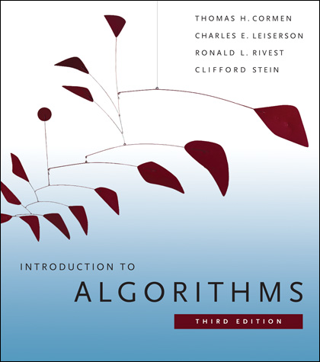
Textbook
You really need to read and study material other than the slides.
There are options, but a textbook is the easiest option.
We’ll post readings from CLRS, urge you to read them or get that info from another source.
We may also post additional resources.
Introduction to Algorithms by Cormen, et. al. (CLRS)
  3rd edition!
UVA Library has a digital version of CLRS available online for free at https://search.lib.virginia.edu/catalog/u6757775

Slide 10
Lectures
Back to traditional, in-person lectures.
  12:00 - 12:50 pm @ Newcomb Hall Theatre (Floryan)
  1:00 – 1:50pm @ Newcomb Hall Theatre (Floryan)
At least one of the two lectures (maybe both) will be recorded and posted on Collab -> Lecture Recordings
  Using Panopto, so no live broadcast
Lectures will cover course topics, example problems, proofs, etc.

Slide 11
Lecture Room Change!
I’ve been told that our lecture room is going to change mid-semester.
Is this true? I don’t know, but I’ll try to find out.
I think our “real” room is under renovation, and we will move there once it is done.
  Stay tuned…

Slide 12
Modules
The course is divided into 8 modules
  1: Graphs – Introduction
  2: Graphs – Advanced
  3: Divide and Conquer Algorithms
  4: Greedy Algorithms
  5: Dynamic Programming
  6: Network Flow / Bi-Partite Matching
  7: NP-Completeness
  8: Machine Learning Algorithms

Slide 13
Modules (Cont’d)
Most modules are 5 lectures worth of content, some are 4 or 6 lectures.
Each module involves:
  ~5 lectures worth of content
  1 or 2 homework assignments
  1 quiz (assessment)

Slide 14
Quizzes
Short assessments of your knowledge in each module
  Meant to ensure you have knowledge of the individual topics from lecture to a sufficient degree.
There are five different dates to take quizzes (in lecture)
  Mon, Sep. 26 Mod 1-2 (first attempts)
  Mon, Oct. 24 Mod 1-2 (second attempt), 3-4 (first attempt)
  Fri, Nov. 18 Mod 3-4 (second attempt), 5-6 (first attempt)
  Mon, Dec. 5 Mod 5-6 (second attempt), 7-8 (first attempt)
  Final Exam Mod 1-10 (final attempts)
  Note: it’s naturally harder to do a lot of quizzes in a 50-minute class period, so don’t get yourself into a bad situation!

Slide 15
Quizzes
Three possible grade outcomes for each quiz:
  Incomplete: Knowledge not shown
  Pass: You clearly demonstrate competence for this quiz (Grade >= 70%)
  High-Pass: You did VERY well on this quiz (Grade >= 90%)
You always receive the highest grade over all attempts
Your quiz grade for a module can never decrease
You can take module quizzes multiple times
You never need to retake a quiz once you get a high-pass
  Though you may decide that “pass” is good enough for you and choose not to retake a particular quiz

Slide 16
Quizzes (quick example)
Quiz Day 1:
  Floryan takes quizzes 1-2
  Floryan receives a high-pass and a pass, on them respectively. **Note that the score is PER MODULE
Quiz Day 2:
  Floryan DOES NOT need to retake module 1
  Floryan MIGHT choose to retry module 2 (get pass to high pass) if he has time
  Floryan will attempt modules 3-4 for the first time
In general: always attempt quizzes you haven’t passed FIRST, then try to retake old quizzes you’ve passed to get high-pass second. Grading system rewards prioritizing this way.

Slide 17
Final Exam
Our final exam time will be used to:
  Provide you with one more attempt at every quiz
  You will ONLY attempt quizzes for which you haven’t passed or wish to increase your grade further (to high-pass)
  This means if you’ve already passed every quiz, you do not need to do anything during the final exam period
    Likewise, some of you will come in to take 1 or 2 quizzes only, and that is fine.
  We DO NOT RECOMMEND attempting all 8 quizzes once during the final.

Slide 18
Homeworks
Each of the 8 modules has 1 or 2 homeworks associated
Programming HW:
  Can be written in Java, C++, or Python (your choice)
  Homework will specify the problem, input, and output specs.
  Will be graded solely on passing test-cases and/or meeting a target runtime.
Written HW
  Solving small problems, analyzing runtimes, etc.
  Writing proofs of correctness, etc.
  Written in Latex (tutorial on course webpage)

Slide 19
Homework Grades
Homeworks are pass / fail and meant to be fairly low-stress (compared to other classes):
  Incomplete: The student has not submitted evidence that they have engaged with the material and with the assignment.
  Pass: The student has shown evidence that they have attempted the ENTIRE assignment and made a serious, thoughtful attempt at it. **Grade would be >= 80% if graded in a traditional manner.
You may submit homework assignments as many times as you’d like until you pass.

Slide 20
Homework Grades (Cont’d)
A Pass does NOT mean that your homework is perfect. Simply means you clearly have put in the effort we expect and the quality is high enough to warrant a passing grade.
On a programming HW, a pass might mean:
  You are passing simple, moderate, and some difficult test cases but your code is still a little too slow. You “pass” the assignment, but are encouraged to continue investigating how you can more cleanly solve the problem.
On a written homework:
  You have made a serious, well-written attempt at every problem even if the solutions have some (small) issues.

Slide 21
Homework Grade Philosophy
Wait, so homework is all effort-based?
Well…not quite. The purpose of the homework is:
  To practice in an environment that is lower-stress
  To push yourself to solve algorithms problems to prepare you for the quizzes, NOT just to get a grade.
  To tinker and experiment with your code (e.g., what happens if I slightly change the base case on this algorithm)
  To focus on attempting to solve problems yourself before asking others for assistance.
  To show us that you engaged with the homework by showing that work is “mostly” there.

Slide 22
Quiz and Homework Deadlines
Quiz Deadlines:
  Are in-person during the set lecture dates (see previous slides)
  No makeups provided unless you have extreme extenuating circumstances (e.g., Covid-19 Quarantine, etc.)
    Remember: you get 3 attempts at Quizzes 1-6 and 2 attempts for Quizzes 7-8
Homework Deadlines:
  Each homework will have a recommended deadline (about 1 module per 2 weeks)
    If you want to succeed, you need to try to hit these recommended deadlines
  Deadlines are all soft deadlines (i.e., everyone gets an automatic extension until the end of the semester.
  There are exactly 2 homework deadlines
    Wed. Oct. 5: Modules 1-2 homework due (WHY? I’ll Explain)
    Mon. Dec. 5: Modules 3-8 homework all due

Slide 23
Grading Overview
Let’s look at how grades work on course website →
Your goal is to pass modules
You pass a module by:
  Passing ALL the homework for that module AND
  Passing the quiz (you DO NOT need a high-pass)
Your final letter grade is determined by how many modules you pass
  High-passing the quiz in a module can raise your grade a bit more.

Slide 24
Grading Scheme Philosophy
For grades F-B-, passing new modules is more important than high-passing old ones
  We care about breadth over depth until you reach 8 modules passed to earn a B-
High-pass can be used to raise your grade slightly at each grade level.
After B- obtained, high-passes are needed to earn B, B+, A-, etc.

Slide 25
Why this Approach to Grades?
It’s a good match of CS department policy on course letter grades: http://ugrads.cs.virginia.edu/grading-guidelines.html
We Think These Are Benefits:
It values competence in a breadth of modules
Lower stress from HWs: practice, explore, tinker,…
Lower stress because you can repeat quizzes
  Many quizzes, more chances to take
“Visible:” You know what you’ve earned so far, can predict scores on future modules to see where you might end up
Small grading changes have correspondingly small impacts on final grade

Slide 26
Office Hours
Let’s discuss office hours by looking at the course website.

Slide 27
Homework: Programming Hints
Understand the problem!
Consider all boundary cases
Use pre-existing library code
  Number formatting: NumberFormat in Java, printf() in C/C++
  Input: Scanner in Java, scanf() in C, cin in C++
Know how to handle floating point numbers
  Understand float/double precision issues
  Rounding, floating-point mod
Make sure it works for the provided test cases
Then write some of your own
Make sure you read the language specific details for submission!!!

Slide 28
Homework: Programming FAQ
Do I need to write my own sorting methods.
  No, unless the point of that assignment is to write sorting methods, you can use libraries for this.
Can I get the test cases from submission server?
  No, part of the point is to work on brainstorming cases your code is missing without being told. Submission server will give limited feedback on purpose!
Will you help me debug my code?
  No, we won’t. You need to learn how to do this on your own. I’m happy to give you advice on how to approach your debugging problems, but I will not sit down and debug code with you.

Slide 29
Homework: Written
These assignments must be typeset in LaTeX
I will provide a couple tutorials, guides, and templates when the first assignment is given out
You may not embed images of text or formulas!

Slide 30
Use of Online Code Etc.
Studying code online is permitted but only for getting ideas
Copying or reusing code from an online source violates the pledge
  You must cite sources of any online code you use in this way in a comment in your source file(s)
Remember: the purpose of the homework is
  To practice in an environment that is lower-stress
  To push yourself to solve algorithms problems to prepare you for the quizzes, NOT just to get a grade.
  To tinker and experiment with your code (e.g., what happens if I slightly change the base case on this algorithm)
  To focus on attempting to solve problems yourself before asking others for assistance.

Slide 31
Working in groups
For the homework, you may work together in groups of 5 or less to discuss the algorithmic aspects ONLY
  State who you worked with (in code comments)
  Do not look at or copy another student’s code!
For the written homeworks, you may work together in groups of 5 or less, but you MUST:
  State who you worked with
  Type up your own assignment!

Slide 32
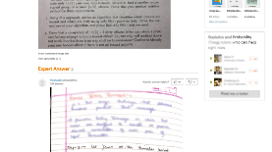
Academic Integrity
Collaboration allowed and encouraged!
  But only within your groups of up to 5 per assignment (you + 4 more)
Write-ups/code written independently
  DO NOT share written solutions / code
  DO NOT share documents (ex: Overleaf)
  DO NOT share debugging of code
DO NOT seek published solutions online
Be able to explain any solution you submit!
We will find those who don’t do the right thing.

Slide 33
What you know already
Definition of an algorithm
Definition of algorithm “complexity”
Measuring worst-case complexity
Cost as a function of input size
Asymptotic rate of growth: Big-Oh, Big-Theta
Relative ordering of rates of growth
Analyzing an algorithm's cost:
  sequences, loops, if/else, functions, recursion
Focus on counting one particular statement or operation; don’t count all statements

Slide 34
What you know already
Problems and their solutions:
  Linear data structures vs. tree data structures
  Searching: linear/sequential search, binary search (?), hashing
  Sorting: quicksort, mergesort in CS2100
  Priority Queue ADT and Heap Implementation

Slide 35
What you know already from all your courses
Examples of Algorithm design methods:
  Divide and Conquer (quicksort, mergesort)
  Greedy (though you didn’t call it this)
  Dynamic programming (fibonacci numbers, Floyd-Warshall)
  NP-complete (traveling salesperson. Have you seen this?)

Slide 36
What you know already from Discrete Math and Theory of Computation…
From CS2102:
  Proofs: induction, contradiction
    If you are uncomfortable with these two, review them NOW!
  Counting, probability, combinatorics, permutations
From some earlier math class:
  Exponents, logarithms, limits, differentiation on polynomials and other simple functions
From CS3102 (if you have taken it)
  Maturity in mathematics and computing theory
  Ability to do proofs
  Abstract models of computation, such as Turing machines

Slide 37
Questions? Concerns? Wrath to vent?

Slide 38
A first algorithm: making change

Slide 39
OK… But What’s It Really All About?
Let’s illustrate some ideas you’ll see throughout the course
  Using one example
Concepts:
  Describing an algorithm
  Measuring algorithm efficiency
  Families or types of problems
  Algorithm design strategies
    Alternative strategies
  Lower bounds and optimal algorithms
  Problems that seem very hard

Slide 40
Everyone Already Knows Many Algorithms!
Worked retail? You know how to make change!
Example:
  My item costs $4.37. I give you a five dollar bill. What do you give me in change?
  Answer: two quarters, a dime, three pennies
  Why? How do we figure that out?

Slide 41
Making Change
The problem:
  Give back the right amount of change, and…
  Return the fewest number of coins!
Inputs: the dollar-amount to return
  Also, the set of possible coins. (Do we have half-dollars? That affects the answer we give.)
Output: a set of coins
Note this problem statement is simply a transformation
  Given input, generate output with certain properties
  No statement about how to do it.
Can you describe the algorithm you use?

Slide 42
A Change Algorithm
Consider the largest coin
How many go into the amount left?
Add that many of that coin to the output
Subtract the amount for those coins from the amount left to return
If the amount left is zero, done!
If not, consider next largest coin, and go back to Step 2
Notes:
Will this always finish? Yes, because we have pennies!

Slide 43
Is this a “good” algorithm?
What makes an algorithm “good”?
  Is it fast?
  Does it ALWAYS work (return fewest number of coins for all inputs)?
  Are there other changes to the problem that might make this algorithm no longer work?

Slide 44
Evaluating Our Greedy Algorithm
How much work does it do?
  Say C is the amount of change, and N is the number of coins in our coin-set
  Loop at most N times, and inside the loop we do:
    A division
    Add something to the output list
    A subtraction, and a test
  We say this is O(N), or linear in terms of the size of the coin-set
Could we do better?
  Is this an optimal algorithm?
  We need to do a proof somehow to show this

Slide 45
You’re Being Greedy!
This algorithm is an example of a family of algorithms called greedy algorithms
Suitable for optimization problems
  There are many feasible answers that add up to the right amount, but one is optimal or best (fewest coins)
Immediately greedy: at each step, choose what looks best now. No “look-ahead” into the future!
What’s an optimization problem?
  Some subset or combination of values satisfies problem constraints (feasible solutions)
  But, a way of comparing these. One is best: the optimal solution

Slide 46
Another Change Algorithm
Give me another way to do this?
Brute force:
  Generate all possible combinations of coins that add up to the required amount
  From these, choose the one with smallest number
What would you say about this approach?
There are other ways to solve this problem
  Dynamic programming: build a table of solutions to small subproblems, work your way up

Slide 47
Motivating problems

Slide 48
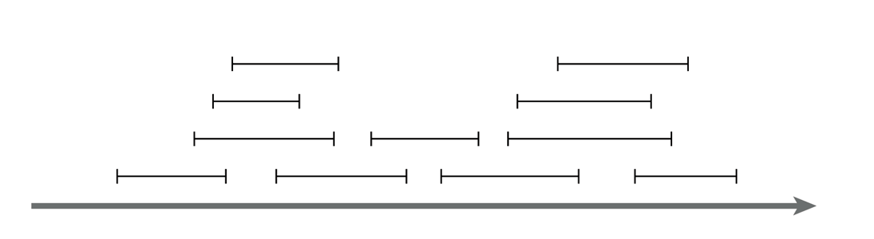
Motivating problem: Interval scheduling
Interval scheduling
  Given a series of requests, each with a start time and end time, maximize the number of requests scheduled
  This is solved by a greedy algorithm
  Most of the CS 2150 algorithms you’ve seen are greedy algorithms: Dijkstra’s shortest path, both MST algorithms, etc.

Slide 49
Motivating problem: Weighted interval scheduling
Weighted interval scheduling
  Same as the regular interval scheduling, but in addition each request has a cost associated with it
  The goal is to maximize the cost from scheduling the items
  This is solved by dynamic programming

Slide 50
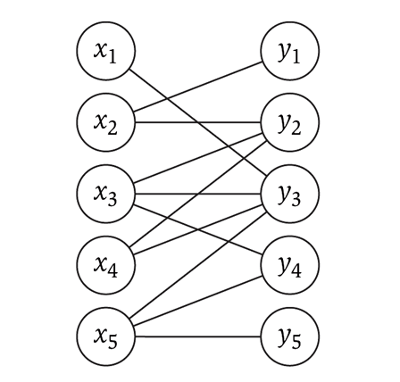
Motivating problem: Bipartite matching
Bipartite matching
  Given a graph G, find the maximum sub-graph of G that partitions G into sets X and Y such that no node from X is connected to a node in Y, and vise-versa
  Example: given a series of requests, and
  entities that can handle each request
  (such people, computers, etc.), find the
  optimal matching of requests to entities
  This is a network flow problem

Slide 51
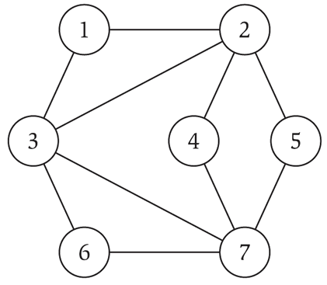
Motivating problem: Independent set
Independent set
  Given a graph G, find the maximum size subset X of G such that no two nodes in X are connected to each other
  This is a NP-complete
  problem
  You’ve seen TSP (travelling
  salesperson problem) in CS
  2150, which is a
  NP-complete problem

Slide 52
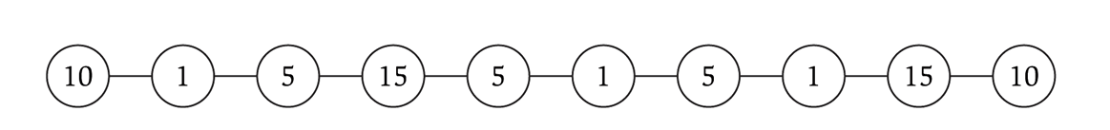
Motivating problem: Competitive facility location
Competitive facility location
  Consider a graph G, where two ‘players’ choose nodes in alternating order. No two nodes can be chosen (by either side) if a connecting node is already chosen. Choose the winning strategy for your player.
  This is a PSPACE problem, which are harder than NP-complete problems

