Slide 1
Cardinality
Discrete Mathematics and Theory 2
Mark Floryan

Slide 2
Goals!
1. Quick review of functions!
2. How do we use functions to compare the sizes of sets? Why might this be useful as we move forward talking about computation?
3. Do all infinite sets have the same size? What can this tell us (already) about the theory of computation?

Slide 3
Part 1: Quick Review of Functions

Slide 4
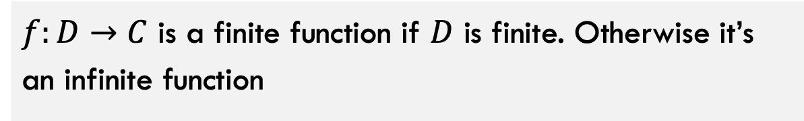
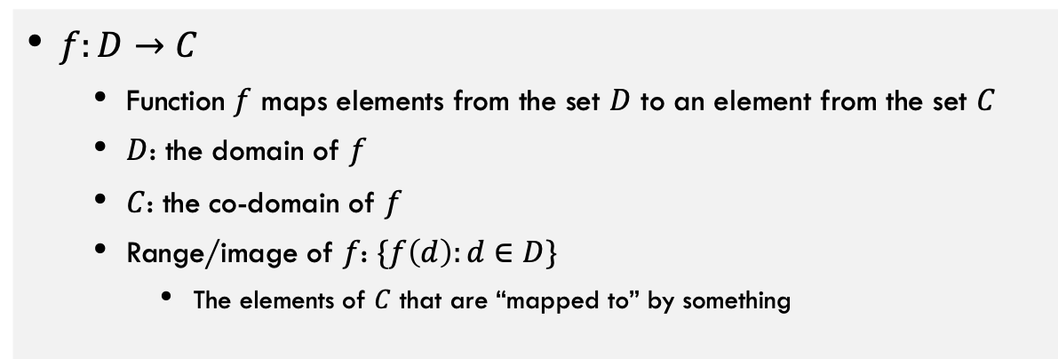
Defining Functions
Function: a “mapping” from input to output
$f:D→C$
  Function $f$ maps elements from the set $D$ to an element from the set $C$
  $D$: the domain of $f$
  $C$: the co-domain of $f$
  Range/image of $f$: $\{f\left(d\right):d∈D\}$
    The elements of $C$ that are “mapped to” by something
Finite function: a function with a finite domain
$f:D→C$ is a finite function if $D$ is finite. Otherwise it’s an infinite function

Slide 5
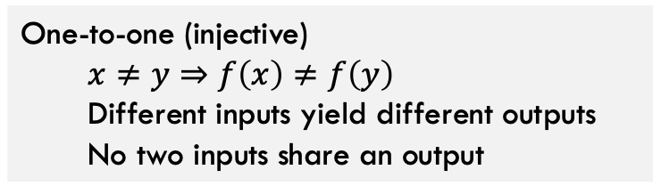
Injective Functions
Domain
Co-Domain
Domain
Co-Domain
INJECTIVE FUNCTION
NON-INJECTIVE FUNCTION
One-to-one (injective)
  $$x≠y⇒f\left(x\right)≠f\left(y\right)$$
  Different inputs yield different outputs
  No two inputs share an output

Slide 6
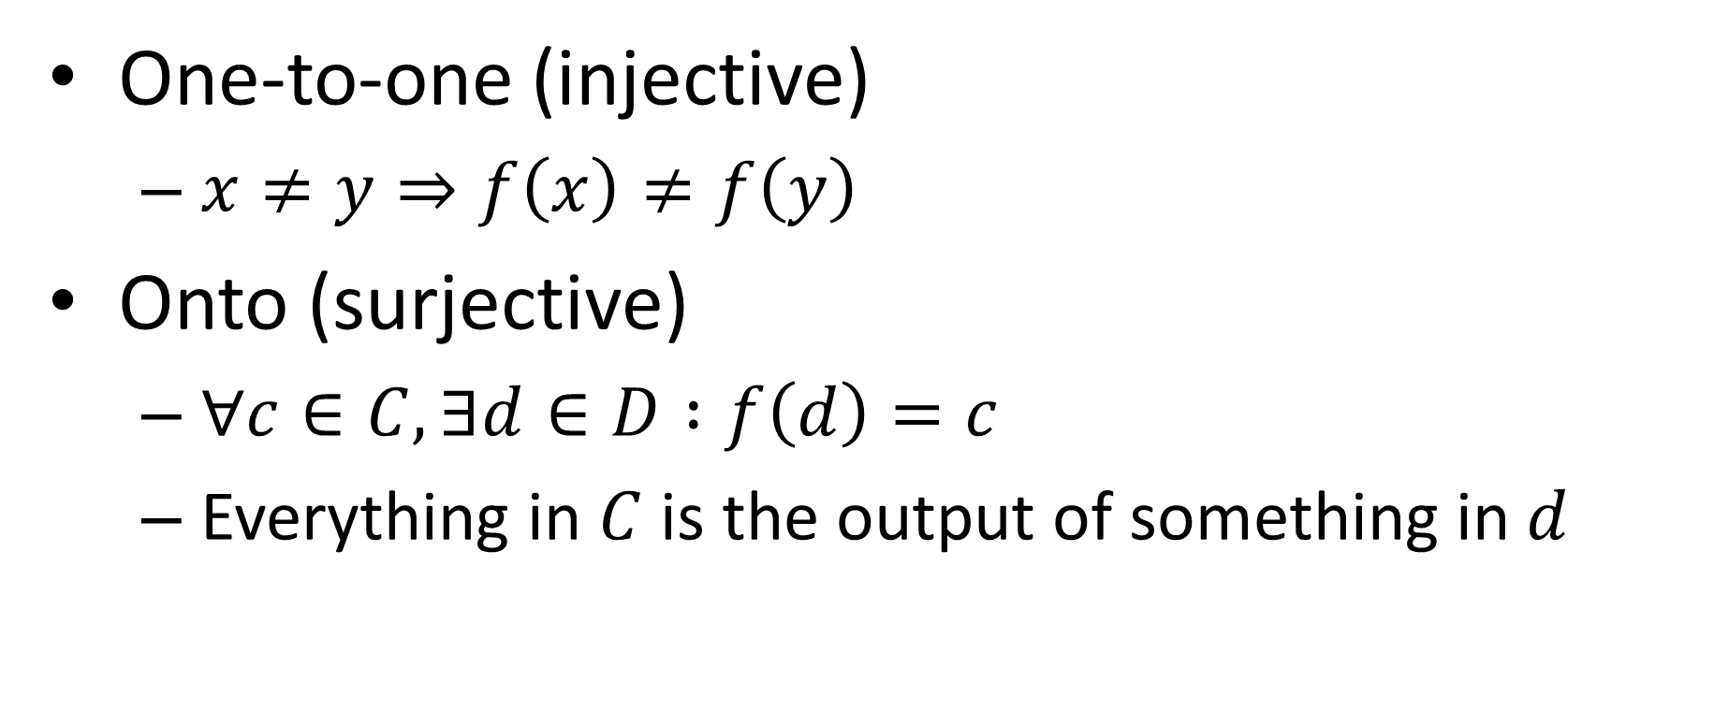
Properties of Functions
One-to-one (injective)
  $x≠y⇒f\left(x\right)≠f\left(y\right)$
Onto (surjective)
  $∀c∈C, ∃d∈D :f\left(d\right)=c$
  Everything in $C$ is the output of something in $d$

Slide 7
Onto, Surjective Functions
Domain
Co-Domain
Domain
Co-Domain
SURJECTIVE FUNCTION
NON-SURJECTIVE FUNCTION
Everything in Co-Domain “receives” something

Slide 8

Properties of Functions
One-to-one (injective)
  $x≠y⇒f\left(x\right)≠f\left(y\right)$
Onto (surjective)
  $∀c∈C, ∃d∈D :f\left(d\right)=c$
One-to-one Correspondence (bijective)
  Both one-to-one and surjective
  Everything in $C$ is mapped to by a unique element in $D$
  All elements from domain and co-domain are perfectly “partnered”

Slide 9
Bijective Functions
Domain
Co-Domain
Because Onto:
Everything in Co-Domain “receives” something
Because 1-1:
Nothing in Co-Domain “receives” two things
BIJECTIVE FUNCTION
Conclusion:
Things in the Domain exactly “partner” with things in Co-Domain

Slide 10
Part 2: Using Functions to Compare Sizes of Sets

Slide 11
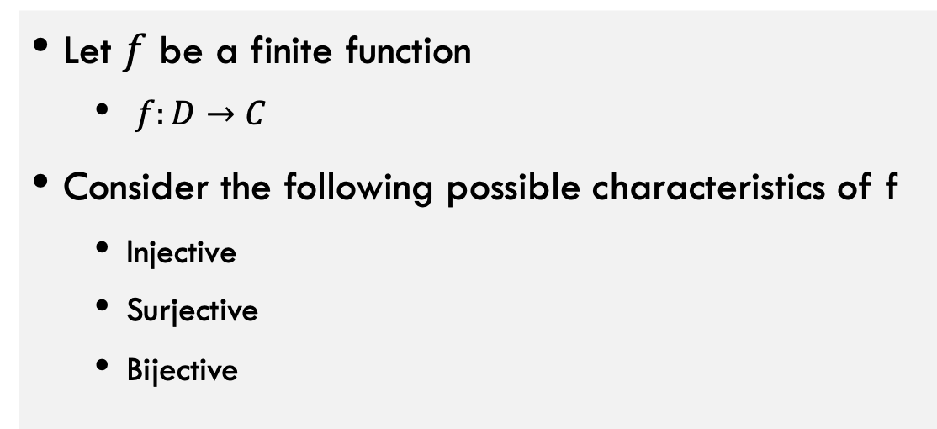
Comparing Cardinalities with Functions
Let $f$ be a finite function
  $f:D→C$
Consider the following possible characteristics of f
  Injective
  Surjective
  Bijective
Each of these will tell us something about the relative sizes of D and C

Slide 12

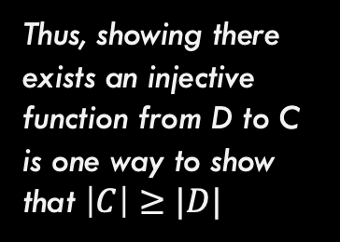
1-1, Injective Functions
Domain
Co-Domain
Thus, showing there exists an injective function from D to C is one way to show that $\left|C\right|≥|D|$
INJECTIVE FUNCTION
Nothing in Co-Domain “receives” two things
**Only possible if $\left|C\right|≥|D|$

Slide 13
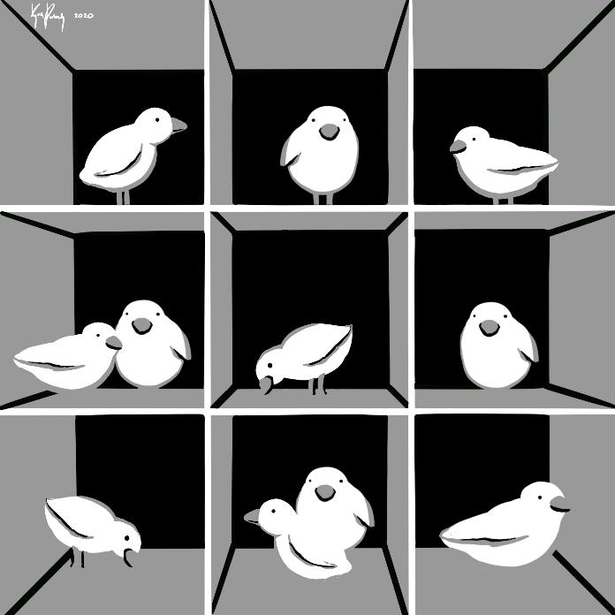
Pigeonhole Principle
Every pigeon is sitting in a hole
There are more pigeons than there are holes
At least one hole has at least two pigeons

Slide 14

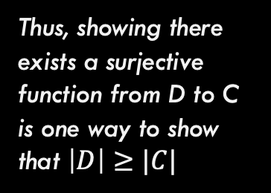
Onto, Surjective Functions
Domain
Co-Domain
Thus, showing there exists a surjective function from D to C is one way to show that $\left|D\right|≥|C|$
SURJECTIVE FUNCTION
Everything in Co-Domain “receives” something
**Only possible if $\left|D\right|≥|C|$

Slide 15



Bijective Functions
Domain
Co-Domain
Because 1-1:
Nothing in Co-Domain “receives” two things
$\left|C\right|≥|D|$
Because Onto:
Everything in Co-Domain “receives” something
$\left|D\right|≥|C|$
BIJECTIVE FUNCTION
Conclusion:
Things in the Domain exactly “partner” with things in Co-Domain
**Note: This means that $\left|D\right|=|C|$

Slide 16

Comparing Cardinalities with Functions
To show $\left|S\right|≥|T|$
  Find a surjective function $f:S→T$
  Find an injective function $f:T→S$
To show $\left|S\right|=|T|$
  Find a bijective function $f:S↔T$
  Find both a surjective function $f_{1}:S→T$ and an injective function $f_{2}:S→T$

Slide 17
Practice: $\left|{\left\{0,1\right\}}^{n}\right|=2^{n}$ via bijection
Theorem: $\left|{\left\{0,1\right\}}^{n}\right|=2^{n}$
How do we show this? Any ideas?

Slide 18

$\left|{\left\{0,1\right\}}^{n}\right|=2^{n}$ via bijection
Proof idea:
  Find a bijection $f_{n}:{\left\{0,1\right\}}^{n}↔\left\{x∈ℕ|x<2^{n}\right\}$
Given $b∈{\left\{0,1\right\}}^{n}$, what is $f_{n}\left(b\right)∈\left\{x∈ℕ|x<2^{n}\right\}$?
  $f_{n}\left(b\right)=\sum_{i=0}^{n−1}{{b_{i}⋅2}^{i}}$
  E.g. $1101=1⋅2^{0}+0⋅2^{1}+1⋅2^{2}+1⋅2^{3}=13$
  In other words, let each item b map to the natural number corresponding to the binary representation!!

Slide 19


Calculating binary of 13
$13$ is odd, so last bit is $1$
  $x=\left\lfloor \frac{13}{2}\right\rfloor =6$
6 is even, so next bit is $0$
  $x=\left\lfloor \frac{6}{2}\right\rfloor =3$
3 is odd, so next bit is 1
  $x=\left\lfloor \frac{3}{2}\right\rfloor =1$
1 is odd, so next bit is 1
$$b=$$
1
1
0
1
…and fill with the last n-4 zeros to ensure there are n digits

Slide 20
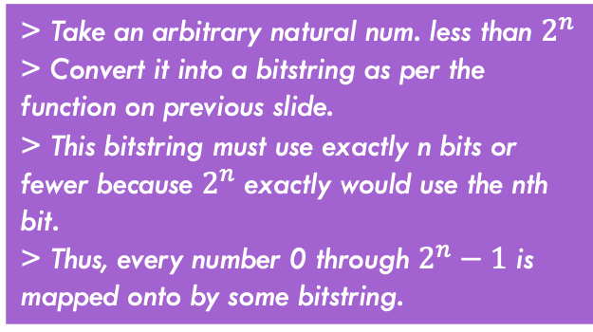

Practice: $\left|{\left\{0,1\right\}}^{n}\right|=2^{n}$ via bijection
Theorem: $\left|{\left\{0,1\right\}}^{n}\right|=2^{n}$
Is the mapping we provided injective (Every input has unique output)? Why?
Is the mapping we provided surjective (Every value less than $2^{n}$ is covered)? Why?
> Take two unique inputs B1 and B2
> B1 and B2 differ in at least one digit
> Thus, values differ if no other way to produce the exact value of that bit
> Consider case where B1 and B2 differ in multiple bits, but sum of difference of sum bits equals difference in another bit.
> This is impossible because sum of powers of two can never equal another power of 2.
> Thus B1 and B2 map to two different outputs. Function is injective.
> Take an arbitrary natural num. less than $2^{n}$
> Convert it into a bitstring as per the function on previous slide.
> This bitstring must use exactly n bits or fewer because $2^{n}$ exactly would use the nth bit.
> Thus, every number 0 through $2^{n}−1$ is mapped onto by some bitstring.

Slide 21
Practice 2
Theorem: For a finite set $S$, $\left|𝒫\left(S\right)\right|=2^{|S|}$
How do we show this? Any ideas?

Slide 22

For a finite set $S$, $\left|𝒫\left(S\right)\right|=2^{|S|}$
Find a function $f:𝒫\left(S\right)↔{\left\{0,1\right\}}^{|S|}$
Example: let $S=\left\{1,2,3\right\}$
$𝒫\left(S\right)=\left\{∅, \left\{1\right\}, \left\{2\right\}, \left\{3\right\}, \left\{1,2\right\}, \left\{1,3\right\}, \left\{2,3\right\}, \{1,2,3\}\right\}$
$f\left(\left\{1,2\right\}\right)=110$
$f\left(∅\right)=000$
Bijection: give each value of $S$ an index, for a particular subset of S, make the bit at that index 0 if it is absent, otherwise make it 1.

Slide 23
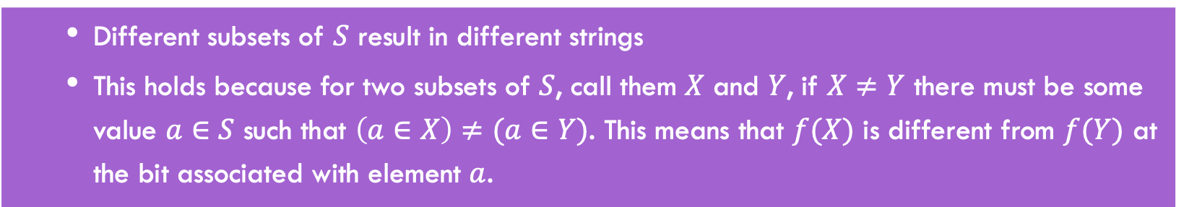
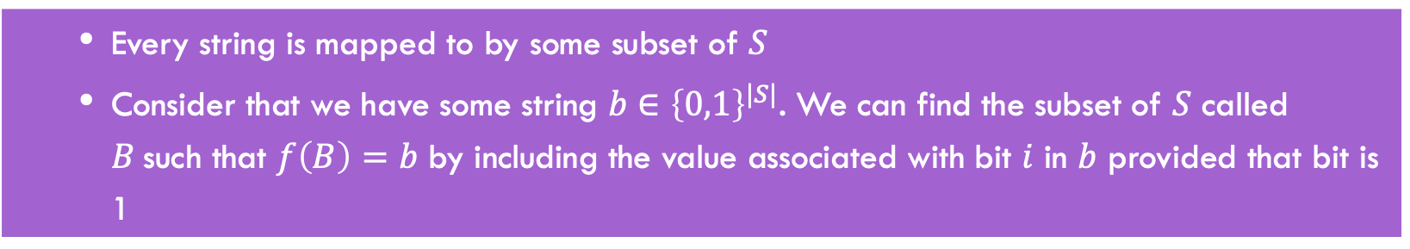
Why is this a bijection?
Show that it’s injective
  Different subsets of $S$ result in different strings
  This holds because for two subsets of $S$, call them $X$ and $Y$, if $X≠Y$ there must be some value $a∈S$ such that $\left(a∈X\right)≠(a∈Y)$. This means that $f(X)$ is different from $f(Y)$ at the bit associated with element $a$.
Show that it’s surjective
  Every string is mapped to by some subset of $S$
  Consider that we have some string $b∈{\left\{0,1\right\}}^{|S|}$. We can find the subset of $S$ called $B$such that $f\left(B\right)=b$ by including the value associated with bit $i$ in $b$ provided that bit is 1

Slide 24
Part 3: Comparing Sizes of Infinite Sets

Slide 25
Infinite Cardinality
How do we compare the sizes of two infinite sets? Wait…do they not automatically have the same size?

Slide 26

Infinite Cardinality
We say that for (infinite) sets $A$ and $B$, that $\left|A\right|=|B|$ if there is a bijection $f:A↔B$

Slide 27

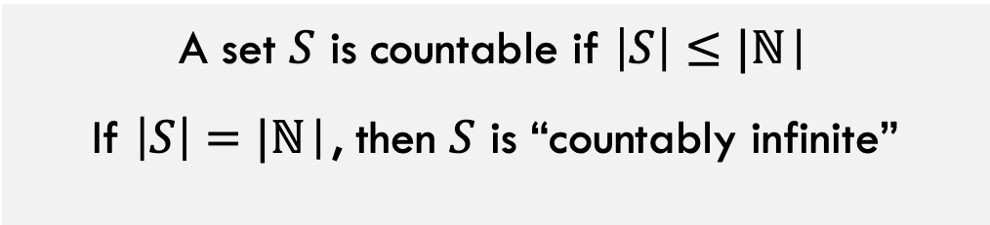
Countability and Uncountability
A set $S$ is countable if $\left|S\right|≤|\text{ℕ}\text{|}$
If $\left|S\right|=|\text{ℕ}\text{|}$, then $S$ is “countably infinite”
A set $S$ is countable if there is an onto (surjective) function from $\text{ℕ}$ to $S$
Otherwise a set is uncountable.

Slide 28
Practice: Show that $\left|{\left\{0,1\right\}}^{∗}\right|=|ℕ|$

Slide 29
${\left\{0,1\right\}}^{∗}$ is countable
Need to “represent” strings with naturals
Idea: build a “list” of all strings, represent each string by its index in that list

Slide 30

Listing all strings (bad way)
$f_{bad}:{\left\{0,1\right\}}^{∗}→ℕ$ can be defined as follows:
$f_{bad}\left(s\right)=$ the number that $s$ represents
Why is this function not a bijection?

Slide 31

Listing all strings
0
0
“”
${\left\{0,1\right\}}^{0}=\left\{""\right\}$
${\left\{0,1\right\}}^{1}=\left\{0,1\right\}$
${\left\{0,1\right\}}^{2}=\left\{00,01,10,11\right\}$
${\left\{0,1\right\}}^{3}=\{000,001,010,011,100,101,110,111\}$
1
0
2
1
1
2
3
00
4
01
5
10
11
6
3
4
5
6
000
001
010
011
100
101
110
111
7
8
9
10
11
12
13
14
7
8
9
10
11
12
13
14

Slide 32

Listing all strings
0
“”
1
0
2
1
3
00
4
01
5
10
11
6
000
001
010
011
100
101
110
111
7
8
9
10
11
12
13
14
Formulaic version:
$$f\left(w∈{\left\{0,1\right\}}^{∗}\right)=2^{|w|}−1+b(w)$$
**Where b(w) is the integer value of the binary bitstring w

Slide 33
Why is this a bijection?
Injective: different strings map to different numbers:
  Different strings map to different nodes in the tree
  No two nodes in the tree have the same index
Surjective: every number appears
  We listed them one by one and there are an infinite number of nodes.
0
“”
1
0
2
1
3
00
4
01
5
10
11
6
000
001
010
011
100
101
110
111
7
8
9
10
11
12
13
14

Slide 34

Demonstrate that each of the following is countable
$ℤ^{+}=ℕ∖\left\{0\right\}$
$\{n∈ℕ|n is even\}$
$\{n∈ℕ|n is odd\}$
$ℤ$
$ℕ×ℕ$
$ℚ$

Slide 35

Proof: $ℤ^{+}$ is countable
$f_{+}:ℤ^{+}↔ℕ$

Slide 36

Proof: $\{n∈ℕ|n is even\}$ is countable
$f_{e}:\{n∈ℕ|n is even\}↔ℕ$

Slide 37

Proof: $\{n∈ℕ|n is odd\}$ is countable
$f_{0}:\{n∈ℕ|n is odd\}↔ℕ$

Slide 38

$ℤ$ is countable
To build $f_{z}:ℤ↔ℕ$
  Idea: map natural numbers to evens, map negative numbers to odds
$f_{z}\left(x\right)=$
  $f_{e}^{−1}(x)$ If $x∈ℕ$
  $f_{o}^{−1}(−x)$ if $x∈ℤ^{−}$
Note that this means that if $A$ and $B$ are both countable then $A∪B$ is also countable!

Slide 39
$ℕ×ℕ$ is countable
Thoughts on how to prove it?

Slide 40


$ℕ×ℕ$ is countable
$$ℕ$$
0 1 2 3 4 5
$$ℕ$$
…
0
0,0 0,1 0,2 0,3 0,4 0,5
…
1
1,0 1,1 1,2 1,3 1,4 1,5
…
2
2,0 2,1 2,2 2,3 2,4 2,5
…
3
3,0 3,1 3,2 3,3 3,4 3,5
…
4
4,0 4,1 4,2 4,3 4,4 4,5
…
…
…
…
…
…

Slide 41

$ℚ$ is countable
Idea: there is a surjective mapping from $ℤ ×ℤ^{+}$ to $ℚ$
This one is left as an exercise (could be on homework or quiz)

Slide 42
Number of Programs As Number of Functions

Slide 43
How Many Python/Java programs?
How do we represent Java/Python programs?
How many things can we represent using that method?

Slide 44

How many functions $Σ^{∗}→Σ^{∗}$?
Short answer: Too many!
  Uncountable
  $\left|\left\{f \right|f:Σ^{∗}→Σ^{∗}\right\}|>|\text{ℕ}\text{|}$
Conclusion: Some functions cannot be computed by any java/python program
How to prove this?

Slide 45
How to show something is uncountable?

Slide 46
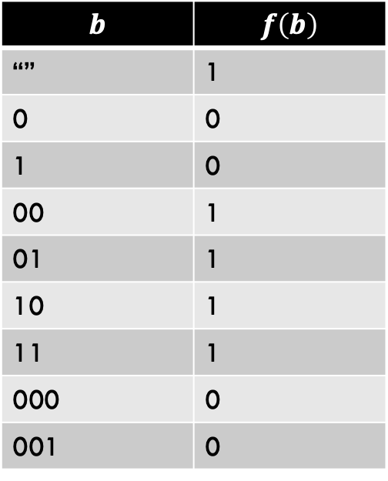

Uncountably many functions
$$b$$ | $$f\left(b\right)$$
“” | 1
0 | 0
1 | 0
00 | 1
01 | 1
10 | 1
11 | 1
000 | 0
001 | 0
If we show a subset of $\left\{f \right|f:Σ^{∗}→Σ^{∗}\}$is uncountable, then $\left\{f \right|f:Σ^{∗}→Σ^{∗}\}$ is uncountable too
Consider just the “yes/no” functions (decision problems):
$$\left\{f \right|f:{\{0,1\}}^{∗}→\{0,1\}\}$$

Slide 47

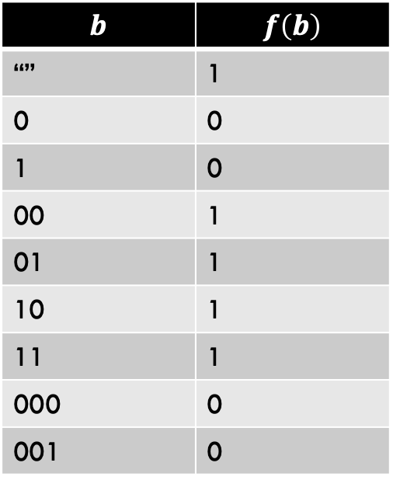
Goal: $\left\{f:{\left\{0,1\right\}}^{∗}→\{0,1\}\right\}$ is uncountable
$$b$$ | $$f\left(b\right)$$
“” | 1
0 | 0
1 | 0
00 | 1
01 | 1
10 | 1
11 | 1
000 | 0
001 | 0
Each function can be represented by a single infinite bitstring : ${\left\{0,1\right\}}^{∞}$ is a simpler representation of f
Show there is no onto mapping from $ℕ$ to ${\left\{0,1\right\}}^{∞}$
For example, this function can be fully described by the outputs only (the order of the inputs is fixed). So the right column (100111100…) fully describes this unique function

Slide 48


$$\left|{\left\{0,1\right\}}^{∞}\right|>|\text{ℕ}\text{|}$$
Idea:
  show there is no way to “list” all infinite length binary strings
  Any list of binary strings we could ever try will be leaving out elements of ${\left\{0,1\right\}}^{∞}$

Slide 49
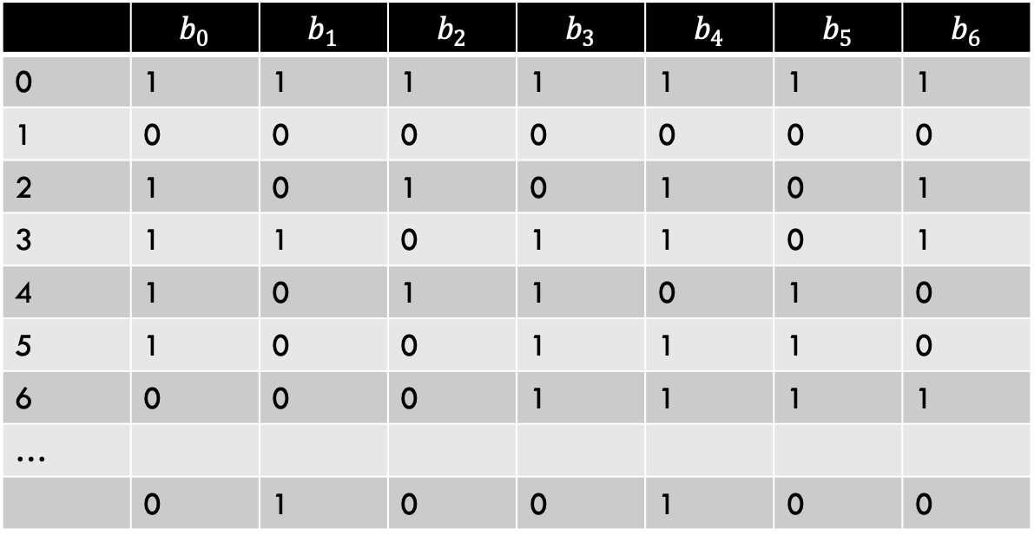
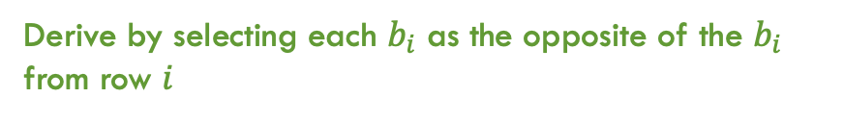

$$\left|{\left\{0,1\right\}}^{∞}\right|>|\text{ℕ}\text{|}$$
 | $$b_{0}$$ | $$b_{1}$$ | $$b_{2}$$ | $$b_{3}$$ | $$b_{4}$$ | $$b_{5}$$ | $$b_{6}$$
0 | 1 | 1 | 1 | 1 | 1 | 1 | 1
1 | 0 | 0 | 0 | 0 | 0 | 0 | 0
2 | 1 | 0 | 1 | 0 | 1 | 0 | 1
3 | 1 | 1 | 0 | 1 | 1 | 0 | 1
4 | 1 | 0 | 1 | 1 | 0 | 1 | 0
5 | 1 | 0 | 0 | 1 | 1 | 1 | 0
6 | 0 | 0 | 0 | 1 | 1 | 1 | 1
…
 | 0 | 1 | 0 | 0 | 1 | 0 | 0
Attempt at mapping $\text{ℕ}$ to ${\left\{0,1\right\}}^{∞}$
A string that our attempt missed
Derive by selecting each $b_{i}$ as the opposite of the $b_{i}$ from row $i$

Slide 50
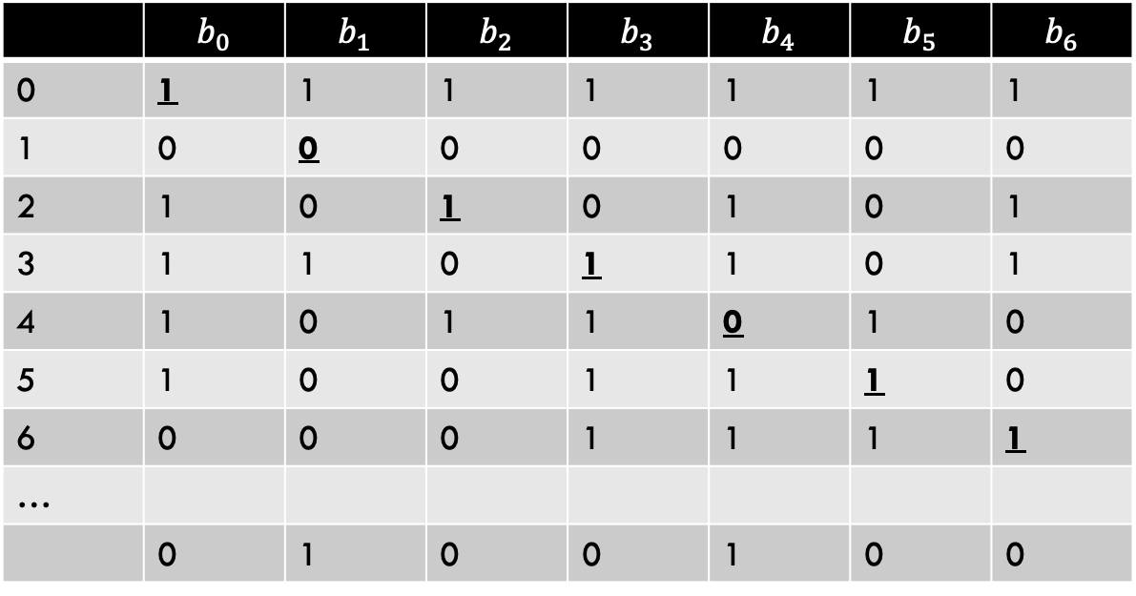
$$\left|{\left\{0,1\right\}}^{∞}\right|>|\text{ℕ}\text{|}$$
 | $$b_{0}$$ | $$b_{1}$$ | $$b_{2}$$ | $$b_{3}$$ | $$b_{4}$$ | $$b_{5}$$ | $$b_{6}$$
0 | 1 | 1 | 1 | 1 | 1 | 1 | 1
1 | 0 | 0 | 0 | 0 | 0 | 0 | 0
2 | 1 | 0 | 1 | 0 | 1 | 0 | 1
3 | 1 | 1 | 0 | 1 | 1 | 0 | 1
4 | 1 | 0 | 1 | 1 | 0 | 1 | 0
5 | 1 | 0 | 0 | 1 | 1 | 1 | 0
6 | 0 | 0 | 0 | 1 | 1 | 1 | 1
…
 | 0 | 1 | 0 | 0 | 1 | 0 | 0
Attempt at mapping $\text{ℕ}$ to ${\left\{0,1\right\}}^{∞}$
Take the bolded bits across the diagonal. Select a bitstring where each of these bits is flipped. In this example: 0100100…

Slide 51
Other countable/uncountable sets
Countable sets:
  Integers
  Rational numbers
  Any finite set
Uncountable Sets:
  Real numbers
  The power set of any infinite set

Slide 52

Cantor’s Theorem
For any set $S$, $\left|S\right|<|2^{S}|$
Even if $S$ is infinite!
Idea:
  $\left|S\right|≤|2^{S}|$ (why?)
  There cannot be a bijection between $S$ and $2^{s}$
  Not going to prove

Slide 53
Conclusion
There are countably many strings
  And therefore binary strings, programs, etc.
There are uncountably many functions
Some functions can’t be implemented

