Slide 1



GALE-SHAPLEY ALGORITHM
Billy Zhang, Sarah Kota, Almas Telek, Moses Zhang

Slide 2

Stable Matching Problem
Notes:
Background – Stable Marriage Problem. This is what the gale-shapley algorithm is trying to solve. Let’s break down the components of this problem.

Slide 3










n
A:
B:
Notes:
For the sake of guaranteeing a perfect matching, we are going to assume that each set is of size n (same number of people in each set). We want to find a 1-to-1 mapping between them, so an arbitrary mapping is shown here.

Slide 4

Pairs
Notes:
So these are the pairs from the last slide, and every person from each set only shows up once. There are n pairs.

Slide 5
Preferences
1
2
3
4
5
A
Y
V
X
U
Z
U
D
B
E
C
A
B
Z
X
V
U
Y
V
B
A
D
C
E
C
Y
X
X
A
C
E
D
B
V
Z
U
D
Z
V
Y
X
U
D
A
C
B
E
Y
E
Y
U
V
Z
B
E
A
C
D
X
Z
Notes:
The real complication comes from the preferences lists of each person. Each person has a list next to themselves ranking all of the members of the other set. For example, the guy A prefers girl Y first, girl V second, girl X third, girl U fourth, and girl Z fifth. It is not necessary for the preferences to be reciprocated. While guy E prefers girl Y the most, she actually prefers him the least. In the final matching, there should be no two people who would prefer to be with each other, over their current match.

Slide 6
A
B
C
D
E
A:
U
V
X
Y
Z
B:
Notes:
For the sake of guaranteeing a perfect matching, we are going to assume that each set is of size n (same number of people in each set). We want to find a 1-to-1 mapping between them, so an arbitrary mapping is shown here.

Slide 7


B
Z
Z
C
B
U
Notes:
So the original mapping showed in the beginning was actually a bad matching. Pay particular attention to the white girl and black guy. In each other’s lists, they prefer each other the most as they are both the top options on each other’s list. So they prefer each other more than their current matching (current is white girl with navy blue guy and black guy with sky blue girl)

Slide 8
Instability
A
Y
V
X
U
Z
U
D
B
E
C
A
B
Z
X
V
U
Y
V
B
A
D
C
E
C
Y
X
X
A
C
E
D
B
V
Z
U
D
Z
V
Y
X
U
D
A
C
B
E
Y
E
Y
U
V
Z
B
E
A
C
D
X
Z
Notes:
The real complication comes from the preferences lists of each person. Each person has a list next to themselves ranking all of the members of the other set. For example, the navy blue guy prefers turquoise girl first, white girl second, sky blue girl third, navy girl fourth, and black girl fifth. It is not necessary for the preferences to be reciprocated. While the black guy prefers the turquoise girl the most, she actually prefers him the least. In the final matching, there should be no two people who would prefer to be with each other, over their current match.

Slide 9

The Algorithm (initialization)
All individuals have ranked members of the opposite set in order of preference
One of the two sets is chosen to make proposals
Notes:
Moses: Algorithm initialization. Note for point 2: either set would produce stable matchings

Slide 10

The Algorithm (Loop)
One individual from the proposing group who is not already engaged will propose to their most preferred option who has not already rejected them
The person being proposed to will:
  Accept if this is their first offer
  Reject if this is worse than their current offer
  Accept if this is better than their current offer. Jilt their previous offer
Notes:
Moses: Algorithm Loop

Slide 11
The Algorithm (Termination)
When all members of the proposing group are matched, the loop terminates. Currently engaged pairs are now stably matched
Notes:
Moses: Algorithm – termination

Slide 12
Example – Male Proposers
A
Y
V
X
U
Z
U
D
B
E
C
A
B
Z
X
V
U
Y
V
B
A
D
C
E
C
Y
X
X
A
C
E
D
B
V
Z
U
D
Z
V
Y
X
U
D
A
C
B
E
Y
E
Y
U
V
Z
B
E
A
C
D
X
Z
Notes:
The real complication comes from the preferences lists of each person. Each person has a list next to themselves ranking all of the members of the other set. For example, the navy blue guy prefers turquoise girl first, white girl second, sky blue girl third, navy girl fourth, and black girl fifth. It is not necessary for the preferences to be reciprocated. While the black guy prefers the turquoise girl the most, she actually prefers him the least. In the final matching, there should be no two people who would prefer to be with each other, over their current match.

Slide 13
Example – Male Proposers
A
Y
V
X
U
Z
U
D
B
E
C
A
B
Z
X
V
U
Y
V
B
A
D
C
E
C
Y
X
X
A
C
E
D
B
V
Z
U
D
Z
V
Y
X
U
D
A
C
B
E
Y
E
Y
U
V
Z
B
E
A
C
D
X
Z
Notes:
The real complication comes from the preferences lists of each person. Each person has a list next to themselves ranking all of the members of the other set. For example, the navy blue guy prefers turquoise girl first, white girl second, sky blue girl third, navy girl fourth, and black girl fifth. It is not necessary for the preferences to be reciprocated. While the black guy prefers the turquoise girl the most, she actually prefers him the least. In the final matching, there should be no two people who would prefer to be with each other, over their current match.

Slide 14
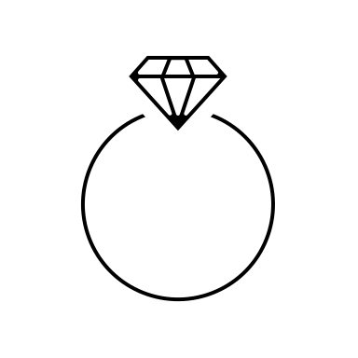


Stable Matching
A
Y
B
Z
C
X
D
V
E
U
C
V
V
D
Notes:
This is a stable matching. We know this because if any man prefers a woman more than his current match, he would’ve already proposed to her.
Because they are not matched, she must of rejected him meaning she cannot prefer him over her current match.
To provide an example here. Sky blue guy preferred white girl over his current match (sky blue girl), so this means he must of proposed to white girl and she rejected him because she prefers her own match (turquoise guy) over him.

Slide 15
Female Proposers
A
Y
V
X
U
Z
U
D
B
E
C
A
B
Z
X
V
U
Y
V
B
A
D
C
E
C
Y
X
X
A
C
E
D
B
V
Z
U
D
Z
V
Y
X
U
D
A
C
B
E
Y
E
Y
U
V
Z
B
E
A
C
D
X
Z
Notes:
The real complication comes from the preferences lists of each person. Each person has a list next to themselves ranking all of the members of the other set. For example, the navy blue guy prefers turquoise girl first, white girl second, sky blue girl third, navy girl fourth, and black girl fifth. It is not necessary for the preferences to be reciprocated. While the black guy prefers the turquoise girl the most, she actually prefers him the least. In the final matching, there should be no two people who would prefer to be with each other, over their current match.

Slide 16
Final Pairs – Female Proposers
A
V
B
Z
C
X
D
Y
E
U
Notes:
These are the final pairs when the females are the proposers.
The only difference here is that white girl and turquoise girl got more favorable outcomes.
Meanwhile navy blue guy and turquoise guy got a less favorable outcome.

Slide 17

Analysis
n
A
Y
V
X
U
Z
B
Z
X
V
U
Y
O(n²)
C
V
Z
U
Y
X
n
D
Z
V
Y
X
U
E
Y
U
V
X
Z
Notes:
Each member of the proposing group can at most propose to the other group only once, as they cannot propose to someone who has previously rejected them.
Because of this, the runtime of this algorithm will be O(n^2), but will often times be less than this.
This can also be considered linear in terms of the input size, which is 2 nxn arrays.
Brute force is O(n! n^2), n! permutations and n^2 to check stability
O(n^2) is optimal in this case because you would have to do n^2 checks anyways to check stability

Slide 18
Correctness and Proposer Optimality
A
Y
V
X
U
Z
U
D
B
E
C
A
B
Z
X
V
U
Y
V
B
A
D
C
E
C
Y
X
X
A
C
E
D
B
V
Z
U
D
Z
V
Y
X
U
D
A
C
B
E
Y
E
Y
U
V
Z
B
E
A
C
D
X
Z
Notes:
- Proposers go down their list of preferences
- Acceptors only change their tentative match when they get a better option
- This deferred acceptance is an important mechanism to the algorithm because it let's us overcome blocking pairs
- And thus, the algorithm progresses towards a state where all are matched and any proposal that has been made is a proposer's next best option and an acceptor's preferred option over their previous
- As we mentioned previously, the same algorithm can result in different stable matching when the proposer side is swapped
- The algorithm produces the optimal result for the proposing side
- This is because proposers go down their preferences in preferred order while acceptors are at the will of the proposals they receiver and only upgrade up

Slide 19






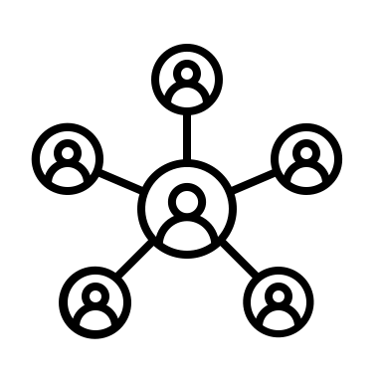

Applications
Notes:
Moses: Have actual examples ready, do research
Top left: National Resident Matching Program
Top right: Kidney matching
Bottom left: applicants to jobs
Bottom right: can even be used as a load balancing algorithm

Slide 20
THANK YOU

