Slide 1
HYPERLOGLOG
ADVANCED ALGORITHMS BRIAN LAI, ANDY LIANG, DOMINIC TRAN SLIDES STOLEN FROM https://markfloryan.github.io/advAlgo/slides/index.html

Slide 2


MOTIVATION
You want to know how many unique books there are in the library
Each book is uniquely identified by a barcode (e.g. 10100100100101001110110101)
Assume the digits in a barcode are essentially random
More generally, this is the count-distinct problem (cardinality estimation problem)

Slide 3

NAÏVE APPROACH 1
S = {0001, 1100, 0110, 0111}
A = [0001, 1100, 0110, 1100, 0110, 0111]
S will take up O(n) space. YIKES!!!! If we are in the Library of Congress thats 175,000,000 unique books! RIP SSD
Keep track of seen barcodes as we iterate by adding new values to S.
By this point, we’ve seen 3 unique elements, so there are 3 elements in S.

Slide 4

REDUCING MEMORY USAGE
The digits in a barcode are like coin flips
Keep track of the longest prefix of 0s you have seen so far
Only one value stored as opposed to millions!
Longer trail ⇒ more unique books seen (probably)
unique books ≈ 2^{longest prefix}
Unbiased approximation, but high variance—we will fix later

Slide 5
Small Example
B = 0b0001
So: if B is the number with the longest run of leading 0s, we’ve seen, we can expect to have already seen 8 unique numbers
Suppose: We have a universe of 4 bit numbers, uniformly distributed from 0-15
Chance of each digit being 0 is ½, so chance of seeing this run of 3 0s in a row is ½³ = ⅛.

Slide 6
NAÏVE APPROACH 2
A = [0001, 1000, 1100, 1110, 1000, 0101]
register = 0001
Store: number with highest number of leading 0s in register
At the end, find register’s longest run of leading 0s (n). Estimate the number of distinct elements to be 2^{n}.
Iterate through A. At each iteration, check if the current number has a higher number of leading 0s than what’s stored in register
For number in A:
Register = max(register, number)

Slide 7
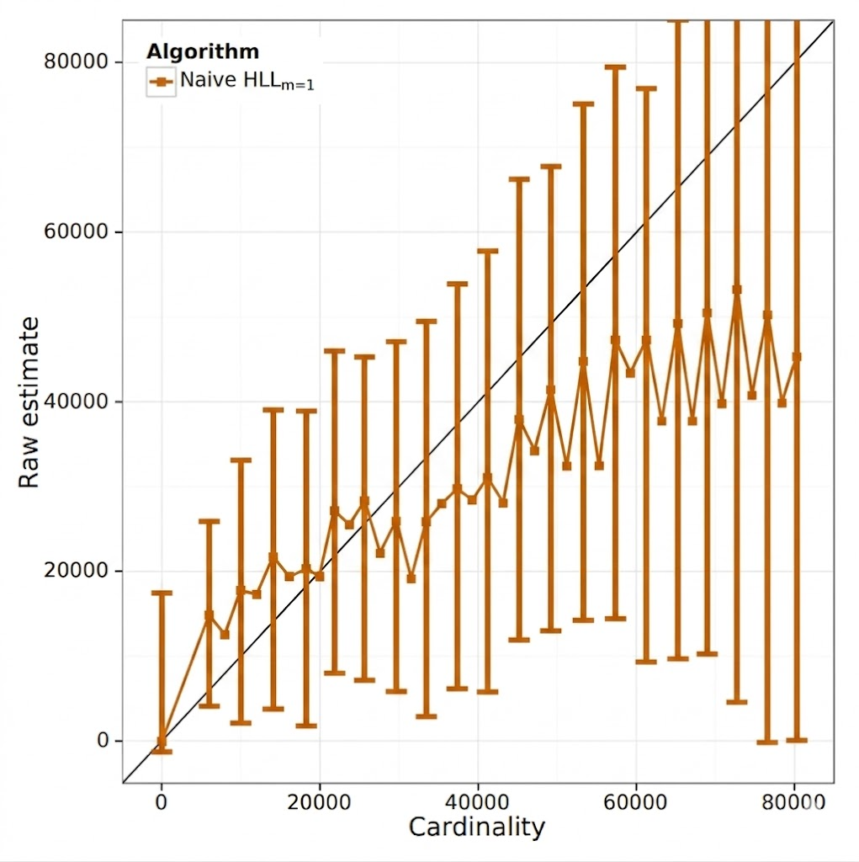
TERRIBLE ESTIMATION 1
A = [0000, 0000, 0000, ...]
Expected: 1
Estimated: 16

Slide 8
TERRIBLE ESTIMATION 2
A = [1001, 1011, 1110, 1111, 1101, 1000, 1010, 1100]
Expected: 8
Estimated: 1

Slide 9
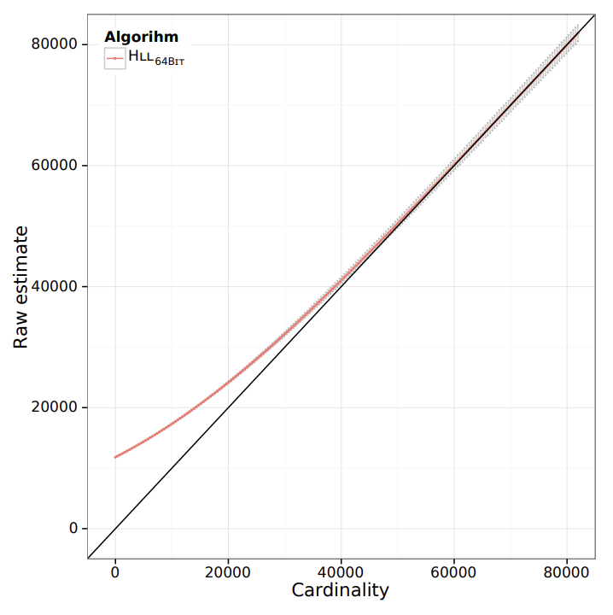
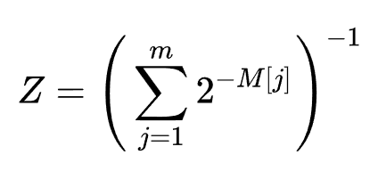

REDUCING VARIANCE
Split the values among m registers (buckets)
Each register keeps track of its longest 0 prefix
More registers ⇒ less variance but more memory
Relative error is 1.04/√m
Harmonic mean of estimates across m registers
a_{m} ≈ 0.7 corrects for hash collisions

Slide 10
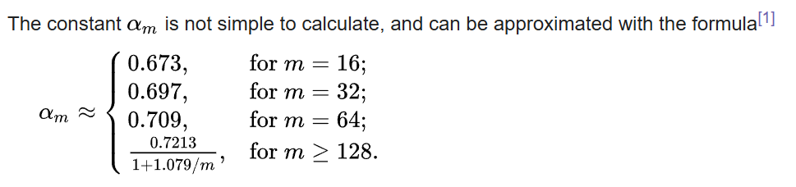

CONCLUSIONS
Strengths:
Small constant memory cost
Small error (depending on number of registers m)
Update is O(1) runtime
O(loglog(n)) space
Weaknesses:
Small data sets cook it (use naive approach 1 instead)
Other cool things:
Use hash function for non number objects (or numbers without a uniform distribution)
“This is left as an exercise for the reader”

