Slide 1
Minkowski sum of convex polygons
Tijun Fu
Ja-Zhua Chen
Brian Xiao

Slide 2
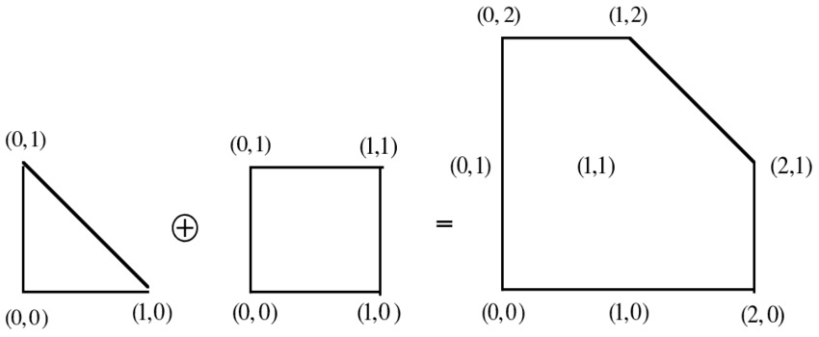
Minkowski Sum
Given two sets A and B in space, the Minkowski sum (⊕) A + B is defined as:
A + B = {a + b | a 𝜖 A, b 𝜖 B}

Slide 3
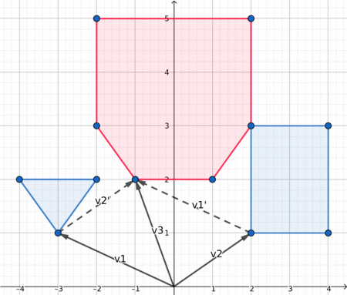
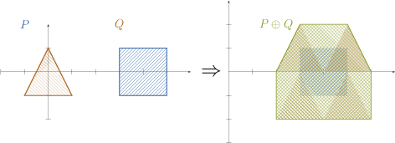
Intuitively
Sets are points of a polygon
Able to inflate obstacles. Taking shape B and repeatedly “stamping” over every point on shape A.
If both A and B are convex, the Minkowski sum A + B will also be convex!

Slide 4
Minkowski Difference (Erosion)
Given two sets A and B in space, the Minkowski Difference A - B is defined as:
A - B = {a - b | a 𝜖 A, b 𝜖 B} = A + (-B)
Not an inverse operation. -B graphically is reflected about the origin.
If two convex shapes intersect, the resulting set will contain the origin. (Regardless of the position of the initial shapes)

Slide 5
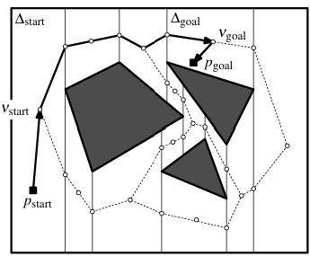
Motivation
Motion Path planning
Edge cases that arise from physical space occupied by moving object
Tolerances
Computer-aided design and manufacturing
Fast polygon intersection
Collision Detection in Physics Engines

Slide 6
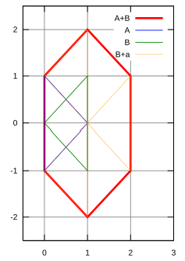
Naive Approach
minkowskiSum(A, B)
S = []
for point a in A:
for point b in B:
S.append(a + b)
minkowskiDifference(A, B)
for point b in B:
negate(b)
minkowski(Sum(A, B))

Slide 7
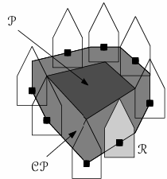
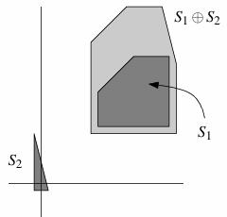
Overall Approach
Key Ideas:
if a + b is a boundary point of A ⊕ B, a is a vertex and b is on an edge or vice versa
We only need to check vertices of the convex hull!
Just need to know in what order to add the edges
Consider polygons sorted in counterclockwise order
Ordered by polar angle and can be merged into one list in polar order

Slide 8
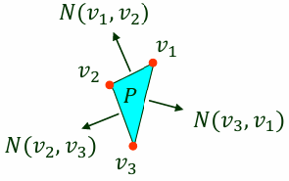
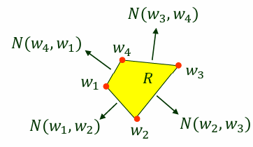
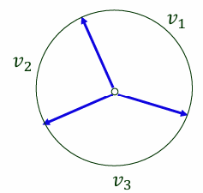
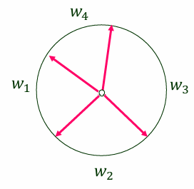
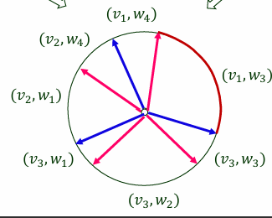
Overall Approach

Slide 9
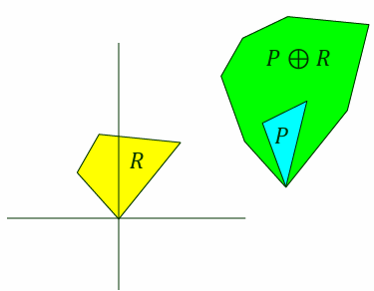
Overall Approach

Slide 10
High level Implementation
01
Reorder/rotate the vertices so that the point with smallest y-coordinate start first.* Create a pointer to start of vertices of each polygon
02
Add the sum of the current vertices of the polygons to your answer. Increment pointer of polygon with smaller polar angle for the current edge (both if equal)
03
Repeat 02 until all edges are accounted for
* We assume inputs of polygons in counter-clockwise order, as that is the usual output of convex hull algorithms

Slide 11
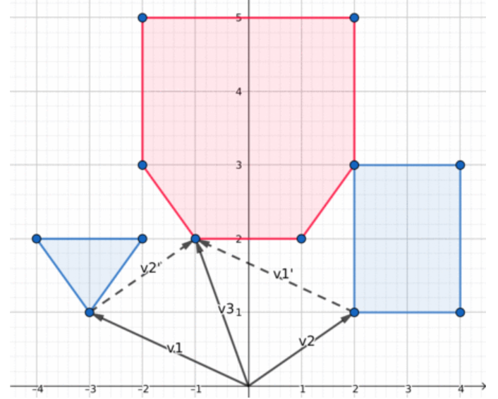
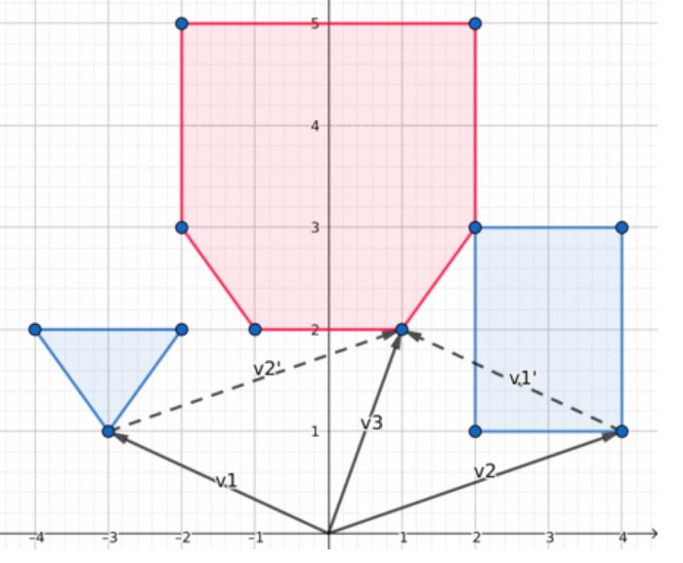
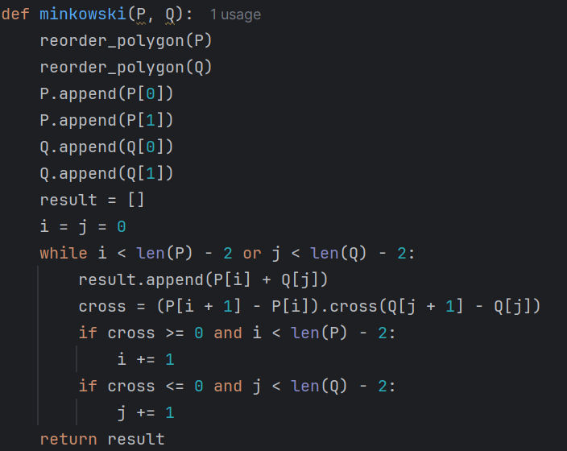
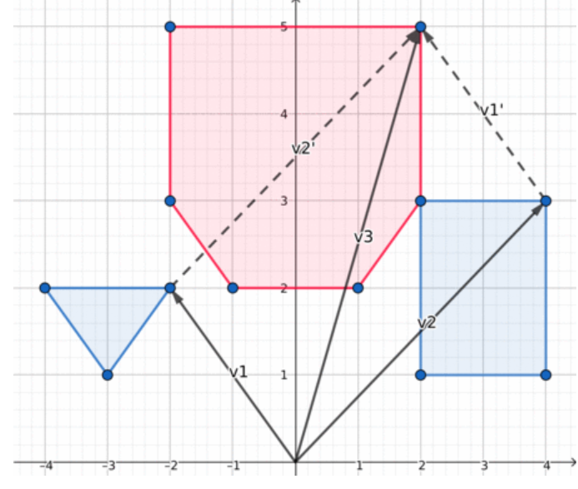
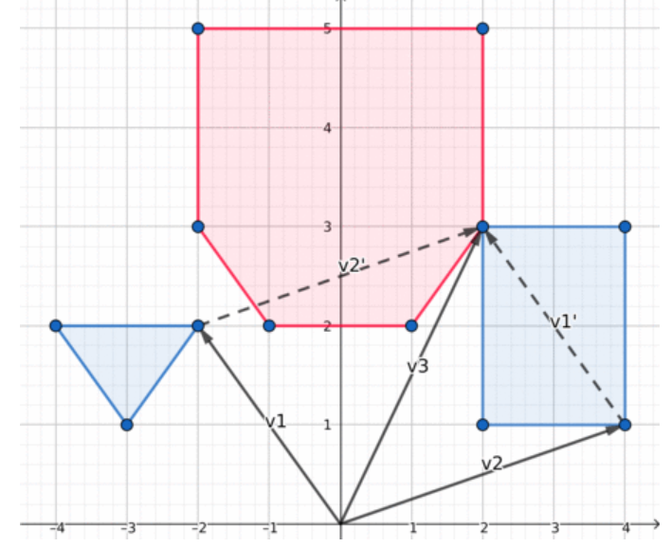
Implementation
Loop until each point is iterated

Slide 12
Polygon Distance Problem
How it works?
Reduces the problem to find the smallest distance between (0,0) and P+(-Q). -> this is actually the distance
Improvements?
Naive approach sums each vertices to each vertices, which is |P||Q|
We check the cross product, sum up based on polar angles (so that the problem boils down to a convex hull problem. With sorted points we can solve it in linear time)

Slide 13
Analysis
Given polygons P and Q with n and m vertices respectively
Naive Approach: O(nm(log n + log m)
Optimized: O(n + m) (if sorted)

