Slide 1
Linear Programming
Advanced Algorithms Mark Floryan CLRS Ch. 29

Slide 2
Introduction and motivation

Slide 3
Motivating Problem
You are a politician trying to win an election. Your district contains urban, suburban, and rural areas that have 100,000, 200,000, and 50,000 residents respectively. You want to spend the least amount of money, and target your advertisements so that you can win over at least half of the people in each respective area. Your policy priorities are to build roads, increase gun control, provide farm subsidies, and add a gasoline tax.
Your policies are not all popular in all areas of your district, so how can you divide your message advertisement across the three areas to obtain votes from at least half of the people in each area?

Slide 4
Modeling the constraints
With some polling, you decide that the table to the right is a good approximation of the effect of spending money on each issue.
For each row, spending $1000 on that issue will lead to x*1000 voters moving in/out of your favor in each respective area.
Policy | Urban | Suburban | Rural
Build Roads | -2 | 5 | 3
Gun Control | 8 | 2 | -5
Farm Subsidies | 0 | 0 | 10
Gasoline Tax | 10 | 0 | -2
For example, if you spend $1000 on your gun control stance, you will gain 8000 urban voters, 2000 suburban voters, but lose 5000 rural voters

Slide 5
Modeling the constraints
Ok, so we are trying to calculate:
x₁: Money spent on build roads x₂: Money spent on gun control x₃: Money spent on farm subsidies x₄: Money spent on gas tax
Subject to: We want to win half the voters in each area (see next slide for formulas)
Policy | Urban | Suburban | Rural
Build Roads | -2 | 5 | 3
Gun Control | 8 | 2 | -5
Farm Subsidies | 0 | 0 | 10
Gasoline Tax | 10 | 0 | -2

Slide 6
Final Linear Program
We want to minimize total cost on advertising:
$$x_{1}+x_{2}+x_{3}+x_{4}$$
Subject to these constraints
$$−2x_{1}+8x_{2}+0x_{3}+10x_{4}≥50 \\ 5x_{1}+2x_{2}+0x_{3}+0x_{4}≥100 \\ 3x_{1}−5x_{2}+10x_{3}−2x_{4}≥25 \\ x_{1},x_{2},x_{3},x_{4}≥0$$

Slide 7
What is linear programming?

Slide 8
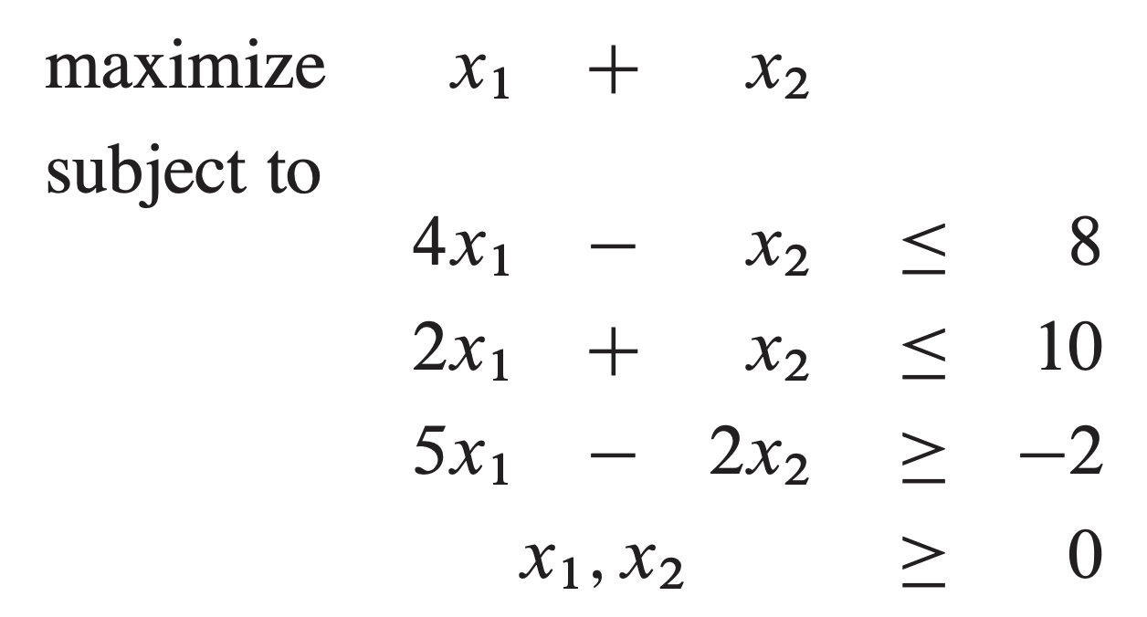
Linear Programming
As seen on the previous slide. A Linear Program is any problem in which you wish to maximize or minimize a linear function subject to a list of linear inequalities.
Most LPs have many (often infinite) feasible solutions.
Some LPs do not have a feasible solution
Others are unbounded (solution is infinite)

Slide 9
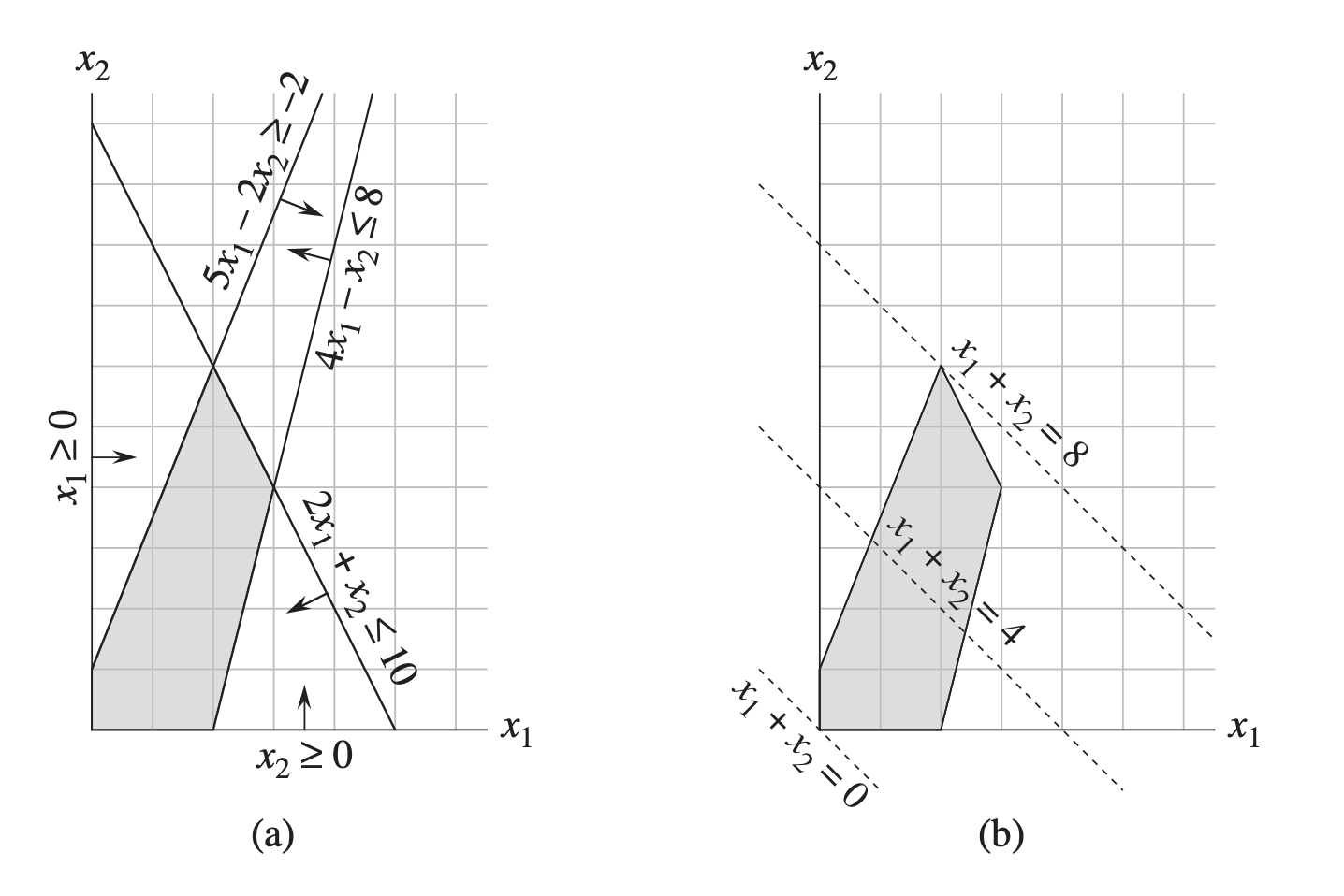
Linear Programming

Slide 10
Overall LP Process
Model your problem using linear functions
Put LP into proper format.
*Standard Form *Slack Form
Known Linear Programming Algorithms.
*Simplex *Ellipsoid Method *Interior Point Methods
Optimal Solution IFF one exists
Some algorithms require LP to be in a specific format
We will study Simplex Algorithm, but usually you will use these as black boxes
Usually this is the hardest part

Slide 11
Other Applications of LP
An airline wishes to schedule flight crews. The government imposes many constraints (such as number of consecutive flights worked), work hours per week, etc. Company wants to use as few employees as possible.
An oil company want to find new places to drill. They know the likelihood of a drill site paying off, the expected payout, how much it would cost to drill at each location, etc. They want to maximize profit.
**LP is a very general technique. If you can model your problem as a linear optimization under a set of linear constraints, you can use these algorithms!

Slide 12
Standard Form

Slide 13
Motivation for standard / Slack Form
It is easier to reason about Linear Programs if we have a standard format that all are required to be expressed in!
We will use a form called Standard Form for normalizing all Linear Programs.
Many algorithms either require the LP to be in standard form OR will convert it into standard form
Slack Form is another popular LP form that many algorithms use (Simplex uses it)

Slide 14
General Standard Form
In Standard From, we always maximize, all constraints are upper bound inequalities, and all variables have non-negativity constraints
$$\sum_{j=1}^{n}{c_{j}x_{j}}$$
Maximize:
Subject To:
$\sum_{j=1}^{n}{a_{ij}x_{j}≤b_{i}}$ for $i=1,2,…,m$
$x_{j}≥0$ for $j=1,2,…,n$

Slide 15
Standard Form (Matrix Representation)
Standard Form is usually expressed with matrices, making them easy to manipulate and work with.
c is coefficients of objective function. e.g.,:
$$c=\left(\begin{matrix}3 \\ 1 \\ 2\end{matrix}\right)$$
$$\sum_{j=1}^{n}{c_{j}x_{j}}$$
Maximize:
b is matrix of constant bounds. e.g.,:
$$b=\left(\begin{matrix}30 \\ 24 \\ 36\end{matrix}\right)$$
Subject To:
$\sum_{j=1}^{n}{a_{ij}x_{j}≤b_{i}}$ for $i=1,2,…,m$
$x_{j}≥0$ for $j=1,2,…,n$
A is coefficients all constraints. e.g.,:
$$A=\left(\begin{matrix}1 & 1 & 3 \\ 2 & 2 & 5 \\ 4 & 1 & 2\end{matrix}\right)$$
Thus, a Linear Program can be easily expressed in standard form using only the tuple of matrices {A, b, c}

Slide 16
Standard Form (Matrix Representation)
Standard Form concrete example can be seen below.
c is coefficients of objective function. e.g.,:
$$c=\left(\begin{matrix}3 \\ 1 \\ 2\end{matrix}\right)$$
Maximize:
$$3x_{1}+x_{2}+2x_{3}$$
b is matrix of constant bounds. e.g.,:
$$b=\left(\begin{matrix}30 \\ 24 \\ 36\end{matrix}\right)$$
Subject To:
$$x_{1}+x_{2}+3x_{3}≤30 \\ 2x_{1}+2x_{2}+5x_{3}≤24 \\ 4x_{1}+x_{2}+2x_{3}≤36 \\ x_{1}, x_{2}, x_{3}≥0$$
A is coefficients all constraints. e.g.,:
$$A=\left(\begin{matrix}1 & 1 & 3 \\ 2 & 2 & 5 \\ 4 & 1 & 2\end{matrix}\right)$$

Slide 17
Some Terminology
Some definitions regarding solutions to Linear Programs:
Feasible Solution:
An assignment of the variables x_{i} that does NOT violate any of the constraints
Infeasible Solution:
An assignment of the variables x_{i} that DOES violate at least one of the constraints
Objective Value:
The value of the objective function given by some feasible solution
Optimal Solution:
The highest objective value that can be obtained by any feasible solution
Feasibility of LP:
If LP has no feasible solutions, it is infeasible, otherwise it is feasible
Unbounded:
If a Linear Program has an infinite optimal solution, then it is unbounded

Slide 18
Converting Linear Programs to Standard Form
There are four issues we might need to contend with when converting to Standard Form:
1.
Objective function minimizes instead of maximizes
2.
Some variables do not have a non-negativity constraint
3.
Some constraints might be equalities, instead of inequalities
4.
Some inequalities might be lower-bounds instead of upper-bounds

Slide 19
Issue 1: Objective Function Minimizes
Solution: Negate the coefficients of the objective function
Minimize:
$$−2x_{1}+3x_{2}$$
Maximize:
$$2x_{1}−3x_{2}$$
$$x_{1}+x_{2}=7 \\ x_{1}−2x_{2}≤4 \\ x_{1}≥0$$
$$x_{1}+x_{2}=7 \\ x_{1}−2x_{2}≤4 \\ x_{1}≥0$$

Slide 20
Issue 2: Vars without Non-Negativity
Solution: Introduce two new variables and their difference to each constraint
Maximize:
$$2x_{1}−3x_{2}$$
Maximize:
$$2x_{1}−3x_{2}^{′}+3x_{2}′′$$
$$x_{1}+x_{2}=7 \\ x_{1}−2x_{2}≤4 \\ x_{1}≥0$$
$$x_{1}+x_{2}^{′}−x_{2}′′=7 \\ x_{1}−2x_{2}^{′}+2x_{2}′′≤4 \\ x_{1},x_{2}^{′},x_{2}′′≥0$$
We introduce new variables x₂’ and x₂’’
Replace x₂ with expression (x₂’ – x₂’’) and simplify

Slide 21
Issue 3: Equality Constraints
Solution: Separate into two inequality constraints instead (one of them will be fixed with issue 4 on the next slide)
Maximize:
$$2x_{1}−3x_{2}+3x_{3}$$
Maximize:
$$2x_{1}−3x_{2}+3x_{3}$$
$$x_{1}+x_{2}−x_{3}=7 \\ x_{1}−2x_{2}+2x_{3}≤4 \\ x_{1},x_{2},x_{3}≥0$$
$$x_{1}+x_{2}−x_{3}≤7 \\ x_{1}+x_{2}−x_{3}≥7 \\ x_{1}−2x_{2}+2x_{3}≤4 \\ x_{1},x_{2},x_{3}≥0$$
Notice we have renamed x₂’ to x₂ and x₂’’ to x₃ here

Slide 22
Issue 4: Inequality Constraints ($≥$)
Solution: Multiply through by -1 to reverse the inequality sign
Maximize:
$$2x_{1}−3x_{2}+3x_{3}$$
Maximize:
$$2x_{1}−3x_{2}+3x_{3}$$
$$x_{1}+x_{2}−x_{3}≤7 \\ x_{1}+x_{2}−x_{3}≥7 \\ x_{1}−2x_{2}+2x_{3}≤4 \\ x_{1},x_{2},x_{3}≥0$$
$$x_{1}+x_{2}−x_{3}≤7 \\ {−x}_{1}−x_{2}+x_{3}≤−7 \\ x_{1}−2x_{2}+2x_{3}≤4 \\ x_{1},x_{2},x_{3}≥0$$
This Linear Program is now in valid Standard Form

Slide 23
Conclusion
Standard Form gives a regular articulation of Linear Programs, and generic LPs can be converted into standard form. Can be represented easily with arrays.
Maximize:
$$2x_{1}−3x_{2}+3x_{3}$$
$$x_{1}+x_{2}−x_{3}≤7 \\ {−x}_{1}−x_{2}+x_{3}≤−7 \\ x_{1}−2x_{2}+2x_{3}≤4 \\ x_{1},x_{2},x_{3}≥0$$

Slide 24
A Note On Strict Inequalities (<)
A constraint with strict inequality leads to a regular expression that is unbounded. Consider the LE:
This process could go on forever, so there is no “optimal solution”
$$x_{1}+x_{2}=8$$
Maximize:
$$x_{1}+x_{2}$$
$$x_{1}+x_{2}<8 \\ … \\ x_{1},x_{2}≥0$$
$$x_{1}+x_{2}=7.75$$
$$x_{1}+x_{2}=7.5$$
$$x_{1}+x_{2}=7$$

Slide 25
Slack Form

Slide 26
Why Slack Form?
Some algorithms (like Simplex) operate in slack form only.
Very easy to convert between standard form and slack form.
Introduces new variables (basic and non-basic) which can be swapped and manipulated as the algorithm executes.

Slide 27
General Slack Form
In Slack Form, every constraint is in equality that models the slack (or difference) in the target constant and the variable terms.
$$\sum_{j=1}^{n}{c_{j}x_{j}}$$
Same as in Standard Form
Maximize:
Subject To:
$s_{i}=b_{i}−\sum_{j=1}^{n}{a_{ij}x_{j}}$ for $i=1,2,…,m$ $s_{i},x_{j}≥0$ for $i=1,..,m$ and $j=1,..,n$
Introduce new variable s_{i} for each constraint and model difference between left and right side of standard form constraint

Slide 28
Example: Standard vs Slack
In Slack Form, every constraint is in equality that models the slack (or difference) in the target constant and the variable terms.
Standard Form:
Slack Form:
Maximize:
$$2x_{1}−3x_{2}+3x_{3}$$
Maximize:
$$0+2x_{1}−3x_{2}+3x_{3}$$
$$x_{1}+x_{2}−x_{3}≤7 \\ {−x}_{1}−x_{2}+x_{3}≤−7 \\ x_{1}−2x_{2}+2x_{3}≤4 \\ x_{1},x_{2},x_{3}≥0$$
$$x_{4}=7−x_{1}−x_{2}+x_{3} \\ {x_{5}=−7+x}_{1}+x_{2}−x_{3} \\ {x_{6}=4−x}_{1}+2x_{2}−2x_{3} \\ x_{1},x_{2},x_{3},x_{4},x_{5},x_{6}≥0$$

Slide 29
Representation of Slack Form
In Slack Form, we also use matrices to represent coefficients.
c is coefficients of objective function:
$$c=\left(\begin{matrix}2 \\ −3 \\ 3\end{matrix}\right)$$
Maximize:
v is constant term of objective function (here v=0)
$$0+2x_{1}−3x_{2}+3x_{3}$$
$$x_{4}=7−x_{1}−x_{2}+x_{3} \\ {x_{5}=−7+x}_{1}+x_{2}−x_{3} \\ {x_{6}=4−x}_{1}+2x_{2}−2x_{3} \\ x_{1},x_{2},x_{3},x_{4},x_{5},x_{6}≥0$$
b is constant terms of constraints:
$$b=\left(\begin{matrix}7 \\ −7 \\ 4\end{matrix}\right)$$
Basic Variables:
$$B=\{x_{4},x_{5},x_{6}\}$$
A is coefficients of non-basic variables in constraints:
$$A=\left(\begin{matrix}1 & 1 & −1 \\ −1 & −1 & 1 \\ 1 & −2 & 2\end{matrix}\right)$$
Non-basic Variables:
N$=\{x_{1},x_{2},x_{3}\}$
So, our slack form can be represented with these five variables:
N, B, A, b, c, v

Slide 30
Using Linear programming to solve Shortest Path problem

Slide 31
Recall: shortest path problems
Shortest path problems ask you to find the shortest weighted path from a start node to some designated destination node in a weighted graph.

Slide 32
Some terms
$$d_{u}$$
The shortest weighted distance from the start node to an arbitrary node u
$$G=(V,E)$$
Definition of a graph
$$\left(u,v\right)∈E$$
Definition of an Edge. Note u,v are in V
w$\left(u,v\right)$
Weight of an edge from u to v

Slide 33
Shortest path: LP Solution
Maximize? Why? I thought this was shortest path?
Maximize:
$$d_{t}$$
Subject to:
$d_{v}≤d_{u}+w(u,v)$ for each edge $\left(u,v\right)∈E$
$$d_{s}=0$$
No distance can be greater than all the valid ways to get to this node
Distance to start node MUST be 0

Slide 34
Why Maximize?
Consider shortest path to node D in the graph here. Two ways:
- Go through node B - Go Through node E
Feasible range of answers. 0 through 9 are less than or equal to EVERY unique path to D
9 is the largest feasible answer, and the only feasible answer that is actually a correct distance to node D
$$d_{D}≤d_{B}+w\left(B,D\right)≤4+10≤14 \\ d_{D}≤d_{E}+w\left(E,D\right)≤5+4≤9$$
All values above 9 are not feasible AND not the correct shortest distance to D
0
9
14

Slide 35
Using Linear programming to solve Max-Flow Problem

Slide 36
Recall: Maximum Flow
Maximum Flow asks you to find the most units of flow that can be pushed from source node to a sink node in a flow network (see example below).

Slide 37
Some terms
$$G=(V,E)$$
Definition of a graph
$$\left(u,v\right)∈E$$
Definition of an Edge. Note u,v are in V
c$\left(u,v\right)≥0$
Capacity of each edge. Cannot be negative
$$s∈V, t∈V$$
One special source and sink node
$$f:V x V→ℝ$$
A valid flow is an assignment of flow values on each pair of vertices satisfying certain constraints (flow conservation etc.)

Slide 38
Max-Flow: LP Solution
Want to maximize the flow coming out of the source node
$$\sum_{v∈V}{f_{sv} −\sum_{v∈V}{f_{vs}}}$$
Maximize:
Ensure that flow through every edge does not exceed capacity of that edge.
Subject to:
$f_{uv}≤c\left(u,v\right)$ for each $u,v∈V$
$\sum_{v∈V}{f_{vu}=\sum_{v∈V}{f_{uv}}}$ for each $u∈V−\{s,t\}$
$f_{uv}≥0$ for each $u,v∈V$
Flow conservation: Flow entering each node must equal flow leaving that node.
All flow values must be non-negative

Slide 39
Size of the Linear Program
We should always analyze the size of our Linear Programs. Let’s use two metrics:
- Number of variables in the linear program
- Number of constraint equations in the linear program
$$LP_{v}={\left|V\right|}^{2}=Θ(|E|)$$
Number of variables is linear in number of edges of graph, quadratic in number of nodes in graph.
$$LP_{c}=2{\left|V\right|}^{2}+\left|V\right|−2$$
Number of constraints.
**So, this linear program is considered polynomial in size relative to the size of the flow graph.

Slide 40
Min-Cost Flow

Slide 41
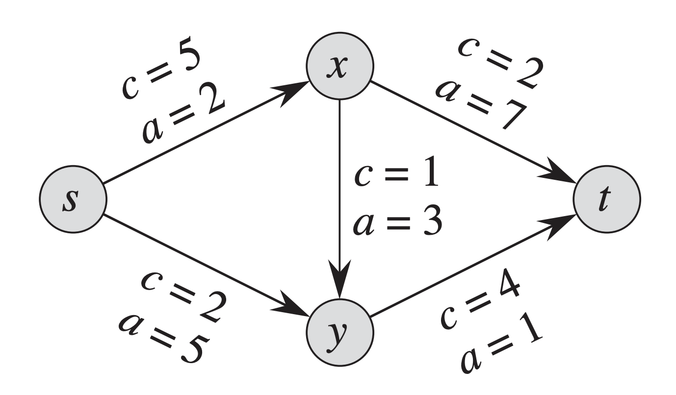
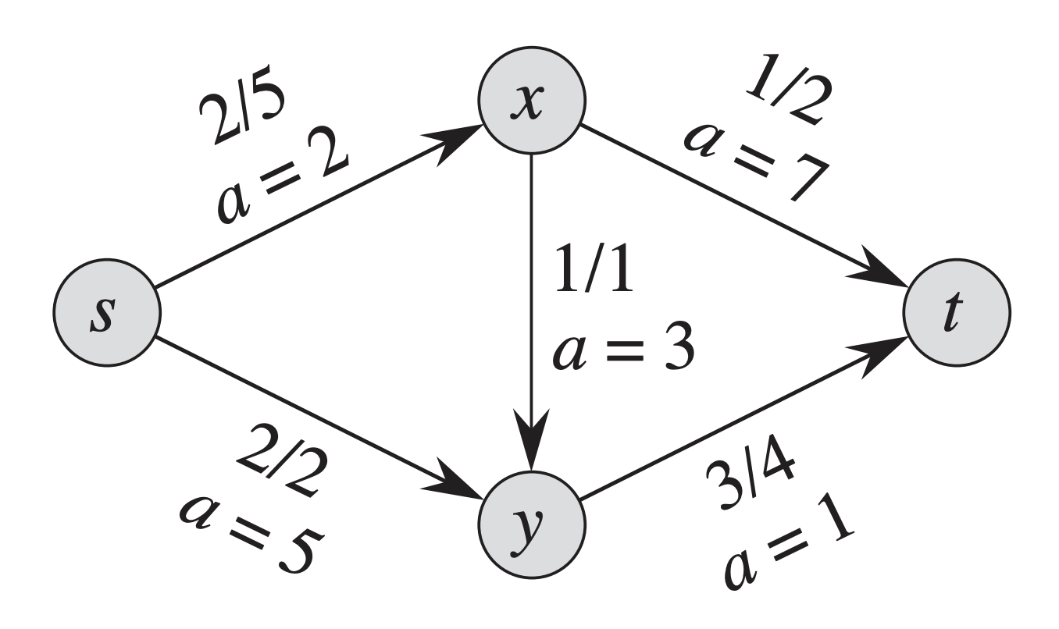
Minimum-Cost Flow
Similar to the Max-Flow Problem, the Min-Cost Flow problem provides a flow-network, an integer d, and a cost function a(u,v)
d = 4
d = 4
An example min-cost flow network. We want to push d=4 units of flow through the network. the ‘a’ values are the costs
Solution to the network. We incur cost:
$$2\left(2\right)+2\left(5\right)+1\left(7\right)+3\left(1\right)= \\ 4+10+7+3=24$$

Slide 42
Some terms
$$G=(V,E)$$
Definition of a graph
$$\left(u,v\right)∈E$$
Definition of an Edge. Note u,v are in V
c$\left(u,v\right)≥0$
Capacity of each edge. Cannot be negative
a$\left(u,v\right)$
Cost per unit of flow on edge from u to v
$$s∈V, t∈V$$
One special source and sink node
$$f:V x V→ℝ$$
A valid flow is an assignment of flow values on each pair of vertices satisfying certain constraints (flow conservation etc.)

Slide 43
Min-Cost Flow: LP Solution
Want to minimize the cost of the flow moving along all the edges in the Graph
$$\sum_{(u,v)∈V}{{a(u,v)f}_{uv}}$$
Minimize:
Ensure that flow through every edge does not exceed capacity of that edge.
Flow conservation: Flow entering each node must equal flow leaving that node.
Subject to:
$f_{uv}≤c\left(u,v\right)$ for each $u,v∈V$
$\sum_{v∈V}{f_{vu}=\sum_{v∈V}{f_{uv}}}$ for each $u∈V−\{s,t\}$
$$\sum_{v∈V}{f_{sv}−\sum_{v∈V}{f_{vs}}}=d$$
$f_{uv}≥0$ for each $u,v∈V$
Flow must be exactly equal to d
All flow values must be non-negative

Slide 44
Conclusions

Slide 45
Conclusions
What we have seen so far:
What linear programs are and how to represent them (2 ways)
How to model a couple example problems as an LP
Assumption is that we would feed our equations into a known algorithm
What have we NOT seen yet:
An actual algorithm that solves an LP (we will see that next slide deck)

