Slide 1
Approximation Algorithms (Part 2)
Advanced Algorithms Mark Floryan CLRS Ch. 35

Slide 2
Advanced Tree Structures
In this deck we will look at:
- More Approximation Algorithms!

Slide 3
Randomization Methods Max 3-SAT

Slide 4

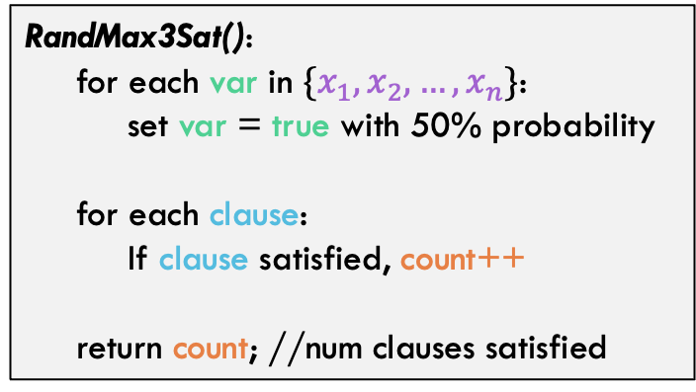
Max 3-SAT
Given a Boolean formula $θ$:
$$θ=\left(x_{1}∨¬x_{2}∨¬x_{3}\right)∧\left(x_{2}∨¬x_{4}∨x_{5}\right)∧\left({¬x}_{3}∨x_{4}∨x_{6}\right)∧(x_{1}∨x_{3}∨x_{5})$$
Set the variables $x_{1},x_{2},…,x_{n}$ to {true,false} and satisfy as many clauses as possible
Algorithm Idea:
RandMax3Sat():
for each var in $\{x_{1},x_{2},…,x_{n}\}$:
set var = true with 50% probability
for each clause:
If clause satisfied, count++
return count; //num clauses satisfied

Slide 5
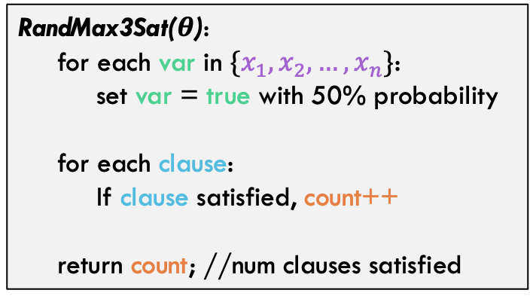

Max 3-SAT
Algorithm:
RandMax3Sat($θ$):
for each var in $\{x_{1},x_{2},…,x_{n}\}$:
set var = true with 50% probability
for each clause:
If clause satisfied, count++
return count; //num clauses satisfied
Definition: A randomized algorithm A is a $ρ\left(n\right)$ approximation if:
$$Max\left(\frac{𝔼\left(C\right)}{Opt},\frac{Opt}{𝔼\left(C\right)}\right)≤ρ(n)$$
Where C is the cost of the solution returned by A
Claim: RandMax3Sat($θ$) is an $\frac{8}{7}$ approximation of the Max 3-Sat problem

Slide 6

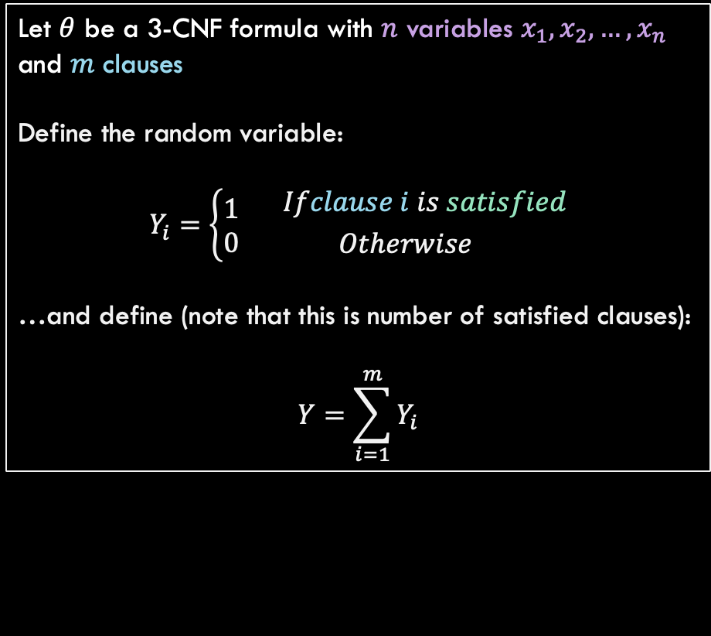
Max 3-SAT
Claim: RandMax3Sat($θ$) is an $\frac{8}{7}$ approximation of the Max 3-Sat problem
Proof:
Algorithm:
Let $θ$ be a 3-CNF formula with $n$ variables $x_{1},x_{2},…,x_{n}$ and $m$ clauses
Define the random variable:
$$Y_{i}=\left\{\begin{aligned}1 \\ 0\end{aligned}\right.{ Ifclause i is satisfied \atop Otherwise}$$
…and define (note that this is number of satisfied clauses):
$$Y=\sum_{i=1}^{m}{Y_{i}}$$
RandMax3Sat($θ$):
for each var in $\{x_{1},x_{2},…,x_{n}\}$:
set var = true with 50% probability
for each clause:
If clause satisfied, count++
return count; //num clauses satisfied

Slide 7
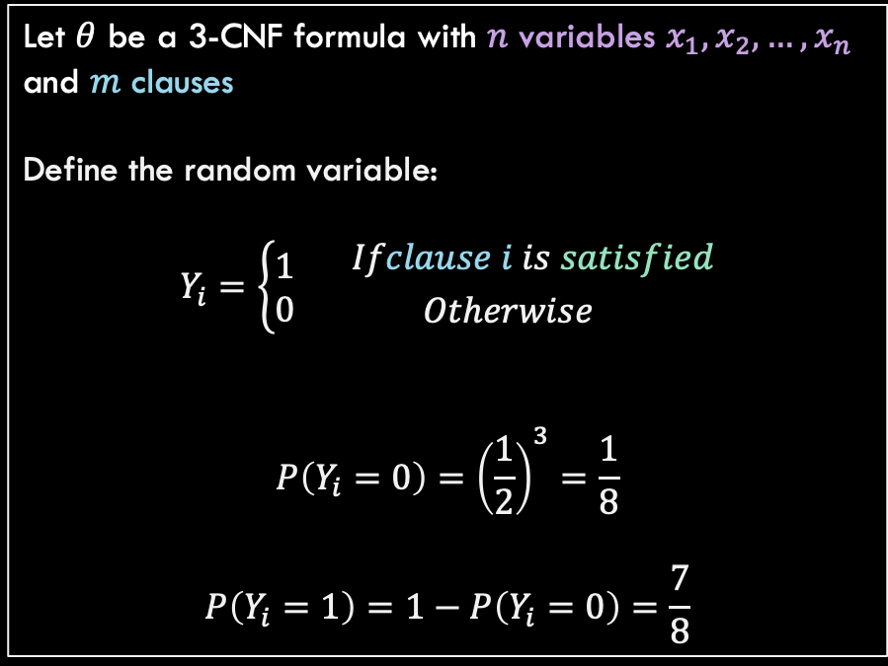
Max 3-SAT
Claim: RandMax3Sat($θ$) is an $\frac{8}{7}$ approximation of the Max 3-Sat problem
Proof:
Algorithm:
Let $θ$ be a 3-CNF formula with $n$ variables $x_{1},x_{2},…,x_{n}$ and $m$ clauses
Define the random variable:
$$Y_{i}=\left\{\begin{aligned}1 \\ 0\end{aligned}\right.{ Ifclause i is satisfied \atop Otherwise}$$
$$P\left(Y_{i}=0\right)={\left(\frac{1}{2}\right)}^{3}=\frac{1}{8}$$
$$P\left(Y_{i}=1\right)=1−P\left(Y_{i}=0\right)=\frac{7}{8}$$
RandMax3Sat($θ$):
for each var in $\{x_{1},x_{2},…,x_{n}\}$:
set var = true with 50% probability
for each clause:
If clause satisfied, count++
return count; //num clauses satisfied

Slide 8
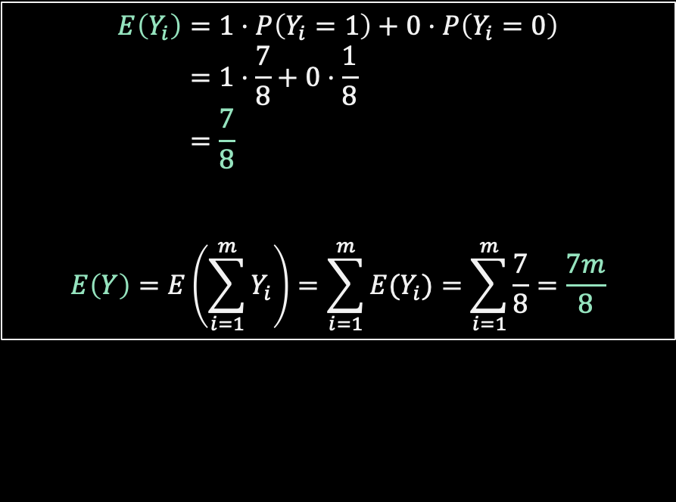
Max 3-SAT
Claim: RandMax3Sat($θ$) is an $\frac{8}{7}$ approximation of the Max 3-Sat problem
Proof:
Algorithm:
$$E\left(Y_{i}\right)=1⋅P\left(Y_{i}=1\right)+0⋅P\left(Y_{i}=0\right) \\ =1⋅\frac{7}{8}+0⋅\frac{1}{8} \\ =\frac{7}{8}$$
$$E\left(Y\right)=E\left(\sum_{i=1}^{m}{Y_{i}}\right)=\sum_{i=1}^{m}{E(Y_{i})}=\sum_{i=1}^{m}{\frac{7}{8}}=\frac{7m}{8}$$
RandMax3Sat($θ$):
for each var in $\{x_{1},x_{2},…,x_{n}\}$:
set var = true with 50% probability
for each clause:
If clause satisfied, count++
return count; //num clauses satisfied

Slide 9
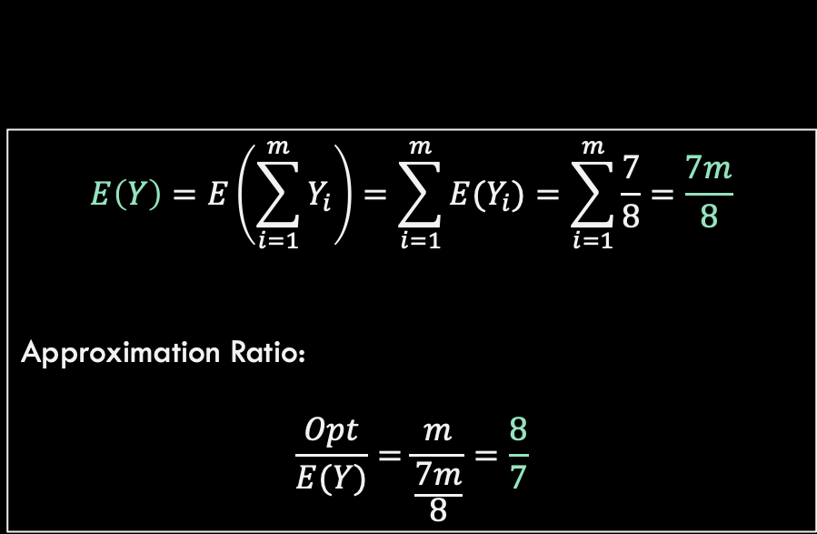
Max 3-SAT
Claim: RandMax3Sat($θ$) is an $\frac{8}{7}$ approximation of the Max 3-Sat problem
Proof:
Algorithm:
$$E\left(Y\right)=E\left(\sum_{i=1}^{m}{Y_{i}}\right)=\sum_{i=1}^{m}{E(Y_{i})}=\sum_{i=1}^{m}{\frac{7}{8}}=\frac{7m}{8}$$
Approximation Ratio:
$$\frac{Opt}{E(Y)}=\frac{m}{\frac{7m}{8}}=\frac{8}{7}$$
RandMax3Sat($θ$):
for each var in $\{x_{1},x_{2},…,x_{n}\}$:
set var = true with 50% probability
for each clause:
If clause satisfied, count++
return count; //num clauses satisfied

Slide 10
Max 3-SAT
Claim: RandMax3Sat($θ$) is an $\frac{8}{7}$ approximation of the Max 3-Sat problem
Algorithm:
RandMax3Sat($θ$):
for each var in $\{x_{1},x_{2},…,x_{n}\}$:
set var = true with 50% probability
for each clause:
If clause satisfied, count++
return count; //num clauses satisfied
Hold on a sec! What if some clauses contain a variable AND its negation? Doesn’t this proof assume that all variables in each clause are unique?

Slide 11

Max 3-SAT
Claim: RandMax3Sat($θ$) is an $\frac{8}{7}$ approximation of the Max 3-Sat problem
Suppose that $θ$ contains $m$ clauses with unique variables and $k$ clauses with repeated variables
The chance of satisfying these clauses remains the same: $\frac{7}{8}$
Note that our random algorithm is guaranteed to satisfy these clauses!

Slide 12

Max 3-SAT
Claim: RandMax3Sat($θ$) is an $\frac{8}{7}$ approximation of the Max 3-Sat problem
Suppose that $θ$ contains $m$ clauses with unique variables and $k$ clauses with repeated variables
$$E\left[Y\right]=E\left(\sum_{i=1}^{m}{Y_{i}}+k \right) \\ =\sum_{i=1}^{m}{{E(Y}_{i}) +k} \\ =\frac{7m}{8}+k$$
For an approximation ratio of:
$$\frac{OPT}{E[Y]}=\frac{m+k}{\frac{7m}{8}+k}≤\frac{m+k}{\frac{7m}{8}+\frac{7k}{8}}=\frac{8}{7}$$

Slide 13
Weighted Vertex-Cover and LP-Rounding

Slide 14
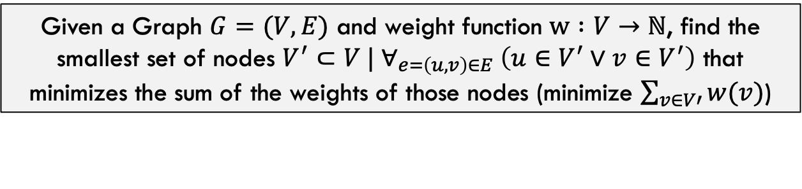
Min-Weight Vertex-Cover
Given a Graph $G=(V,E)$ and weight function $w :V→ℕ$, find the smallest set of nodes $V^{′}⊂V | ∀_{e=\left(u,v\right)∈E} \left(u∈V^{′}∨v∈V^{′}\right)$ that minimizes the sum of the weights of those nodes (minimize $\sum_{v∈V′}{w(v})$)
5
4
8
b
c
d
This problem is NP-Hard
7
2
6
3
a
e
f
g
What is the solution to this instance here?

Slide 15
Min-Weight Vertex-Cover
Given a Graph $G=(V,E)$ and weight function $w :V→ℕ$, find the smallest set of nodes $V^{′}⊂V | ∀_{e=\left(u,v\right)∈E} \left(u∈V^{′}∨v∈V^{′}\right)$ that minimizes the sum of the weights of those nodes (minimize $\sum_{v∈V′}{w(v})$)
5
4
8
b
c
d
This problem is NP-Hard
This solution has total weight 3 + 4 + 2 + 8 = 17
Can we do better?
7
2
6
3
a
e
f
g

Slide 16
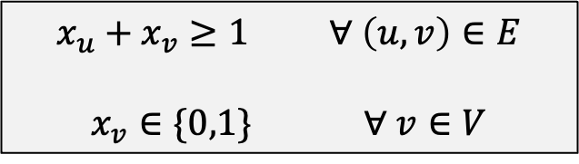
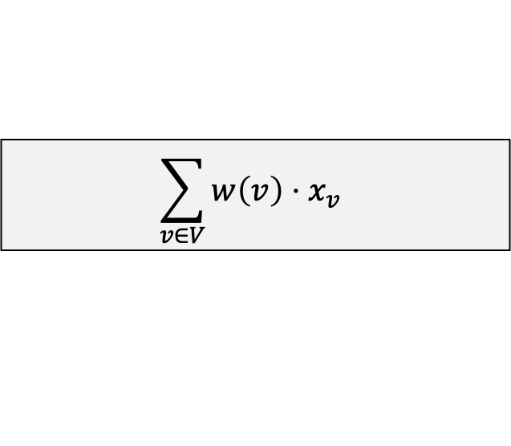
Min-Weight Vertex-Cover As Integer Program
Integer Program: An integer program is a linear program with the added constraint that all variables must take on integer values.
Minimize:
4
$$\sum_{v∈V}{w\left(v\right)⋅x_{v}}$$
b
5
c
d
8
6
Subject to:
3
7
2
a
e
f
g
$x_{u}+x_{v}≥1$ $∀ \left(u,v\right)∈E$
$x_{v}∈\{0,1\}$ $∀ v∈V$
Note that solving integer programs must also be NP-Hard, as solutions would produce the solution for NP-Hard problems like this one
Also note how the first constraint ensures that we get a vertex-cover. Can you see why?

Slide 17
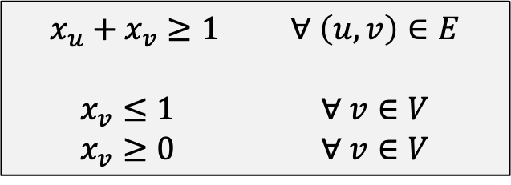
Min-Weight Vertex-Cover As Integer Program
LP-Relaxation: An integer program can be easily converted into a linear program by relaxing the integer constraint.
Minimize:
4
$$\sum_{v∈V}{w\left(v\right)⋅x_{v}}$$
b
5
c
d
8
6
Subject to:
3
7
2
a
e
f
g
$x_{u}+x_{v}≥1$ $∀ \left(u,v\right)∈E$
$x_{v}≤1$ $∀ v∈V$
$x_{v}≥0$ $∀ v∈V$
Now…this is a linear program. However, the solution to this would set each “node” selection to a floating point value…

Slide 18
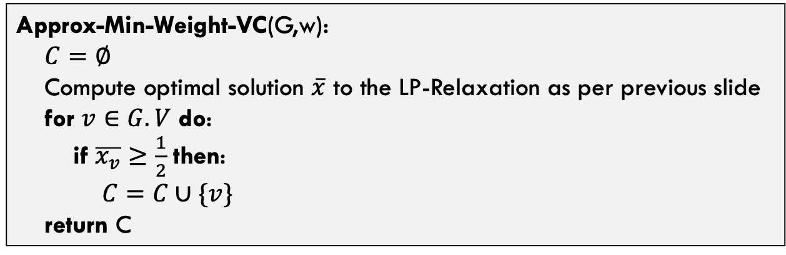
Min-Weight Vertex-Cover As Integer Program
Algorithm:
Approx-Min-Weight-VC(G,w):
$C=∅$
Compute optimal solution $\overline{x}$ to the LP-Relaxation as per previous slide
for $v∈G.V$ do:
if $\overline{x_{v}}≥\frac{1}{2}$ then:
$C=C∪\{v\}$
return C
This is guaranteed to be a valid vertex-cover. Do you see why?

Slide 19
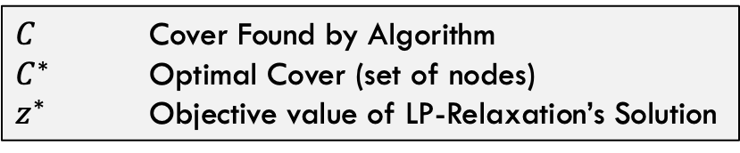
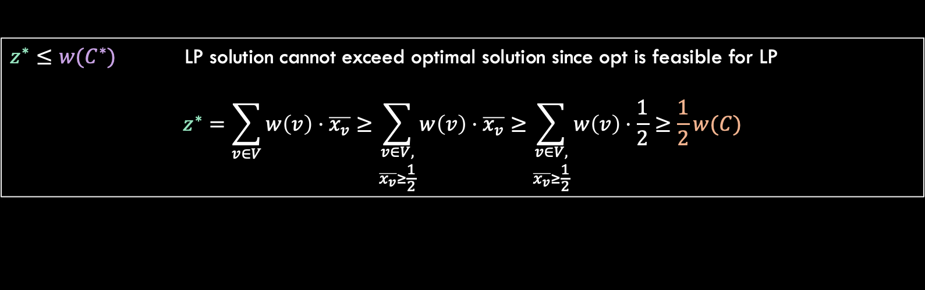
Min-Weight Vertex-Cover As Integer Program
Claim: Approx-Min-Weight-VC is a 2-approximation of the weighted vertex-cover problem
Some terms:
$C$ Cover Found by Algorithm
$C^{∗}$ Optimal Cover (set of nodes)
$z^{∗}$ Objective value of LP-Relaxation’s Solution
$z^{∗}≤w(C^{∗})$ LP solution cannot exceed optimal solution since opt is feasible for LP
$$z^{∗}=\sum_{v∈V}{w\left(v\right)⋅\overline{x_{v}}≥\sum_{\begin{aligned}v∈V, \\ \overline{x_{v}}≥\frac{1}{2}\end{aligned}}{w\left(v\right)⋅\overline{x_{v}}}}≥\sum_{\begin{aligned}v∈V, \\ \overline{x_{v}}≥\frac{1}{2}\end{aligned}}{w\left(v\right)⋅\frac{1}{2}}≥\frac{1}{2}w(C)$$

Slide 20

Min-Weight Vertex-Cover As Integer Program
Claim: Approx-Min-Weight-VC is a 2-approximation of the weighted vertex-cover problem
Some terms:
From previous slide:
$C$ Cover Found by Algorithm
$C^{∗}$ Optimal Cover (set of nodes)
$z^{∗}$ Objective value of LP-Relaxation’s Solution
$$z^{∗}≤w(C^{∗})$$
$$z^{∗}≥\frac{1}{2}w(C)$$
$$\frac{1}{2}w\left(C\right)≤z^{∗}≤w\left(C^{∗}\right)≤Opt$$

Slide 21
FPTAS for Knapsack Problem

Slide 22


Some Definitions
$ρ(n)$-Approximation Algorithm
An approximation algorithm that achieves an approximation of $ρ(n)$ on all inputs
Approximation Scheme
An approximation algorithm that takes as input the instance of the problem and a value $ε>0$ such that for any fixed $ε$, the scheme is a $(1+ε)$-approximation algorithm.
Polynomial Time Approximation Scheme
A scheme is polynomial time if, for any fixed $ε>0$, the algorithm runs in polynomial time in terms of the input size n
Fully Polynomial Time Approximation Scheme
A scheme is fully polynomial time if it has a runtime that is polynomial in terms of $\frac{1}{ε}$.
For example, a fully polynomial time approximation scheme might have runtime $Θ\left({\left(\frac{1}{ε}\right)}^{2}n^{2}\right)$

Slide 23
Recall: Knapsack Problems
Knapsack Problem:
Scenario: A thief is robbing a store and finds n items, each with a profit amount $p_{i}$ and a weight $w_{i}$. The thief also has a knapsack that can fit a total weight of $C$.
Problem: Which items should the thief steal such that $\sum_{i}{p_{i}}$ is maximized and $\sum_{i}{w_{i}≤C}$
Example:
Weight
$$p_{2}=12$$
$$p_{3}=3$$
Knapsack capacity
$$p_{1}=10$$

Slide 24
Approximation Process
Turn the typical DP algorithm around to design a new DP solution
Approximate knapsack by ”cutting off” portions of the input values and running DP solution
Analysis to show approximation is proper FPTAS

Slide 25
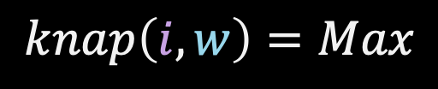

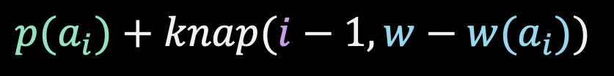
Typical Knapsack DP Recurrence
Do NOT take the ith item, just solve the subproblem that does not include it
$$knap\left(i−1,w\right)$$
$$knap\left(i,w\right)=Max$$
$$p(a_{i})+knap(i−1,w−w(a_{i}))$$
You can use up to the first i items only
Capacity of knapsack able to be used
Take the ith item and remove its weight from the knapsack capacity but earn its profit

Slide 26


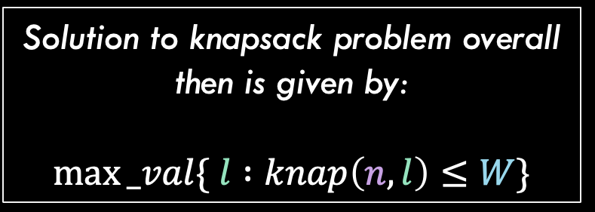
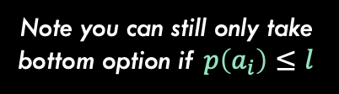

Changing DP Around…
Instead of solving the maximum profit that fits in an arbitrary capacity w, we are going to solve for the least weight that gets us some exact profit target l
Turn the typical DP algorithm around to design a new DP solution
$$knap\left(i−1,l\right)$$
$$knap\left(i,l\right)=Min$$
$$w(a_{i})+knap(i−1,p−p(a_{i}))$$
Solution to knapsack problem overall then is given by:
$$max⁡_val\{ l :knap\left(n,l\right)≤W\}$$
Note you can still only take bottom option if $p\left(a_{i}\right)≤l$

Slide 27
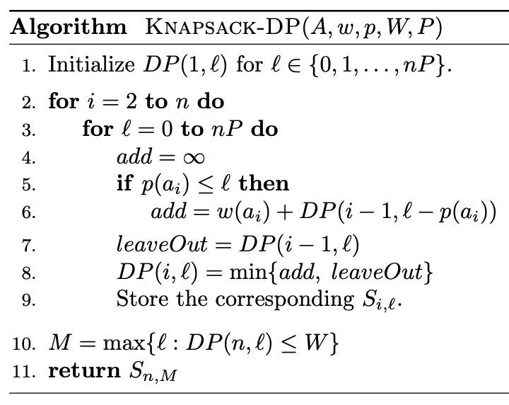





Changing DP Around…
$$knap\left(i−1,l\right)$$
$$knap\left(i,l\right)=Min$$
$$w(a_{i})+knap(i−1,p−p(a_{i}))$$
Turn the typical DP algorithm around to design a new DP solution
Notice the $n⋅P$ term on line 3 $$P=max⁡\{p\left(a\right) :a∈A, p\left(a\right)≤W\}$$
Essentially, P is the maximum profit over all items that fit in the knapsack. $n⋅P$ is an upper bound on our solution, so we don’t need to solve beyond this.
Runtime: $Θ(n^{2}P)$

Slide 28
Approximation Process
Turn the typical DP algorithm around to design a new DP solution
Approximate knapsack by ”cutting off” portions of the input values and running DP solution

Slide 29
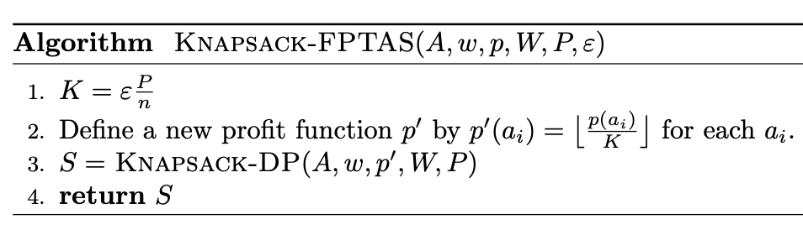
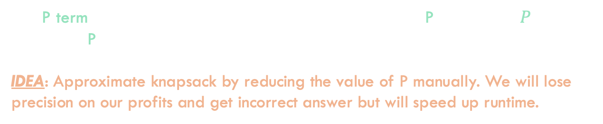

Approximating Knapsack
Runtime: $Θ(n^{2}P)$
Approximate knapsack by ”cutting off” portions of the input values and running DP solution
This P term makes the algorithm exponential time because P takes $\log_{2}\left(P\right)$ bits to represent. P can be very large and the size of the DP table grows with it.
IDEA: Approximate knapsack by reducing the value of P manually. We will lose precision on our profits and get incorrect answer but will speed up runtime.

Slide 30
Approximation Process
Turn the typical DP algorithm around to design a new DP solution
Approximate knapsack by ”cutting off” portions of the input values and running DP solution
Analysis to show approximation is proper FPTAS

Slide 31



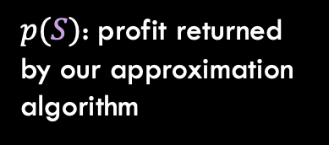
Approximating Knapsack
Analysis to show approximation is proper FPTAS
Intermediate Goal - show that:
$$p\left(S\right)≥p\left(O\right)⋅(1−ε)$$
$ε$: Approximation should be within this percent of optimal solution
$p(S)$: profit returned by our approximation algorithm
$p(O)$: Optimal profit achievable

Slide 32
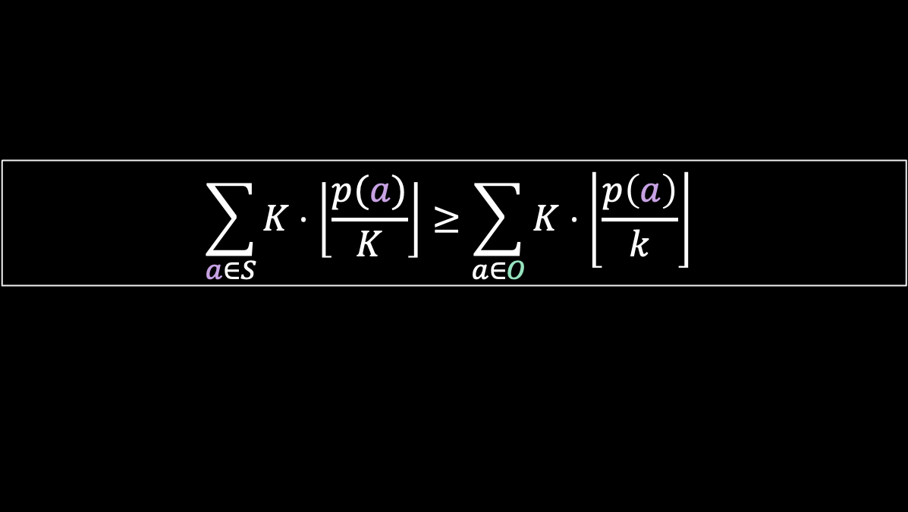
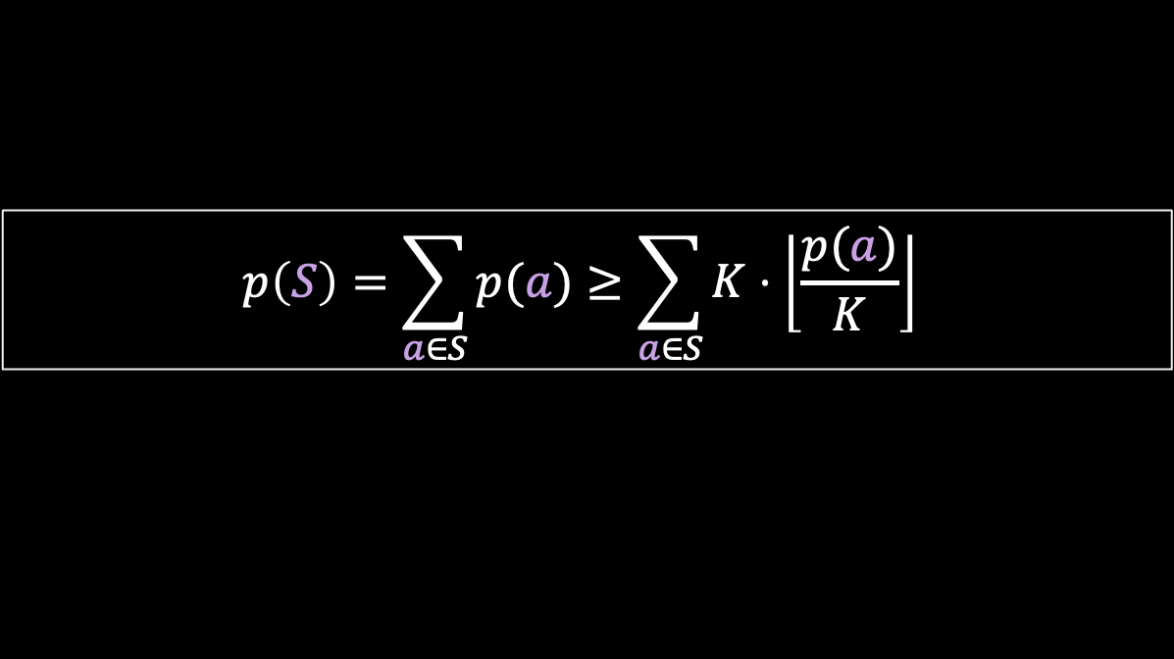
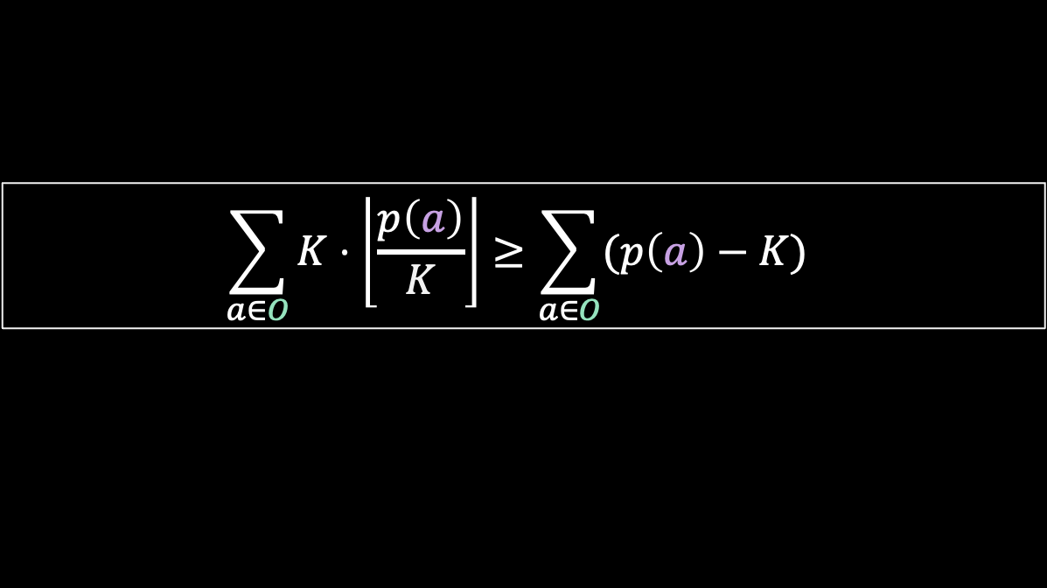
Three Inequalities
$$p\left(S\right)=\sum_{a∈S}{p(a)}≥\sum_{a∈S}{K⋅\left\lfloor \frac{p(a)}{K}\right\rfloor }$$
This is simply true due to rounding (we floor the division before multiplying back in
Analysis to show approximation is proper FPTAS
$$\sum_{a∈S}{K⋅\left\lfloor \frac{p(a)}{K}\right\rfloor }≥\sum_{a∈O}{K⋅\left\lfloor \frac{p\left(a\right)}{k}\right\rfloor }$$
Since S is an optimal solution with respect to the new profits, it dominates the optimal solution with respect to the NEW profits
$$\sum_{a∈O}{K⋅\left\lfloor \frac{p\left(a\right)}{K}\right\rfloor }≥\sum_{a∈O}{(p\left(a\right)−K)}$$
Due to rounding again, $K⋅\left\lfloor \frac{p\left(a\right)}{k}\right\rfloor$ can never be smaller than $p\left(a\right)$ by more than $K$

Slide 33
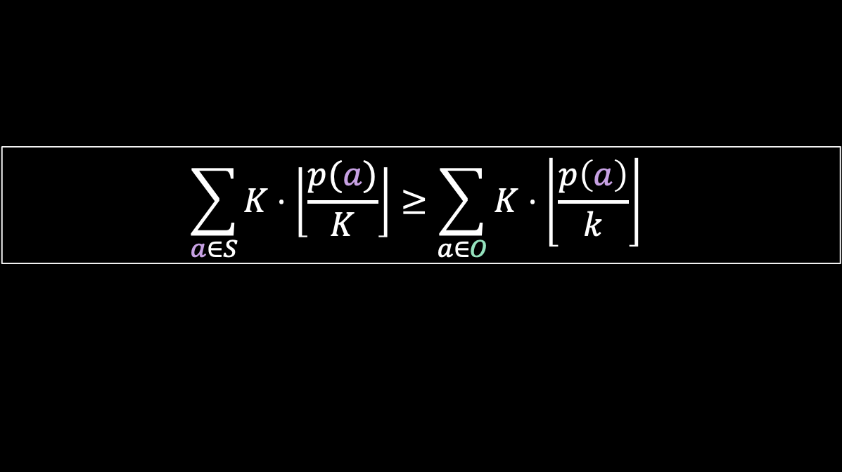
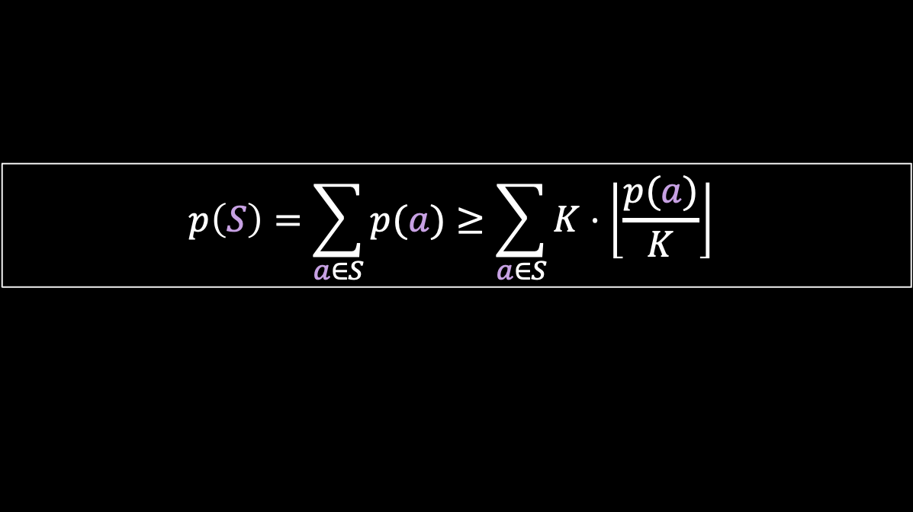
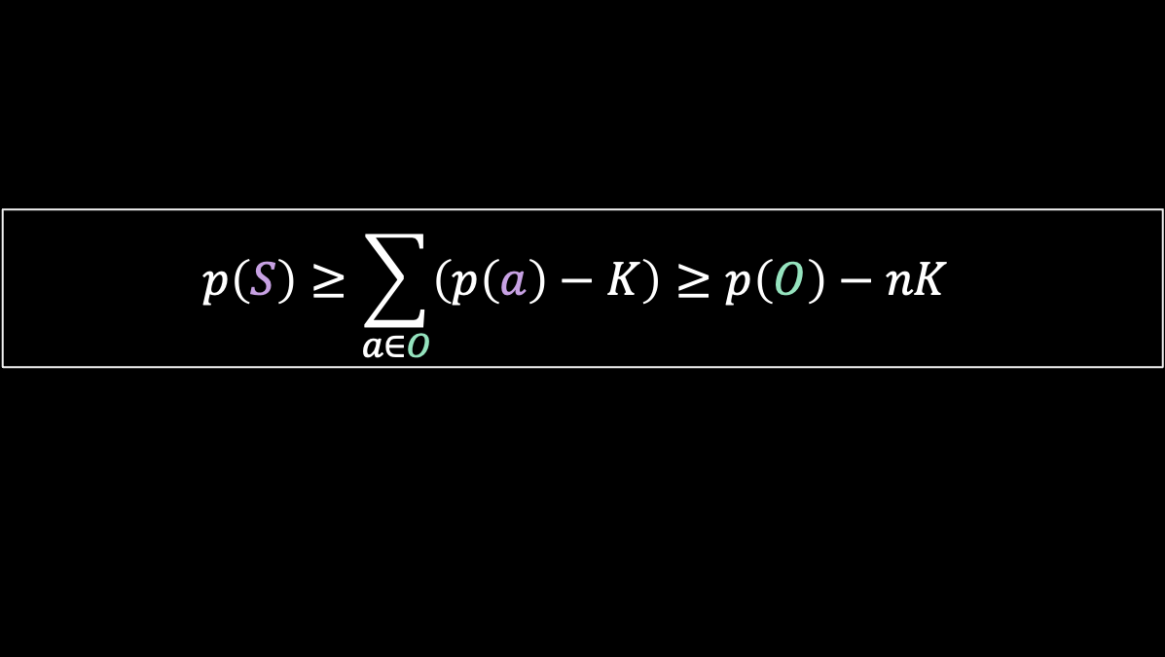
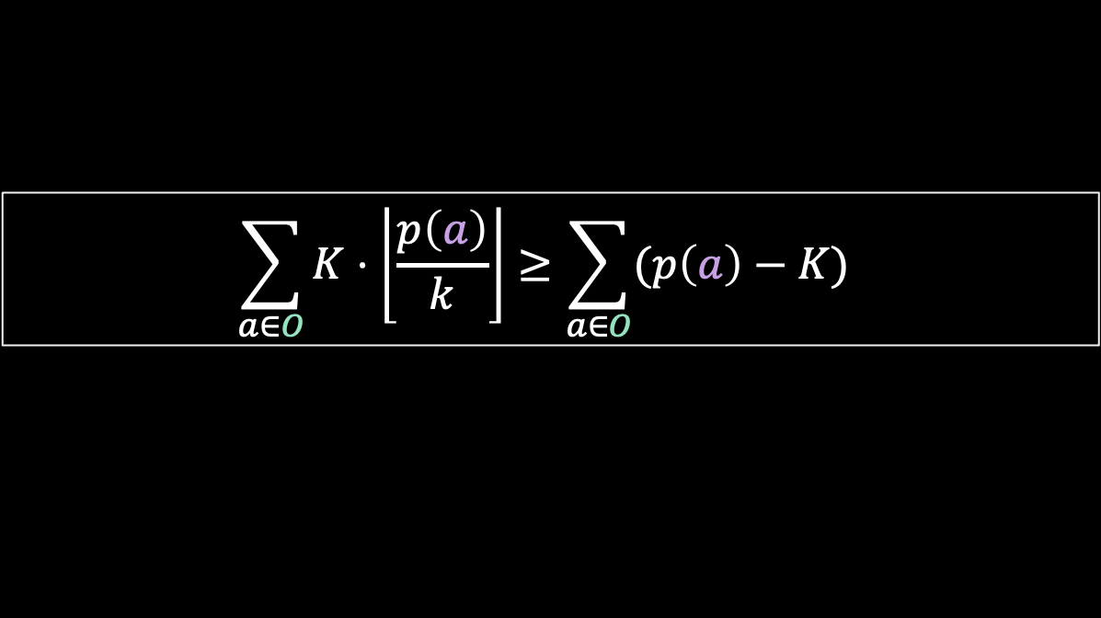
Three Inequalities
$$p\left(S\right)=\sum_{a∈S}{p(a)}≥\sum_{a∈S}{K⋅\left\lfloor \frac{p(a)}{K}\right\rfloor }$$
$$\sum_{a∈S}{K⋅\left\lfloor \frac{p(a)}{K}\right\rfloor }≥\sum_{a∈O}{K⋅\left\lfloor \frac{p\left(a\right)}{k}\right\rfloor }$$
Analysis to show approximation is proper FPTAS
$$\sum_{a∈O}{K⋅\left\lfloor \frac{p\left(a\right)}{k}\right\rfloor }≥\sum_{a∈O}{(p\left(a\right)−K)}$$
Putting these together…
$$p\left(S\right)≥\sum_{a∈O}{\left(p\left(a\right)−K\right)}≥p\left(O\right)−nK$$

Slide 34

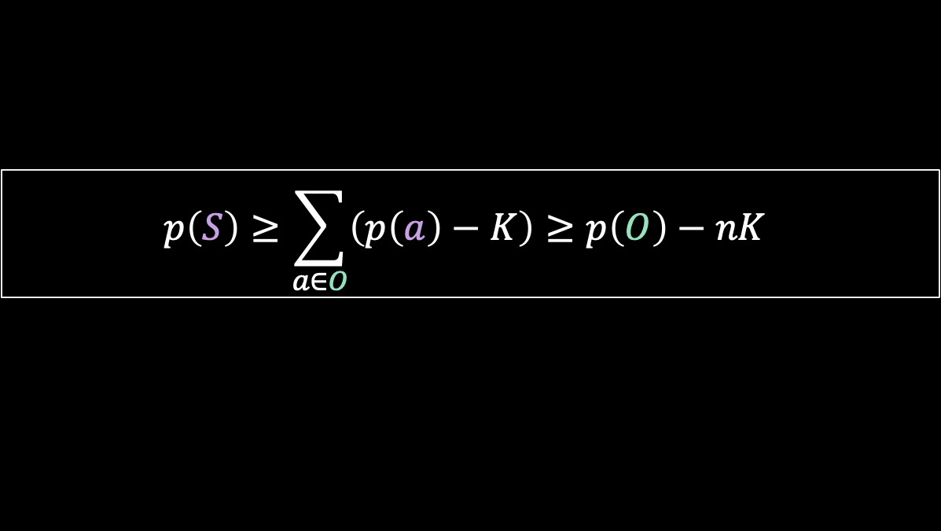
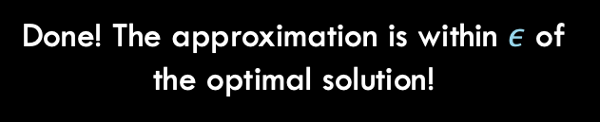
Three Inequalities
$$p\left(S\right)≥\sum_{a∈O}{\left(p\left(a\right)−K\right)}≥p\left(O\right)−nK$$
Analysis to show approximation is proper FPTAS
Almost done…
$$p\left(S\right)≥p\left(O\right)−nK \\ =p\left(O\right)−n\left(\frac{εP}{n}\right) \\ =p\left(O\right)−εP \\ ≥p\left(O\right)−εp(O) \\ ≥p\left(O\right)⋅(1−ε)$$
Done! The approximation is within $ε$ of the optimal solution!

Slide 35
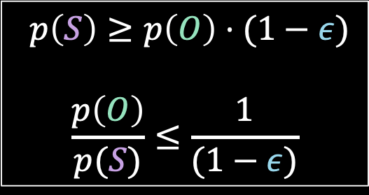
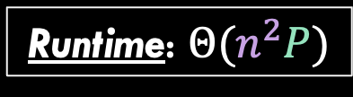
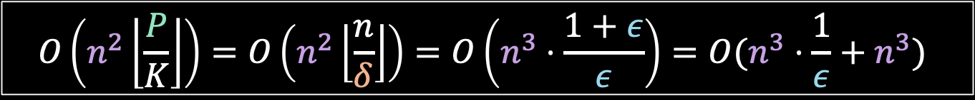

Runtime!
$p\left(S\right)≥p\left(O\right)⋅(1−ε)$
$$\frac{p\left(O\right)}{p(S)}≤\frac{1}{(1−ε)}$$
Runtime: $Θ(n^{2}P)$
Known from earlier analysis
Analysis to show approximation is proper FPTAS
To easily show runtime is FPTAS, we will run our algorithm with $δ=\frac{ε}{(1+ε)}<0$
$$\frac{p\left(O\right)}{p(S)}≤\frac{1}{\left(1−δ\right)}=\frac{1}{1−\frac{ε}{\left(1+ε\right)}}=1+ε$$
…so final runtime is:
$$O\left(n^{2}\left\lfloor \frac{P}{K}\right\rfloor \right)=O\left(n^{2}\left\lfloor \frac{n}{δ}\right\rfloor \right)=O\left(n^{3}⋅\frac{1+ε}{ε}\right)=O(n^{3}⋅\frac{1}{ε}+n^{3})$$

